Slide 1
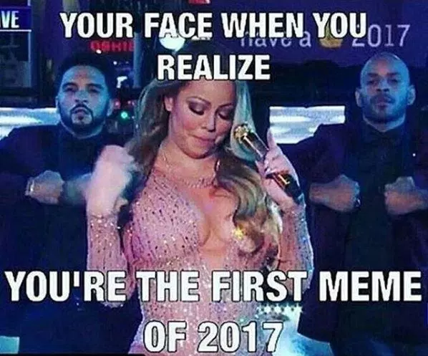
Tuesday, January 3rd
Sporting News:
Bball vs Butler – TONIGHT @ Home 6:00!
Senior Announcements:
Florida Trip $$$
Class Announcements:
ESD After School This Week
Agenda:
Grab Folders
Look at Grade Sheet
Do you need to take the midterm?
For those who took it already, work on Presidential Packets

Slide 2
Presidents that should be complete up to this point are:
Washington – farewell address, whiskey rebellion
Adams – xyz affair, alien & sedition acts
Jefferson – embargo act, LA Purchase
Madison – burning of white house, war of 1812, impressment
Monroe – Monroe Doctrine, Adams-Onis Treaty
Adams – Erie Canal, Lowell System
Jackson – trail of tears, bank wars, nullification
Tyler – Texas Annexation
Polk – manifest destiny, Mexican-American War (Mexican Cession), Gold Rush
Taylor / Fillimore – Compromise of 1850
Pierce – Bleeding Kansas, Kansas-Nebraska Act, Brooks-Sumner Incident
Buchanon – Harper’s Ferry, Dred Scott Decision
Lincoln – Emancipation Proclamation, Civil War, Homestead Act
Johnson – 13th – 15th Amendments, Reconstruction Act of 1867
Grant – Transcontinental Railroad
Cleveland – Haymarket Affair, Pullman Strike, Unions
Harrison – Sherman Anti-Trust Act
Roosevelt – Square Deal

Slide 3
An Example of what yours should resemble

Slide 4
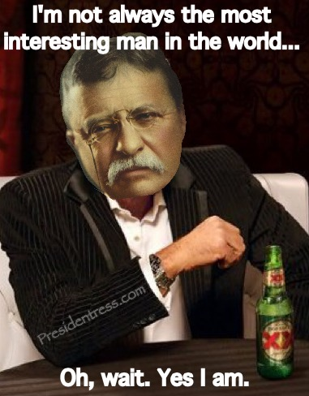
Wednesday, January 4th
Sporting News:
Bball vs BE – Friday @ Home 6:00!
Senior Announcements:
Florida Trip $$$ - Jan 11th
Class Announcements:
ESD After School This Week
Next Comp Check – next Friday
Agenda:
New Seating Arrangments
Copy New Learning Target
Copy & Define Terms
Introduce Imperialism, Review
Play Imperialism Game
Types of Imperialism Worksheet

Slide 5
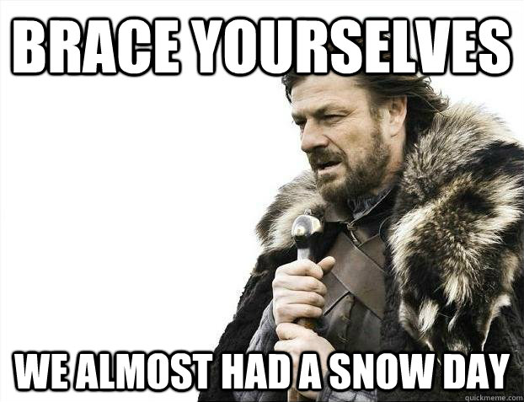
Thursday, January 5th
Sporting News:
Bball vs BE – Friday @ Home 6:00!
Senior Announcements:
Florida Trip $$$ - Jan 11th
Class Announcements:
ESD After School This Week
Next Comp Check – next Friday
Agenda:
Copy & Define Terms
PPT, Lecture & Notes – Imperialism
Begin Mapping Assignment

Slide 6
Friday, January 6th
Sporting News:
Bball vs BE – TONIGHT @ Home 6:00!
Senior Announcements:
Florida Trip $$$ - Jan 11th
Class Announcements:
ESD After School This Week
Next Comp Check – next Friday
Agenda:
Copy & Define Terms
Complete Mapping Assignment
Begin Video Segments & Note Sheet

Slide 7
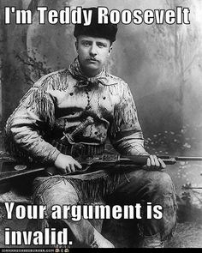
Monday, January 9th
Sporting News:
Swimming – Wednesday @ Central
Bball Boys Lit – Wednesday @ Valley 5:00
Girls Bball – Friday 5:00
Senior Announcements:
Florida Trip $$$ - Jan 11th
Class Announcements:
Next Comp Check – Friday
Agenda:
Copy & Define Terms
Finish Video Segments
PPT, Lecture & Notes – Imperialism
Drunk History – Teddy, Rough Riders

Slide 8
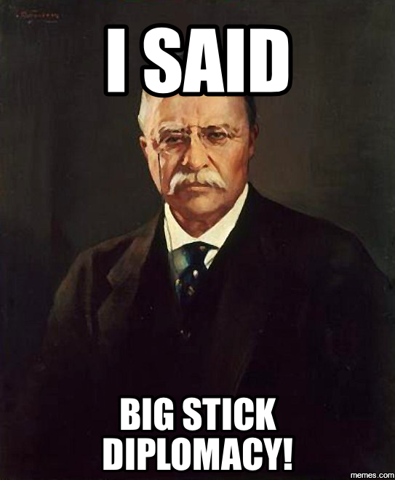
Tuesday, January 10th
Sporting News:
Swimming – Wednesday @ Central
Bball Boys Lit – Wednesday @ Valley 5:00
Girls Bball – Friday 5:00
Senior Announcements:
Florida Trip $$$ - TOMORROW
Class Announcements:
Next Comp Check – Friday
Agenda:
Copy New Learning Target
Copy & Define Terms
Finish Lecture & Notes
Finish Videos
Primary Sources Activity
Checkpoint #1

Slide 9
1. What kind of imperialism was used in the acquisition of Hawaii?
A.) economic
B.) Political
C.) Cultural
D.) Colonial

Slide 10
2. What kind of imperialism was used in the acquisition of Alaska?
A.) economic
B.) Political
C.) Cultural
D.) Colonial

Slide 11
3. How did America demonstrate Political Imperialism in Cuba?
A.) By essentially forcing the Cubans to practice American commercialism and Christianity
B.) By establishing control of a military base in Guantanamo Bay & creating their new government
C.) By forcefully overthrowing the Spanish ruler of Cuba with the US Navy
D.) By Buying the Island of Manila from the Spanish for $20 million

Slide 12
4. Which below is something that an Anti-Imperialist might believe in?
A.) America should show its power by sending the Great White Fleet around the world’s seas
B.) It is the duty and moral responsibility of all Americans to educate and domesticate foreign peoples of the world
C.) If the US does not get involved in the methodical divisions of 3rd World Countries, we will lose out on Valuable resources
D.) American Politics should turn its attention away from Global issues and focus more on Domestic ones.

Slide 13
5. Teddy Roosevelt’s Foreign Policy is best known as what term below?
A.) Great White Fleet Politics
B.) Big Stick Diplomacy
C.) Dollar Diplomacy
D.) Open Door Policy

Slide 14
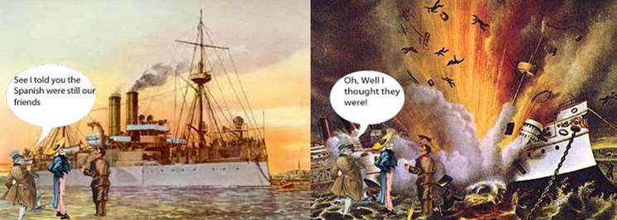
Wednesday, January 11th
Sporting News:
Swimming – Tonight @ Central
Bball Boys Lit – Tonight @ Valley 5:00
Girls Bball – Friday 5:00
Senior Announcements:
Florida Trip $$$ - TODAY
Class Announcements:
Next Comp Check – Friday
Agenda:
Copy New Learning Target
Copy & Define Terms
Discussion of Imperialism Effects
Checkpoint #2
Causes of WWI Activity

Slide 15
1. What was the final catalyst for the Spanish-American War?
A.) Yellow Journalism provided by American newspapers
B.) The Assassination of Archduke Ferdinand
C.) the sinking of the USS Maine
D.) the Murder of Cuban Nationalist Jose Marti

Slide 16
2. Chronologically order the foreign policies of McKinley, Teddy and Taft
A.) Big Stick, Dollar Diplomacy, Open Door
B.) Open Door, Dollar Diplomacy, Big Stick
C.) Open Door, Big Stick, Dollar Diplomacy
D.) Dollar Diplomacy, Big Stick, Open Door

Slide 17
3. The Age of Imperialism was marked by
a. a decrease in the number of naval ships b. the expansion of American political influence c. an increased interest in the plight of day laborers d. the reduction of military intervention in other countries

Slide 18
4. Which below is not an outcome of the Treaty of Paris (1898)?
A.) Guam was annexed
B.) Puerto Rico was Annexed
C.) Cuba was Annexed
D.) The Philippines was Purchased

Slide 19
5. Who owned Alaska prior to America?
A.) the Ottoman Empire
B.) Turkey
C.) Russia
D.) Spain

Slide 20
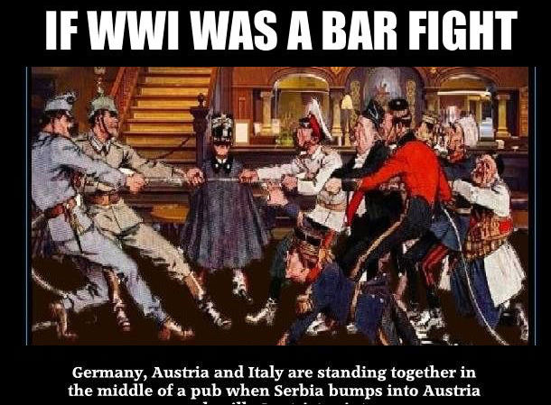
Thursday, January 12th
Sporting News:
Bball Boys Lit – Friday, TBD
Girls Bball – Friday 5:00
Senior Announcements:
Basketball Homecoming – Two Weeks
Class Announcements:
Next Comp Check – Tomorrow!!!
Agenda:
Copy & Define Terms
PPT, Lecture & Notes – WWI
Checkpoint #3
Begin WWI Propaganda
Review

Slide 21
1. What kind of imperialism was used in the acquisition of Hawaii?
A.) economic
B.) Political
C.) Cultural
D.) Colonial

Slide 22
2. What kind of imperialism was used in the acquisition of Alaska?
A.) economic
B.) Political
C.) Cultural
D.) Colonial

Slide 23
3. How did America demonstrate Political Imperialism in Cuba?
A.) By essentially forcing the Cubans to practice American commercialism and Christianity
B.) By establishing control of a military base in Guantanamo Bay & creating their new government
C.) By forcefully overthrowing the Spanish ruler of Cuba with the US Navy
D.) By Buying the Island of Manila from the Spanish for $20 million

Slide 24
4. Which below is something that an Anti-Imperialist might believe in?
A.) America should show its power by sending the Great White Fleet around the world’s seas
B.) It is the duty and moral responsibility of all Americans to educate and domesticate foreign peoples of the world
C.) If the US does not get involved in the methodical divisions of 3rd World Countries, we will lose out on Valuable resources
D.) American Politics should turn its attention away from Global issues and focus more on Domestic ones.

Slide 25
5. Teddy Roosevelt’s Foreign Policy is best known as what term below?
A.) Great White Fleet Politics
B.) Big Stick Diplomacy
C.) Dollar Diplomacy
D.) Open Door Policy

Slide 26
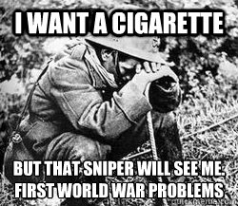
Friday, January 13th
Sporting News:
Bball Boys Lit – Tonight 4:00 @ Valley
Girls Bball – Tonight 5:00
Swimming – Tomorrow @ U of L
Senior Announcements:
Basketball Homecoming – Two Week
Class Announcements:
Next Comp Check – Today!!!
District Proficiency - Today
Agenda:
Copy Vocab
Finish WWI Notes / Lecture
14 Points & Versailles Worksheet
Comp Check / District Prof
Submit Work Packets

Slide 27
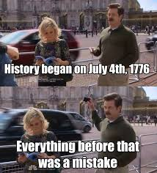
Tuesday, January 17th
Sporting News:
Basketball – @ Jtown Tonight
Senior Announcements:
Basketball Homecoming – Next Week
Class Announcements:
Remediation / Enrichment
Next Proficiency – Friday
Study Guide – due Friday
Agenda:
Submit Work Packets
Enrichment / Remediation for Imperialism & WWI
Transpose Bubble Sheets

Slide 28
Enrichment / Redemption Instructions
Enrichment
Redemption
Turn to the final page in your packet
Grab a blank piece of paper from the table
Complete the WWI Propaganda Assignment
This is due at the end of class
If you scored 14 or 15 on the test, you can choose to do redemption or enrichment
Anyone below 14 must do the Redemption
Pick up the Packet from the Table
Complete each reading, questions and Graphic Organizers
See me for the Retake
Both tasks are due at the end of class

Slide 29
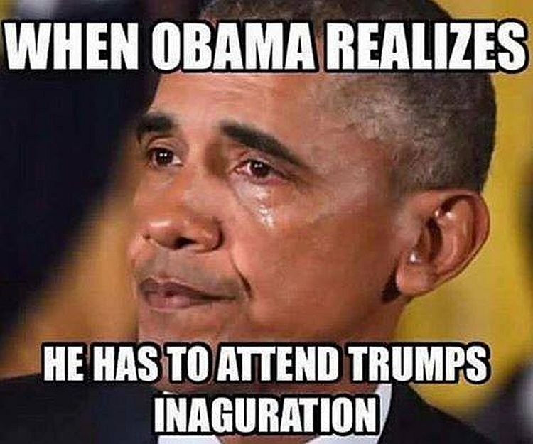
Thursday, January 19th
Sporting News:
Basketball – @ Southern Friday
Senior Announcements:
Basketball Homecoming – Next Week
Class Announcements:
Remediation / Enrichment – submit!
Next Proficiency – Next Friday
Study Guide – due Next Friday
Agenda:
Review Yesterday / Preview 1920s
Introduce Stock Market Game
Chp 13 Guided Reading in Packets, questions
Lecture & Notes – Fundamentals of the 20s

Slide 30
Yes, you can sit anywhere sit with those you will work well with Just so you know, if you sit in groups of less than 4, you’ll likely have more work to do among you.

Slide 31
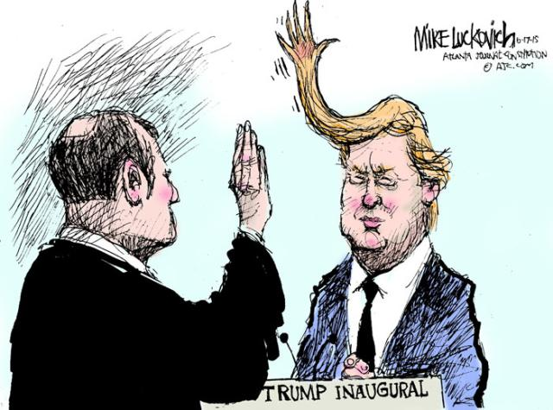
Friday, January 20th
Sporting News:
Basketball – @ Southern TONIGHT
Senior Announcements:
Basketball Homecoming – Next Week
Class Announcements:
Remediation / Enrichment – submit!
Next Proficiency – Next Friday
Study Guide – due Next Friday
Agenda:
New Vocabulary
Introduce Stock Market Game
Lecture & Notes – Fundamentals of the 20s
Introduce Group Task

Slide 32
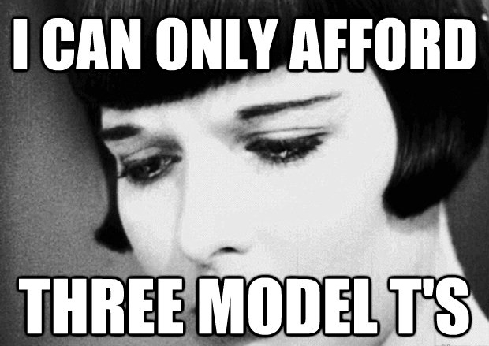
Monday, January 23rd
Sporting News:
Homecoming Week
Senior Announcements:
Today – PJ Day
Tomorrow – Tropical Tuesday
Class Announcements:
Remediation / Enrichment – submit!
1920s Comp Check – Wednesday
Next Proficiency –Friday
Study Guide – due Friday
Agenda:
New Vocabulary
Check Your Stocks
Continue Group Tasks; Educate your group
Lecture & Notes – 1920s America

Slide 33
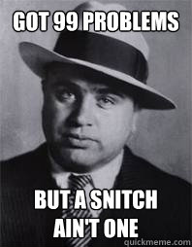
Tuesday, January 24th
Sporting News:
Homecoming Week
Senior Announcements:
Today – Tropical Tuesday
Tomorrow – Hero/Villain
Class Announcements:
1920s Comp Check – Tomorrow
Next Proficiency –Friday
Study Guide – due Friday
Agenda:
New Vocabulary; Check Your Stocks
Lecture, Video & Notes – 1920s America

Slide 34
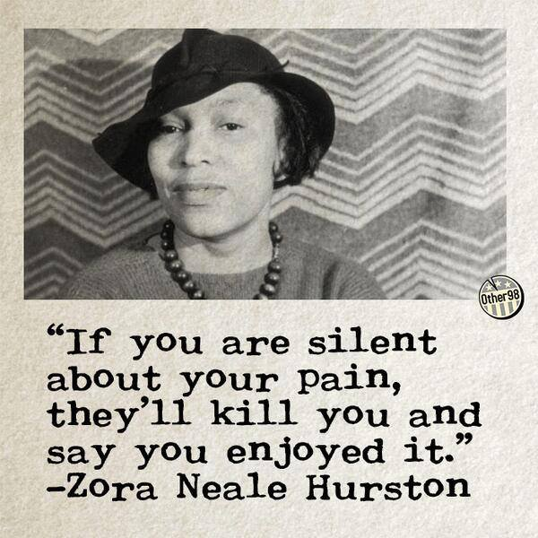
Wednesday, January 25th
Sporting News:
Homecoming Week
Senior Announcements:
Today – Hero/Villain
Tomorrow – Dynamic Duo
Class Announcements:
1920s Comp Check – TODAY
Next Proficiency –Friday
Study Guide – due Friday
Agenda:
New Vocabulary; Check Your Stocks
Finish Reading on Harlem Renaissance
Take Competency Check
Begin Enrichment/Redemption

Slide 35
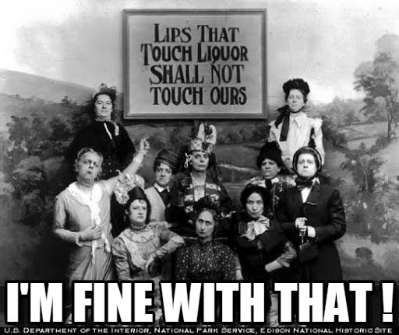
Thursday, January 26th
Sporting News:
Homecoming Week
Senior Announcements:
Today – Dynamic Duo
Tomorrow – Spirit Day
Class Announcements:
Next Proficiency – TOMORROW
Study Guide – due TOMORROW
Signed Grade Sheets – Due TOMORROW
Agenda:
Check Stocks
Finish Enrichment/Redemption
Work on Study Guide if Time Remains

Slide 36
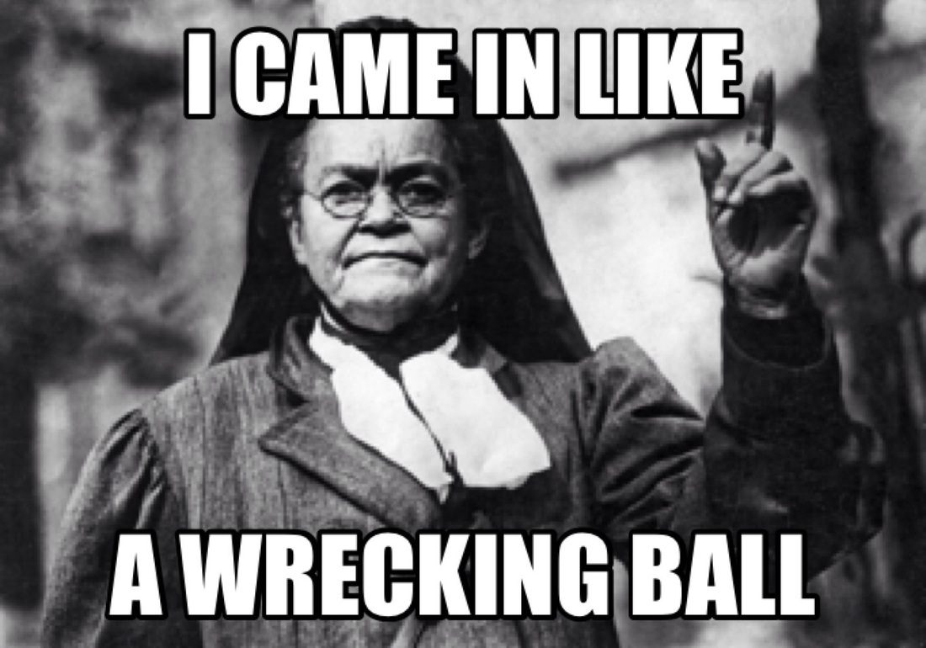
Friday, January 27th
Sporting News:
Homecoming Week
Senior Announcements:
Today – Spirit Day; Pep Rally
Class Announcements:
Next Proficiency – Today
Study Guide – due NOW
Signed Grade Sheets – Due NOW
Agenda:
Submit Study Guides / Grade Sheets
Take Proficiency #3
Check Stocks

Slide 37
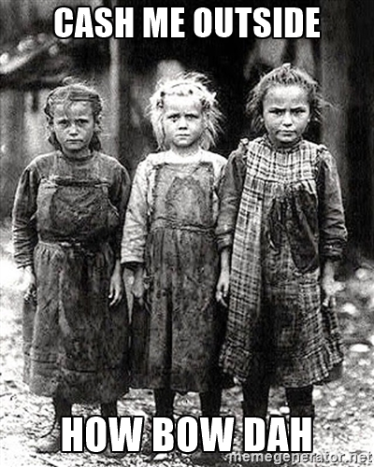
Monday, January 30th
Sporting News:
Boys Bball vs. St X – tomorrow
Girls/Boys Bball @ Whitefield - Friday
Senior Announcements:
New Attendance Policy
Sign up on REMIND App
Class Announcements:
Signed Grade Sheets – Due ASAP
Make Up Proficiencies & Comp Checks
Agenda:
New Packets; New Learning Target; New Vocab
Check Stocks
Lecture & Notes – Stock Market
Roleplay the Crash

Slide 38
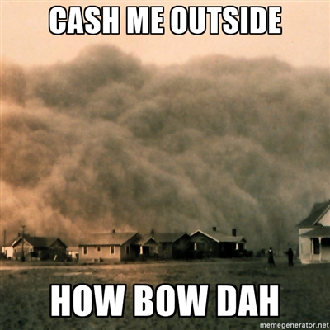
tuesday, January 31st
Sporting News:
Boys Bball vs. St X – tomorrow
Girls/Boys Bball @ Whitefield - Friday
Senior Announcements:
New Attendance Policy
Sign up on REMIND App
Class Announcements:
Signed Grade Sheets – Due ASAP
Unit Comp Check – Next Monday
Agenda:
New Packets; New Learning Target; New Vocab
Check Stocks
Lecture & Notes – Stock Market
Roleplay the Crash

Slide 39
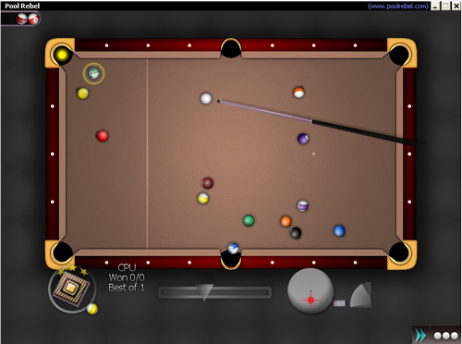
If I see this…I WILL take the phone

Slide 40
Wednesday, February 1st
Sporting News:
Girls/Boys Bball @ Whitefield - Friday
Senior Announcements:
Sign up on REMIND App
Class Announcements:
Signed Grade Sheets – Due ASAP
Unit Comp Check – Next Monday
Agenda:
New Vocab
Check Stocks
Brief PPT & Lecture
Pair Activity – GD Photo Analysis
Unit Project – the New Deal Programs

Slide 41
Thursday, February 2nd
Sporting News:
Girls/Boys Bball @ Whitefield - Friday
Senior Announcements:
Sign up on REMIND App
Class Announcements:
Signed Grade Sheets – Due ASAP
Unit Comp Check – Next Monday
Agenda:
New Vocab
Check Stocks
Chp 15 Reading & Questions
Unit Project – the New Deal Programs

Slide 42
Friday, February 3rd
Sporting News:
Girls/Boys Bball @ Whitefield - TODAY
Senior Announcements:
Sign up on REMIND App
Class Announcements:
Signed Grade Sheets – Due ASAP
Unit Comp Check – Next Monday
Agenda:
New Vocab
Check Stocks
Unit Project – the New Deal Programs & Presentations

