Slide 1
America
The Road to Revolution

Slide 2
Why come to a new land?
PUSH FACTORS
CONDITIONS THAT CAUSE PEOPLE TO MOVE OR FLEE THEIR NATIVE LAND.
FAMINE
WAR
PULL FACTORS
CONDITIONS THAT LURE PEOPLE TO LEAVE THEIR NATIVE LAND.
ECONOMIC OPPORTUNITY
FREEDOM
HOPE FOR A NEW START

Slide 3
Why come to a new land?
The 3 Gs
Gold- economic gain
God- to spread the Christian religion
Glory- fame for finding it first(this was mostly over by the time the “American” colonies were established)

Slide 4
Watch the following video clip and answer the questions
Jamestown
How would you describe life in Jamestown?
Why did people come here in the first place?
Do people around the world still see America the same way they did back then?
What groups are coming to America today? Why?
http://www.history.com/shows/america-the-story-of-us/videos#life-in-jamestown

Slide 5
Watch the following video clip and answer the questions
British Rule
Why did the British put new taxes on the colonies at this time period?
Give 1 example of a new British Tax.
Why did the British see this as fair?
Why did the colonists not see this as fair?
http://player.discoveryeducation.com/index.cfm?guidAssetId=5894C095-A200-40A1-8BBB-03BE3984204F&blnFromSearch=1&productcode=US

Slide 6
Watch the following video clip and answer the questions
Boston Massacre
How did the Boston Massacre begin?
Who was the first to die?
Was this really a massacre?
Do you think they saw this the same way in Britain?
Give an example of one event in your lifetime that is similar to this one?
http://www.history.com/shows/america-the-story-of-us/videos#boston-massacre

Slide 7
Examine the following picture and answer the questions.
Are there any recognizable historical figures in the picture? Who?
How does the artist use light and color to make a point in this picture?
What event is being portrayed?
List other pictures or movies that convey similar feelings.

Slide 8
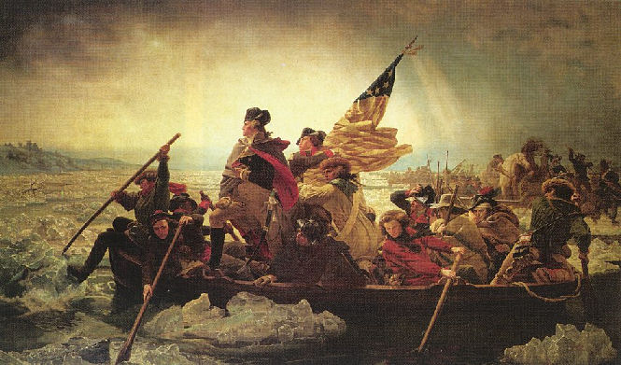

Slide 9
Group Work
Your groups are to use the books to:
Begin unit 1 time line
Define unit 1 vocab. words

Slide 10
Timelines should include:
The name of the event
The year of the event
A short description of the event (1-3 sentences)
A visual depiction ( a symbol, a logo, stick figures, anything that lets us make a visual connection to the event)

