Slide 1
North vs. South
Not Just Slavery

Slide 2
Key Terms
By the end of this lesson you should be able to define the following terms:
Transcendentalism
Secession
Agrarian
Popular sovereignty

Slide 3
North vs. South
North
South
Industrial Economy
Manufacturing
Shipping
Unitarian/Transcendentalism
Public schools
Girls educated (eventually)
Mostly Free
Agrarian Economy
Raw materials
Dependant on the North
Religious Fundamentalism
Lacked public education
Girls seldom educated
Slaves

Slide 4
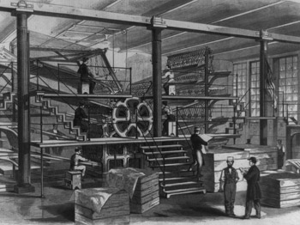
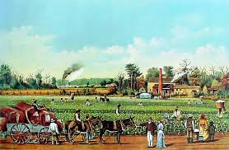
North vs. South
Northern Economy
Southern Economy

Slide 5
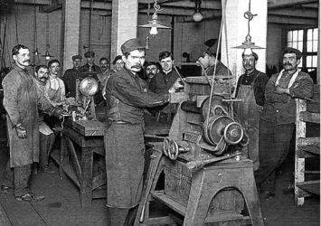
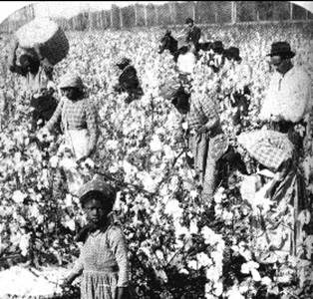
North vs. South
Northern Workers
Southern “Workers”

Slide 6
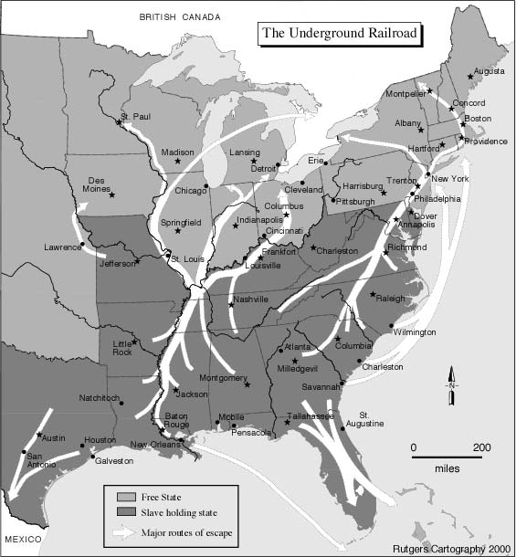
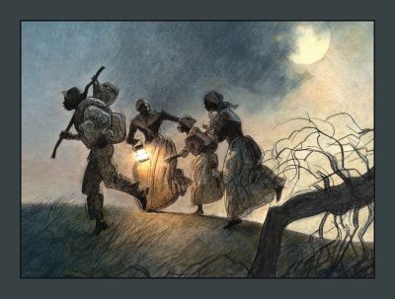
Not really underground, not really a railroad
Harriet Tubman

Slide 7
A quick review
Slavery becomes a major divide between the states

Slide 8
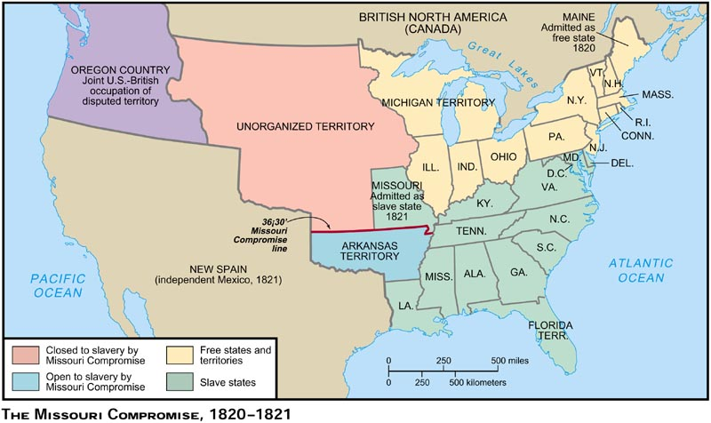
Missouri Compromise 1820

Slide 9
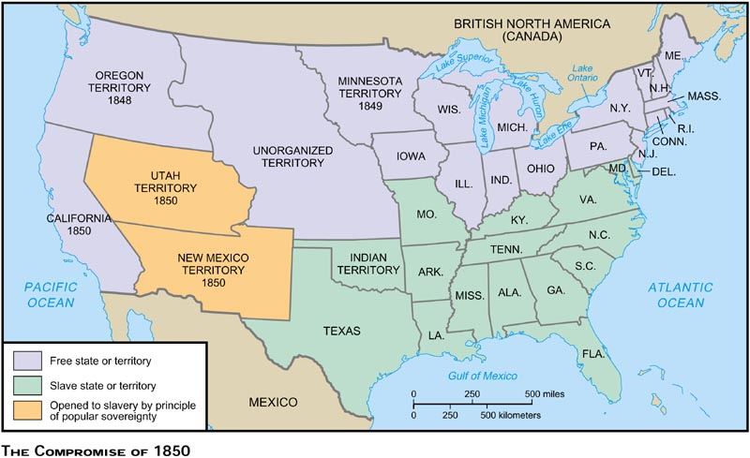
Compromise of 1850

Slide 10
Kansas Nebraska Act 1854
How did it change the boundaries of slavery?

Slide 11
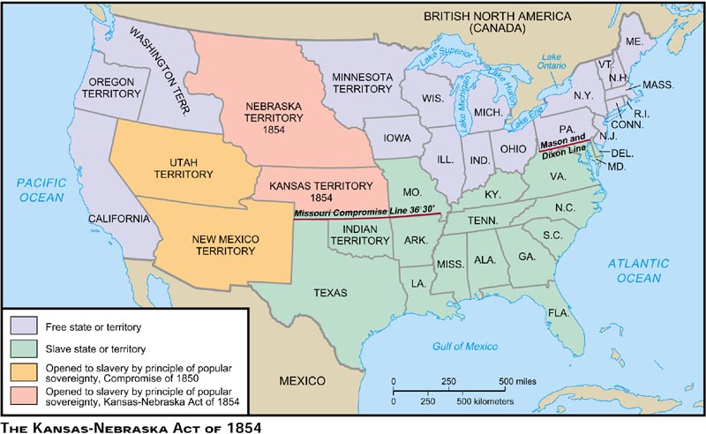
Kansas Nebraska Act 1854

Slide 12
Political Conflicts
Whigs
Republicans
John Brown

Slide 13
Dred Scott Page 166
What was the case?
What was the decision?
What amendment was used to support the decision?

Slide 14
Lincoln
Every body loved him, right?
conflict in the states

Slide 15
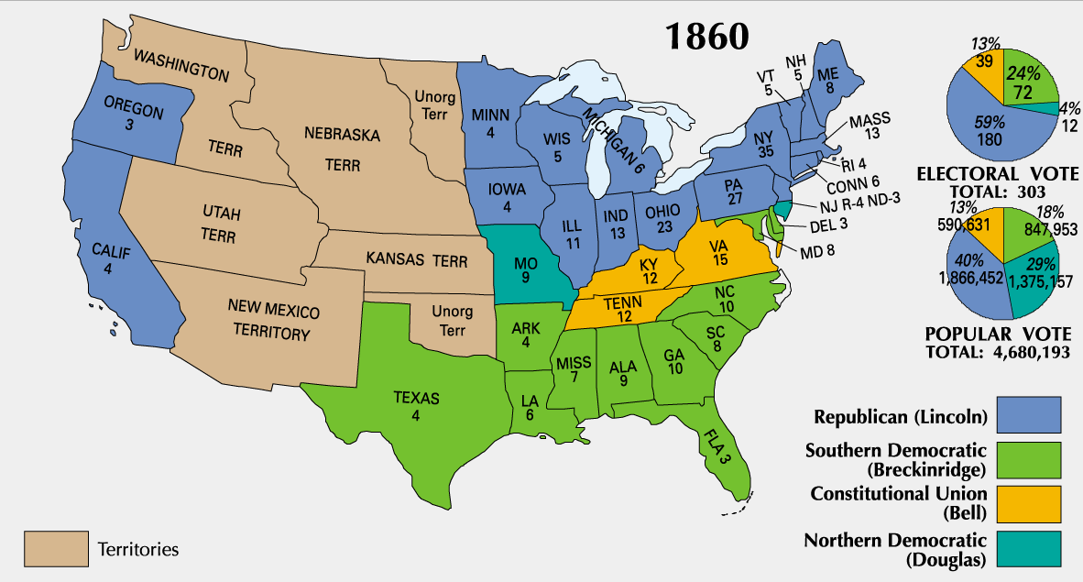
Election of 1860

Slide 16
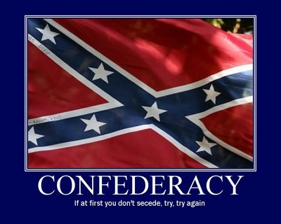
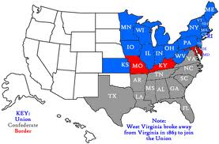
Secession
South Carolina leaves first

Slide 17
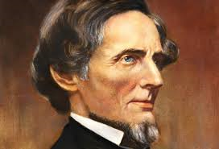
The Confederacy
Lead by Jefferson Davis
Had a constitution that protected slavery

Slide 18
Section II The Civil War
What was the plan?
Civil War Begins: Northern and Southern Advantages Compared - Free US History I Video

Slide 19
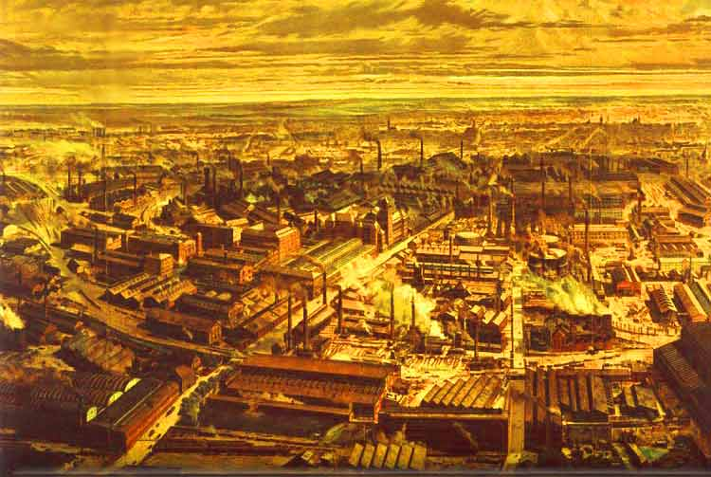
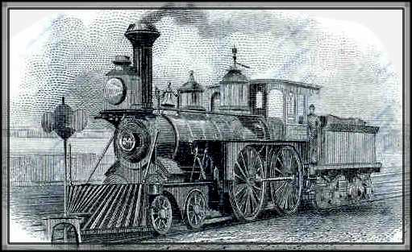
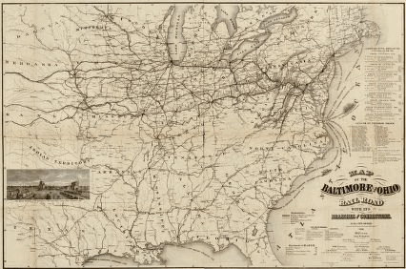
The North’s (Union) Advantages
More factories
More trains
More people

Slide 20
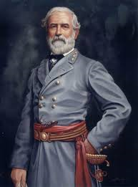
The South’s (Confederacy) Advantages
Nearly all of the nations military colleges are in the south = much better leadership.
Robert E. Lee
“home court” advantage

Slide 21
Life in the War
Conscription- a draft that forced men into service.
10% of the North's army are African American
They saw it as a fight for freedom but faced discrimination there to
Served under white commanders only
Received less pay
Soldiers on both sides faced terrible conditions and more men died in this war than all other US wars combined.
Women fight to improve conditions in this war
Clara Barton begins the Red Cross

Slide 22
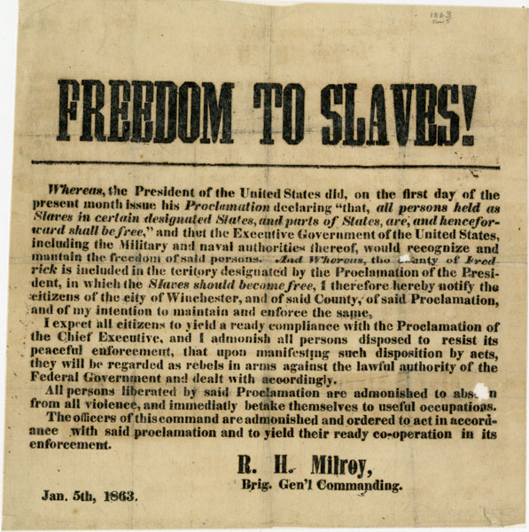
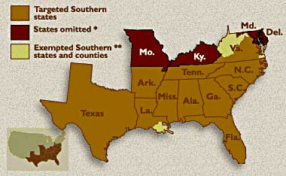
The Emancipation Proclamation

Slide 23
Only one problem, it didn’t actually do anything
Lincoln freed the slaves in the south but the south had it’s own president (Davis)
Did he have the power to do this?
Did it actually free anyone?
No! he had to win for it to really do anything

Slide 24
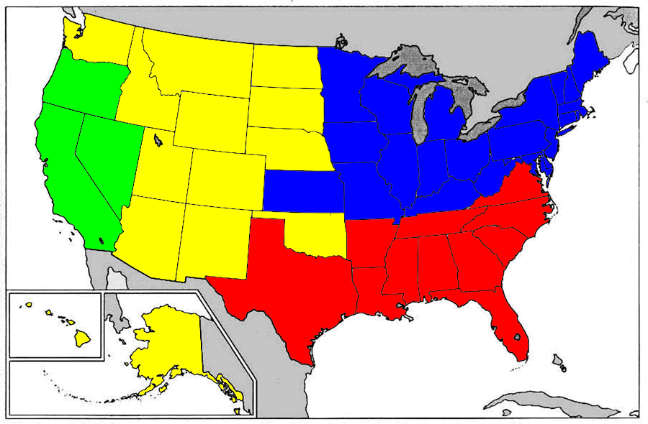
The Mississippi
If you control it, you control the war!

Slide 25
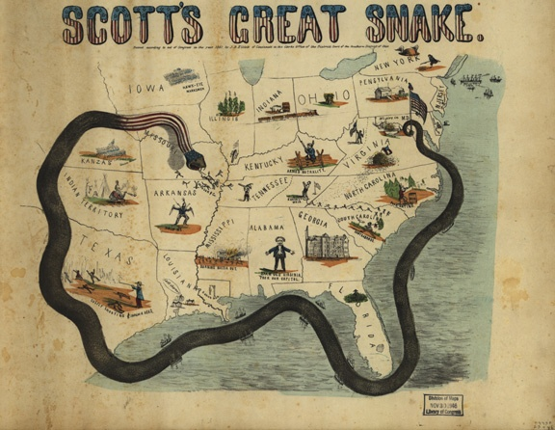
The anaconda plan
Proposed by General- Winfield Scott
the plan emphasized the blockade of the Southern ports, and called for an advance down the Mississippi River to cut the South in two

Slide 26
Gettysburg
The turning point in the war
A three day battle in southern Pennsylvania
23,000 Union casualties
28,000 confederate casualties
Afterwards lincoln gives a speech lasting about 2 minutes= The Gettysburg Address

Slide 27
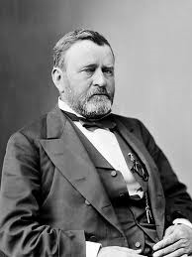
The South Wears Down
Eventually the south cannot keep going
The north has to many soldier & supplies
The north has better technology (trains and telegraph)
South surrenders at Appomattox Court House
4/9/1865
General U.S. Grant represents the north at this event

Slide 28
Effect on the Economy
North
South
Makes them richer!
Increase in demand by the government leads to more factories/jobs
Create the first income tax to pay for the war
Leaves them broke!
Few factories they had are gone.
Few railroad they had are gone.
7000% inflation (McDonalds hamburger would cost $7000)

