Slide 1
CIVIL WAR
EOC REVIEW

Slide 2
Causes of War
Free and slave states
Missouri Compromise
Compromise of 1850
Kansas/Nebraska Act
Sectional Conflicts
Dredd Scott
Harpers Ferry
Lincoln Elected
Southern Secession

Slide 3
Lincoln’s Goals
Before the War
Preserve the Union- keep states from seceding.
During The War
Emancipation Proclamation.

Slide 4
Advantages
Union (North)
More Resources: people, food, factories.
More extensive railroad system.
Confederacy (South)
King Cotton
Better Generals
Highly motivated troops.

Slide 5
Strategy
Union
Navy blockade southern ports to blockade ports.
Riverboats and armies move up and down Mississippi to split south in half.
Capture Richmond!
Confederacy
Mostly defensive, fight on home court.
Attack North if opportunity arose.

Slide 6
My Anaconda Don’t Want None!

Slide 7
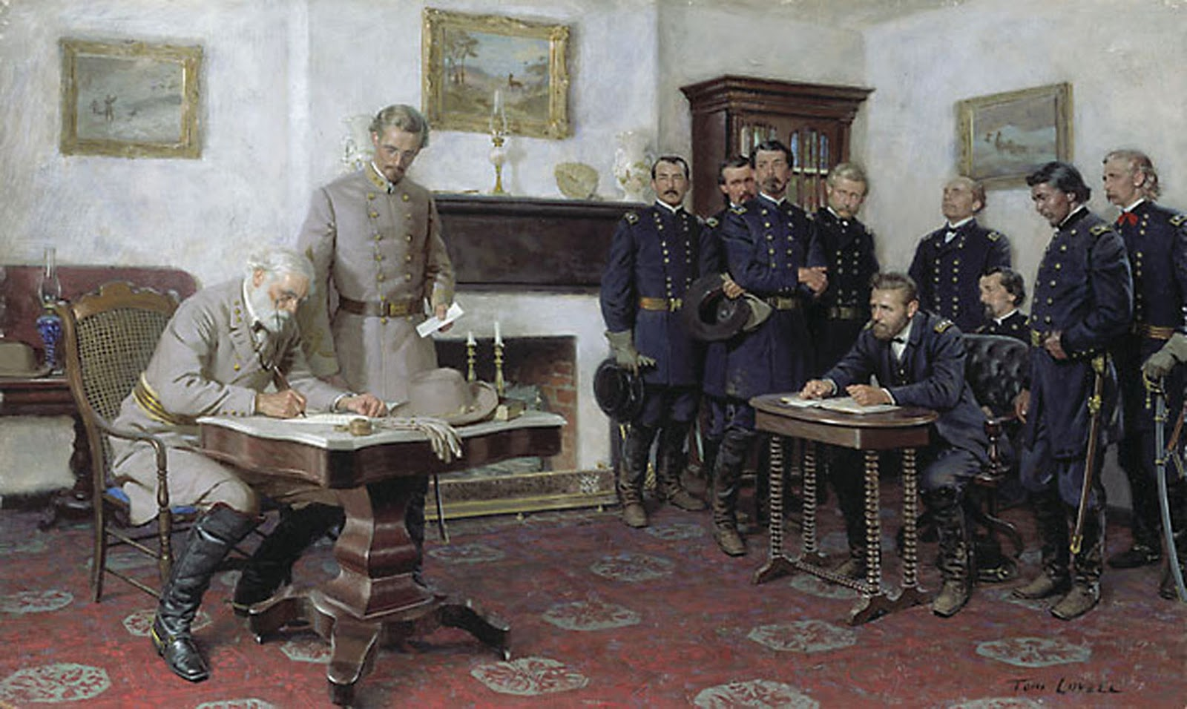
South Surrenders
Appomattox Court House

