Slide 1
Culture Wars of the 1980s

Slide 2
1970s Review
What were the 70s like for most Americans?
The Good
Women’s Rights / Civil Rights
The Not-So-Good
Americans vs. Government / President
Economy / Gas Lines
Mood
Notes:
People lacked confidence in government.
The turbulent 1960s, Watergate, the Soviet invasion of Afghanistan, the Iranian hostage crisis, and long gasoline lines put Americans in an uneasy mood.
Critics said Carter blamed Americans for the crisis in confidence instead of fixing the problems.
A conservative movement that opposed liberal social and racial policies was growing

Slide 3
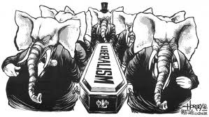
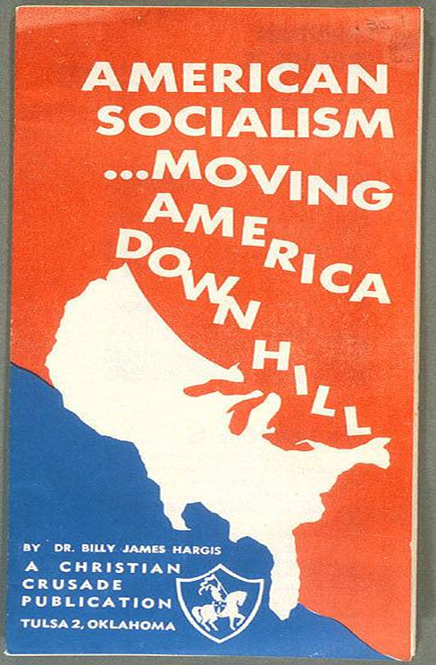
Americans Ready for Change
Notes:
Conservative Backlash
Conservatives react against changes in America during the 1960s
American foreign policy
“Lost Vietnam”
Affirmative Action
Women’s liberation
1978: Regents of U.C. v. Bakke
“Quotas” in college admissions were unconst.
1976: Hyde Amendment
Limited Medicaid funds for Abortion
Moral Majority, 1978
Southern Democrats become Republicans
Many working class Anglos or “White Ethnics” in industrialized urban areas, and new suburbanites blamed immigrants and the poor for their condition, as well as economic decline of “Americans”
Ignored global changes in economy that led to the decline of American manufacturing and industrial base
“Tax and spend” Great Society & War on Poverty
Creationism, “family values,” cut government, stop communists, end abortion, no immigration
Strong military / national defense
American global power
Individualism
Lead to “Culture Wars” & Reagan “Revolution…”
Religious Fundamentalism and Extremism

Slide 4
Conservative Backlash
"I listen to feminists and all these radical gals... These women just need a man in the house. That's all they need. Most of the feminists need a man to tell them what time of day it is and to lead them home. And they blew it and they're mad at all men. Feminists hate men. They're sexist. They hate men; that's their problem."
Jerry Falwell, 1974
Notes:
One leader of the New Right, Rev. Jerry Falwell founded a political activist organization called the Moral Majority in 1979.
Conservative Concerns
Conservative reactions to the “excesses” of the 1960s and 1970s
Lost control of America
Diversity =
Divorce, gay rights, abortion, day care, big government, & decline of the family
Stopped ERA
New “traditionalism”

Slide 5
Enter Ronald Reagan
Leader of Conservative Movement
Hollywood Actor & spokesperson 1930s & 50s
Joins war in 1942
Politics in mid-1950s
Governor of Cal. In 1966

Slide 6
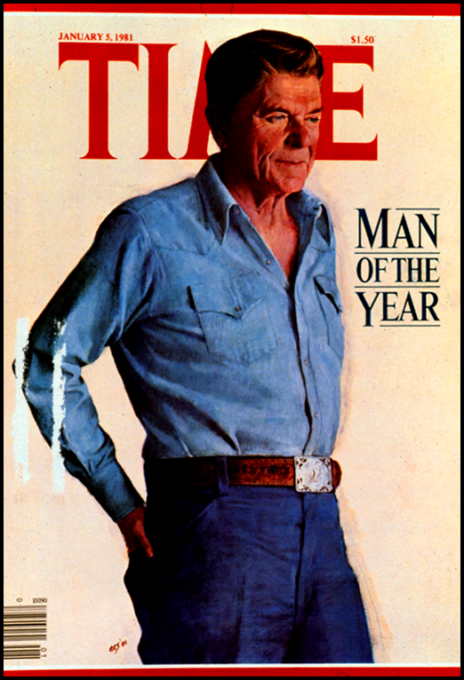
Reagan’s Ideas / Plan
Vietnam was a “Noble Cause”
Renew the Cold War
American Power
Patriotism
Traditionalism
State’s Rights
“Individualism”
Feel Good
Economy!!!
Notes:
Reagan promised to return the country to a simpler time of low taxes, smaller government, a strong military, and conservative moral values.
Focused on “family, work, neighborhood, peace, and freedom.”
Reagan asked if people were better off than they were four years ago.
Reagan and his running mate, George H.W. Bush, won in a landslide; Republicans also gained control of the Senate.

Slide 7
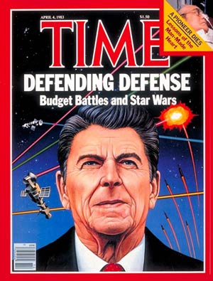
Reagan and the Cold War
“Evil Empire”
In his first term, Reagan rejected the policies of containment and détente; he wanted to destroy communism.
Reagan obtained massive increases in military spending.
Much of the new spending went to nuclear weapons.
Promoted the Strategic Defense initiative (SDI)—a shield in space to protect the United States against incoming Soviet missiles.
Critics called this Star Wars and said it wouldn’t work.
Notes:
Position worsened relations with the Soviets
Forged bonds with like-minded leaders, including Margaret Thatcher and Pope John Paul II
Critics of his policy called Reagan reckless

Slide 8
Reagan and the Cold War
http://www.youtube.com/watch?v=YtYdjbpBk6A

Slide 9
Reaganomics
Reagan’s plan for tax and spending cuts
Two goals
Reduce taxes to stimulate economic growth
Cut the federal budget
Based on supply-side economics
A theory that says breaks for businesses will increase supply of goods and services, aiding the economy
Notes:
Supply-side Economics
Tax cuts and business incentives stimulate investment.
Investment encourages economic growth.
A growing economy results in more goods and services.
Theory appealed to conservatives who supported free enterprise and minimal government regulation.

Slide 10
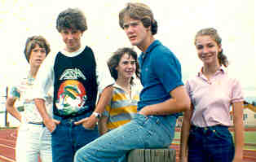
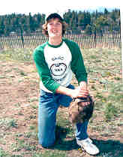
So What?! How did this effect Americans?
Technology
Economy
Culture Wars

Slide 11
New Technologies
Steve Jobs and Steve Wozniak started Apple Computer.
Apple computers were small enough to be used at home, and they transformed the way Americans lived and worked.
Steve Jobs
Bill Gates
Bill Gates started Microsoft, a company that invented a new type of computer-operating software.
Unlike previous spacecraft, the space shuttle could be used over and over again.
The technologies developed or discovered by scientists working on the space shuttle led to the development of infrared cameras and a treatment for brain tumors.
The
Space
Shuttle

Slide 12
Economy
Uneven economic growth—strong growth, but unevenly distributed
Rising deficits—expenditures far greater than tax revenue
Financial deregulation—led to corporate raiders, downsizing, and hostile takeovers
Savings and loan crisis—deregulated S&Ls loaned out too much of their wealth and went bankrupt on a massive scale

Slide 13
Reaganomics: Did it Work?
http://www.youtube.com/watch?v=jJAbEmyZP0o

Slide 14
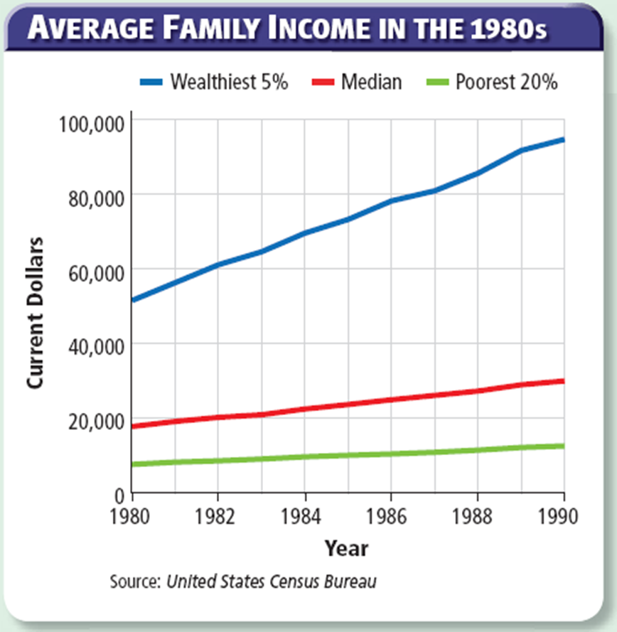

Slide 15
Culture Wars
Abortion
Immigration
Affirmative Action
Bilingual Education
Multiculturalism
Communism
Homosexuality
Taxation
Church and State
HIV-AIDS
God’s punishment
Desegregation
State’s Rights
School Prayer
Abortion
Operation Rescue
Affirmative Action
Hand-outs
Notes:
Milestones for women—politicians began to pay more attention to female voters and to appoint women to high public offices
Changes in immigration law—laws increased the legal immigration limits and toughened penalties on hiring undocumented workers
Court battles over social issues—the Supreme Court ruled on several sensitive landmark cases
Battles over Supreme Court nominations—Reagan and Bush tried to pack the Supreme Court and federal courts with conservative judges
A deadly disease—scientists identified AIDS, one of the world’s worst outbreaks of infectious disease
Milestones for Women
Politicians began to pay attention to women voters and interests.
Reagan elevated women to high public office.
Sandra Day O’Connor—first women appointed to the Supreme Court
Walter Mondale asked Geraldine Ferraro to be his presidential running mate.
Immigration Laws
Laws passed in 1980 and 1986 increased legal immigration limits and granted legal status to millions of undocumented immigrants living in the United States.
They also toughened penalties on employers who hired undocumented workers.
Illegal immigration continued to grow.
Social Issues
New Jersey v. T.L.O.—schools have the right to search students’ belongings
Westside Community School District v. Mergens—school had to allow students to form an after-school Christian group that could meet on school grounds.
Planned Parenthood of Southwestern PA v. Casey—state could require informed consent, a 24-hour wait, and parental consent for minors before women could have an abortion
Cruzan v. Director, Missouri Dept. of Health—recognized an adult’s right to refuse medical service

