Slide 1
Cultures Clash on the Prairie
TOO MANY WHITE PEOPLE
TOO FEW BUFFALO
Notes:
Wrong on both counts
Plains some of the best farm land in the world
Two highly developed Native American lifestyles
East-Side: Planted crops and lived in established villages
West-Side: Nomadic and gathered food and hunted buffalo

Slide 2
Cultures Clash on the Prairie
White settlers
viewed Great Plains as having no value for farming
view people who lived there as primitive savages who were uncivilized
Notes:
Wrong on both counts
Plains some of the best farm land in the world
Two highly developed Native American lifestyles
East-Side: Planted crops and lived in established villages
West-Side: Nomadic and gathered food and hunted buffalo

Slide 3
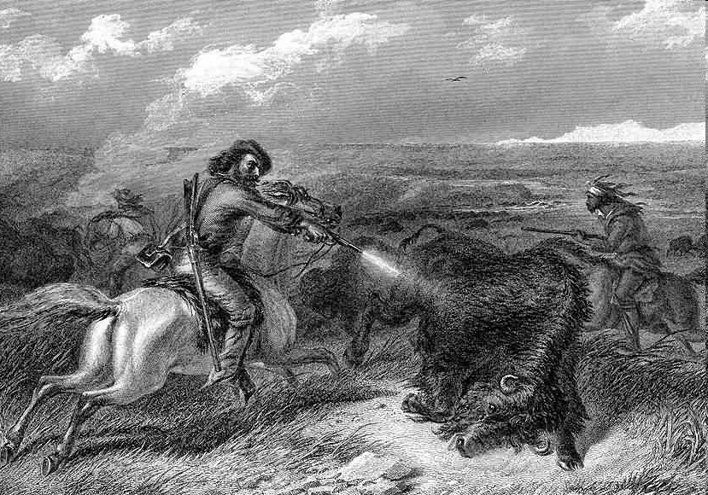
Depletion of the Buffalo
Native Americans were hostile toward the white settlers because between 1860 – 1900, white hunters reduced the number of buffalo from 15 million to only a few hundred.
http://www.firstpeople.us/pictures/buffalo/ls/Shooting-Buffalo-with-a-Revolver.html

Slide 4
Buffalo
buffalo

Slide 5
Bloody Battles
Colonel George A. Custer of the 7th Calvary was sent to investigate rumors of gold and miners and settlers rushed to the Black Hills.
Government offered to buy the land but the Sioux refused.

Slide 6
Little Big Horn
The Last of the Sioux

Slide 7
Dawes Act
Distribute land to families
$ from the sale of remaining land would go to buy farm implements (Native Am. NEVER saw the money)
Set up schools for the education of Indian children
ASSIMILATION
Notes:
Distribute land from reservations into 160 acre lots for each adult head of the family. 80 acres for single adults. (Most land taken over by white settlers eventually)
$ from the sale of remaining land would go to buy farm implements (Native Am. NEVER saw the money)
Set up schools for the education of Indian children
Boarding schools like the one in the video (A Walk in Two Worlds) tried to take away Indian culture and replace it with the white culture

Slide 8
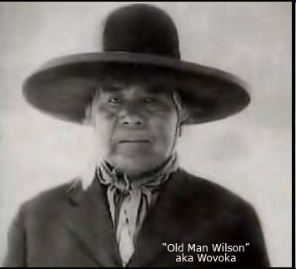
Ghost Dance Movement
Addressed Problems of the Native Americans
Reduced Rations
Increase in Restrictions
Loss of Cattle to Disease
Forced Assimilation
Ghost Dance Movement Promised
Destroy the Whites
Bring back the buffalo
Bring back the Indian’s way of life
Notes:
Many whites became very concerned about the movement and thought the Native Americans were planning an uprising.
Sitting Bull supported the movement
Army sent Indian Police to arrest Sitting Bull in Dec. 1890
Sitting Bull’s body guard fired at police and in the fight Sitting Bull was killed.
Many of the fearful Sioux fled which led to the next tragic event.

Slide 9
Massacre at Wounded Knee
http://www.youtube.com/watch?v=AQDkefN5-bk
Notes:
7th Cavalry rounded up approx. 350 freezing and starving Sioux and took them to Wounded Knee Creek
The 7th Cavalry demanded the Sioux to give up all of their weapons
A shot was fired (not clear who fired), and the soldiers opened up with cannon fire.
Approx. 300 mostly unarmed Sioux Native Americans, including many women and children, were killed.
Significance- Marked an end to the Indian Wars

Slide 10
Cattle Become Big Business
Did you say steak?

Slide 11
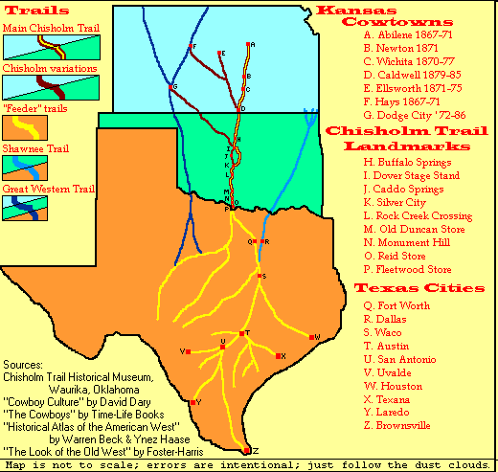

Slide 12
Importance of the Railroad
Before the Civil War - poor transportation of food / livestock
After the Civil War - immigration
Chicago meat packing plants could process the beef if they could find a way to transport the cattle.
By 1866, the railroad reached Midwest!
1869 TRANSCONTINENTAL RAILROAD COMPLETE
Notes:
Before the Civil War few cattle were taken from Texas ranches due to poor transportation and dangerous conditions.
After the Civil War the demand in eastern cities exploded because of the increase in immigration.
Chicago meat packing plants could process the beef if they could find a way to transport the cattle.
By 1866, the railroad had reached Sedalia, Missouri, but the trail was very hazardous.

Slide 13
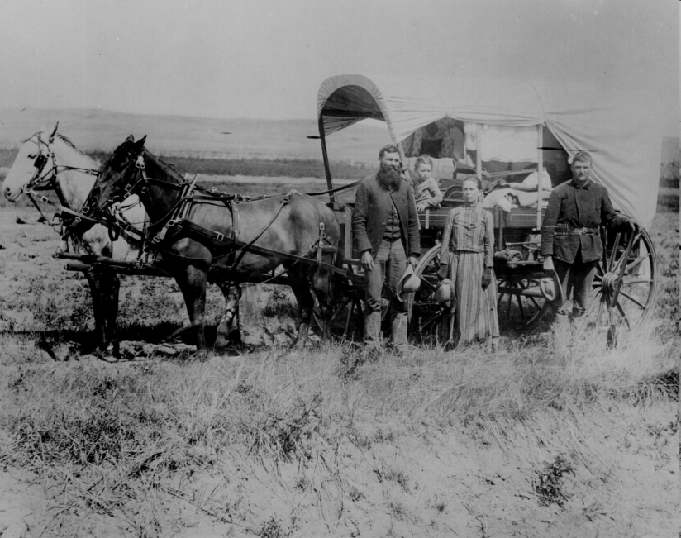
Homestead Act 1862
The government would give the head of the household 160 acres free if homesteaders would live and make improvements on the land for 5 years.

Slide 14
Problems with the Act
Homestead Act Land
Railroad Companies
&
Speculators
Miners & Woodcutters
Only 10% of land went
to Homesteaders
Cattlemen

Slide 15
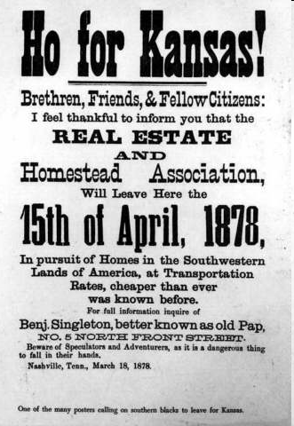
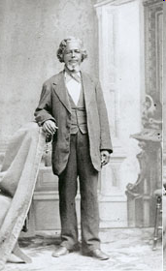
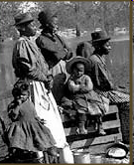
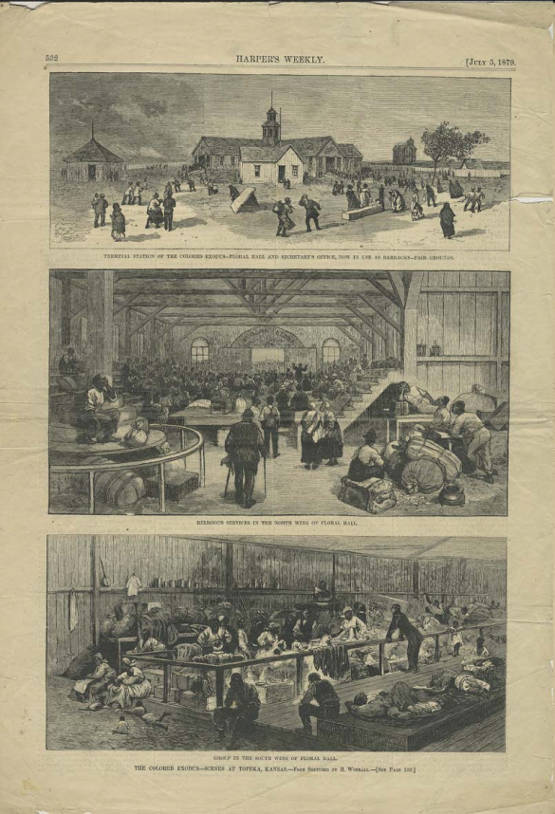
Exodusters
Freedmen who went west to settle and farm

Slide 16
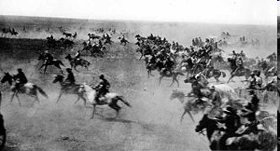
Oklahoma Land Grant
Sooners: Those who snuck into the territory early and claimed land sooner than they should have.
The land run started at high noon on April 22, 1889, with an estimated 50,000 people lined up for their piece of the available two million acres (8,000 km²).
Notes:
The Government passed legislation to preserve the environment of the west.
* 1872 – Yellowstone National Park
*1890’s – Yosemite, Sequoia, Kings Canyon, Mt. Rainer
By 1880 individuals had claimed 19 million acres
By 1890 the Western frontier was considered gone

Slide 17
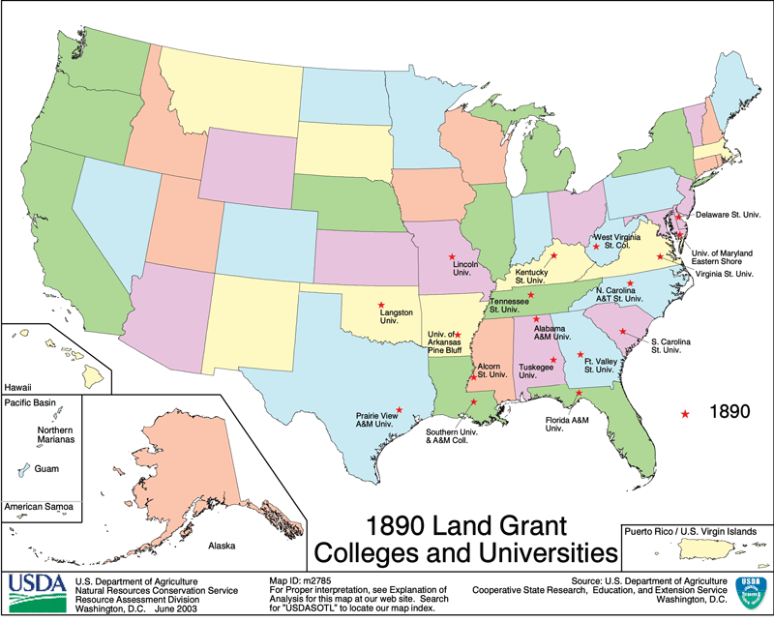
Morrill Land Grant Act 1862 and 1890
Notes:
Gave federal land to states to help finance agricultural colleges.
Passed on July 2, 1862, this act made it possible for new western states to establish colleges for their citizens. The new land-grant institutions, which emphasized agriculture and mechanic arts, opened opportunities to thousands of farmers and working people previously excluded from higher education.
Established agricultural experimental stations to communicate new developments in agriculture to farmers in every state.

