Slide 1
France, Native Americans & Bacon?
The Road To Rebellion

Slide 2
Success
At first the colonies were left alone.
Most people thought the colonists would die.
It was only after the colonies became successful that the British gave them any attention
How were they successful??

Slide 3
Bacon’s Rebellion
an armed rebellion in 1676 by Virginia settlers led by Nathaniel Bacon against the rule of Governor William Berkeley.
Bacon was an indentured servant!!
Virginians rose up in arms against Berkeley, attacking Native Americans, chasing Berkeley Virginia.
They thought Berkeley had not been doing enough to protect them from native attacks
It was the first rebellion in the American colonies in which colonist rebelled against British Authority
Ultimately leads to slave trade rising. WHY???

Slide 4
Problems
The British want a lot from the Colonists $$$$
What do the Colonists want from the British?

Slide 5
The beginning of the End? or The end of the Beginning?
The French & Indian War
(1756 to 1763)

Slide 6
The Conflict
North America in 1750
The British and the French were trying to control much of the same land
Much of the disputed land is where Kentucky is now.
The Teams
The British and the Colonist work to protect Britain's claims to the land
The French and the Native Americans joint to protect the French claims (French & Indian)

Slide 7
Last of the Mohicans

Slide 8
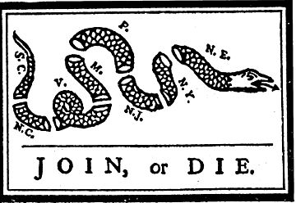
1754 → Albany Plan of Union
Ben Franklin’s propaganda
Many Americans sought for the American colonies to unite
In 1754, 7 of the 13 colonies met in Albany, New York, known simply as the Albany Congress.

Slide 9
1763 → Treaty of Paris
France --> lost Canadian possessions, most of her empire in India, and claims to lands east of the Mississippi River.
Spain --> got all French lands west of the Mississippi River, New Orleans, but lost Florida to England.
England --> got all French lands in Canada, exclusive rights to Caribbean slave trade, and commercial dominance in India.

Slide 10
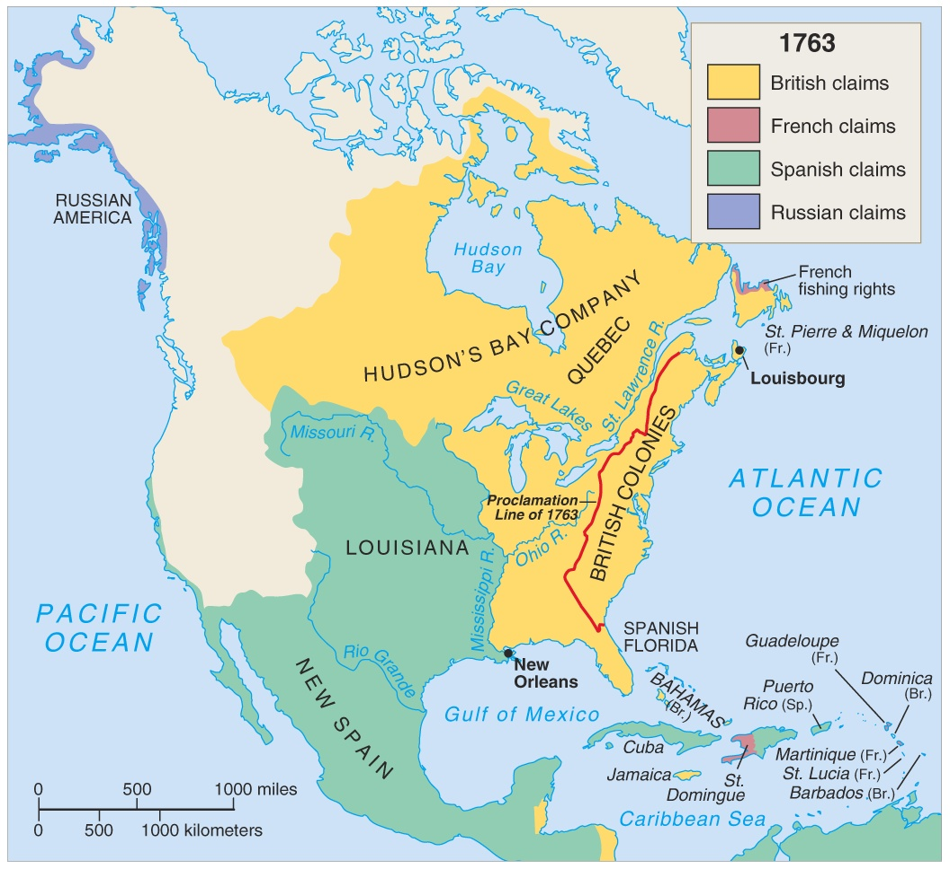
North America in 1763

Slide 11
Effects of the War on Britain?
1. It increased her colonial empire in the Americas.
2. It greatly enlarged England’s debt.
Britain and the colonies started to have conflict
Britain thought the colonies were a burden
The Colonies were growing tired of British Control

Slide 12
Effects of the War on the American Colonials
1. It united them against a common enemy for the first time.
2. It created a socializing experience for all the colonials who participated.
3. It created bitter feelings towards the British that would only intensify.

Slide 13
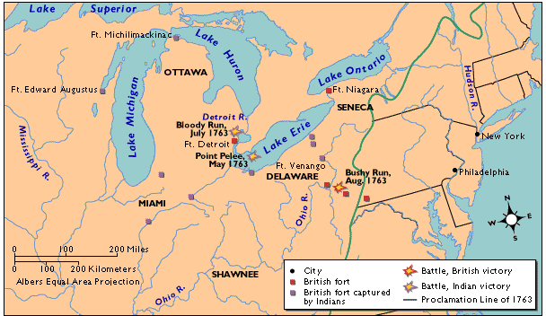
BACKLASH!
British → Proclamation Line of 1763.

Slide 14
Proclamation Line of 1763
Parliament issued its Proclamation of 1763, prohibiting any settlement in the area beyond the Appalachians.
was intended to create a boundary between the colonists and the Indians.
Colonists saw it as a form of oppression from a far away country.
Colonists asked, “Didn’t we just fight a war to win that land?”
Colonists were determined to ignore it.

Slide 15
Essential Question
How do you think the British will react to the colonists refusal to obey the Proclamation Line?

