Slide 1
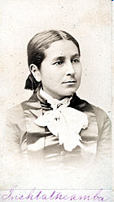
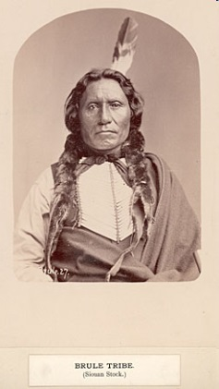
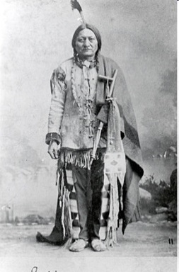
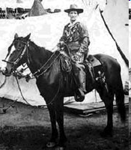
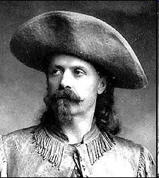
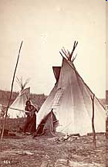
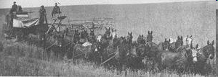
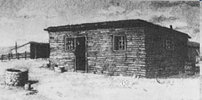
Changes on the Western Frontier

Slide 2
Cultures Clash on the Prairie
Great Plains = “Great American Desert”
Whites viewed plains as having no value for farming
Whites view people who lived there as primitive savages who were uncivilized
Notes:
Wrong on both counts
Plains some of the best farm land in the world
Two highly developed Native American lifestyles
East-Side: Planted crops and lived in established villages
West-Side: Nomadic and gathered food and hunted buffalo

Slide 3
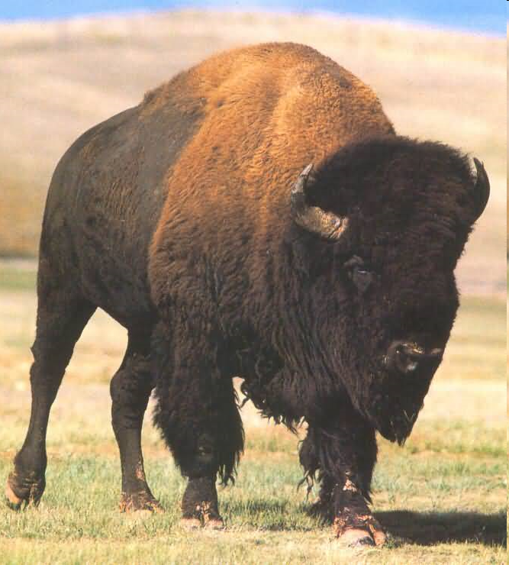
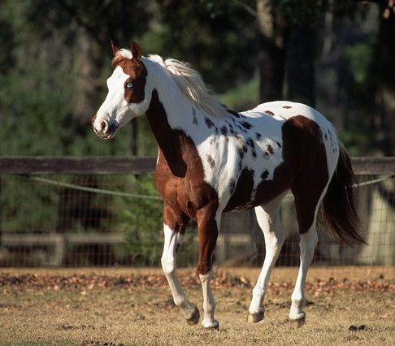
The Horse & The Buffalo
Notes:
Brought by the Spanish
How did it change the Native American’s way of life?
*Increased the mobility of the Indians
1. They could travel farther in search of buffalo.
2. They could hunt more efficiently on horseback
What did the increased mobility lead to?
*Tribal Wars because of competition for buffalo.
What was important about warfare for the Plains Indian?
*Gaining prestige and honor for the warrior.
What is “Counting Coup”?
*Practice in which a warrior touches a live enemy and escapes unharmed, rather than killing.
How does this gain honor for the warrior?
*Very brave to confront an enemy without bloodshed.
Why use counting coup instead of killing an enemy?
*Killing enemies might have wiped out the population of the warring tribes.
*Very practical adaptation for survival
BUFFALO Provided basic needs (See page 207)
Food, Clothing, and Shelter
1. Hides for tepees, clothing, shoes, blankets
2. Meat – jerky
3. Sinew – thread, bowstring
4. Bones – hide scrapers, tool handles, etc.
5. Hoofs – ground to make glue
6. Skull – rituals
7. Horns – bowls and spoons
8. Everything was used

Slide 4
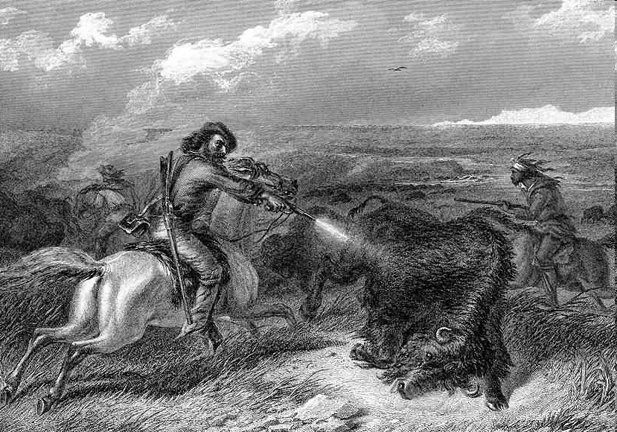
Depletion of the Buffalo
Native Americans were hostile toward the white settlers because between 1860 – 1900, white hunters reduced the number of buffalo from 15 million to only a few hundred.
http://www.firstpeople.us/pictures/buffalo/ls/Shooting-Buffalo-with-a-Revolver.html

Slide 5
Buffalo
http://www.history.com/shows/america-the-story-of-us/videos/american-buffalo

Slide 6
The Government Restricts Native Americans
Great Plains prior to 1850
Scarce land
When increasing # of settlers moved in they started opening the land for settlement and signed treaties with the tribes and set boundaries.
Notes:
Before 1850 the American Policy was to set aside the Great Plains as a huge Indian reservation.
Scarcity of land caused people to take another look at the “Great American Desert”.
Most tribes continued to hunt on traditional lands with disastrous results as whites and Indians clashed.
Corrupt Bureau of Indian Affairs Agents
1. Promised supplies were late
2. Supplies were of poor quality
3. Some supplies were not delivered
Not all tribe representatives signed treaties and didn’t follow the requirements
Indians left reservation land in search of food
Miners invaded the Black Hills in search of gold

Slide 7
Bloody Battles Continue
Colonel George A. Custer of the 7th Calvary was sent to investigate rumors of gold and miners and settlers rushed to the Black Hills.
Government offered to buy the land but the Sioux refused.

Slide 8
Little Big Horn
http://www.history.com/shows/america-the-story-of-us/videos/the-last-of-the-sioux

Slide 9
The Battle of the Little Big Horn June 1876
Crazy Horse and Sitting Bull vs. Custer and the 7th Calvary
Custer’s Mistakes
Custer and all of the men with him were killed in about 20 minutes.
Notes:
Little Big Horn River Indian Encampment
Crazy Horse and Sitting Bull
Custer and the 7th Calvary
Custer’s Mistakes
Underestimated the number of warriors
Had driven his men and horses to exhaustion
Did not wait for other units in the area
Split his regiment into 3 parts
Custer and all of the men with him were killed in about 20 minutes.

Slide 10
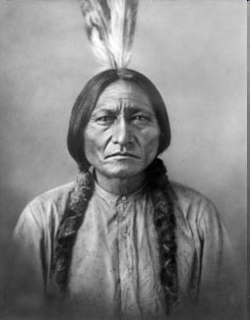
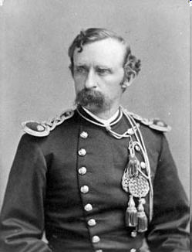
The Battle of the Little Big Horn
http://www.eyewitnesstohistory.com/custer.htm

Slide 11
Aftermath of Custer’s Last Stand
What happens next?
Sitting Bull????
Crazy Horse????
Notes:
The Army continued it attacks on the Native Americans until the Sioux returned to the reservation.
Sitting Bull and some of his people fled to Canada, but eventually he also returned to the reservation.
Crazy Horse eventually surrendered and was killed by an Indian guard as he resisted begin locked up. He was bayoneted in the back.

Slide 12
Government Supports Assimilation
Helen Hunt Jackson
A Century of Dishonor (1881)
exposed the gov’ts mistreatment of Native Americans over the years and the many broken treaties.
Well meaning supporters pushed for a plan of ASSIMILATION :
Notes:
Native Americans give up their beliefs and way of life and become part of white culture.

Slide 13
Dawes Act
Distribute land to families
$ from the sale of remaining land would go to buy farm implements (Native Am. NEVER saw the money)
Set up schools for the education of Indian children
More ASSIMILATION
Notes:
Distribute land from reservations into 160 acre lots for each adult head of the family. 80 acres for single adults. (Most land taken over by white settlers eventually)
$ from the sale of remaining land would go to buy farm implements (Native Am. NEVER saw the money)
Set up schools for the education of Indian children
Boarding schools like the one in the video (A Walk in Two Worlds) tried to take away Indian culture and replace it with the white culture

Slide 14
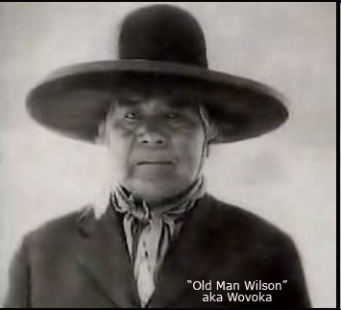
Ghost Dance Movement
Created by Paiute Indian Prophet – Wovoka
Addressed Problems of the Native Americans
Reduced Rations
Increase in Restrictions
Loss of Cattle to Disease
Forced Assimilation
Ghost Dance Movement Promised
Destroy the Whites
Bring back the buffalo
Bring back the Indian’s way of life
Notes:
Many whites became very concerned about the movement and thought the Native Americans were planning an uprising.
Sitting Bull supported the movement
Army sent Indian Police to arrest Sitting Bull in Dec. 1890
Sitting Bull’s body guard fired at police and in the fight Sitting Bull was killed.
Many of the fearful Sioux fled which led to the next tragic event.

Slide 15
Massacre at Wounded Knee
http://www.youtube.com/watch?v=AQDkefN5-bk
Notes:
7th Cavalry rounded up approx. 350 freezing and starving Sioux and took them to Wounded Knee Creek
The 7th Cavalry demanded the Sioux to give up all of their weapons
A shot was fired (not clear who fired), and the soldiers opened up with cannon fire.
Approx. 300 mostly unarmed Sioux Native Americans, including many women and children, were killed.
Significance- Marked an end to the Indian Wars

