Slide 1
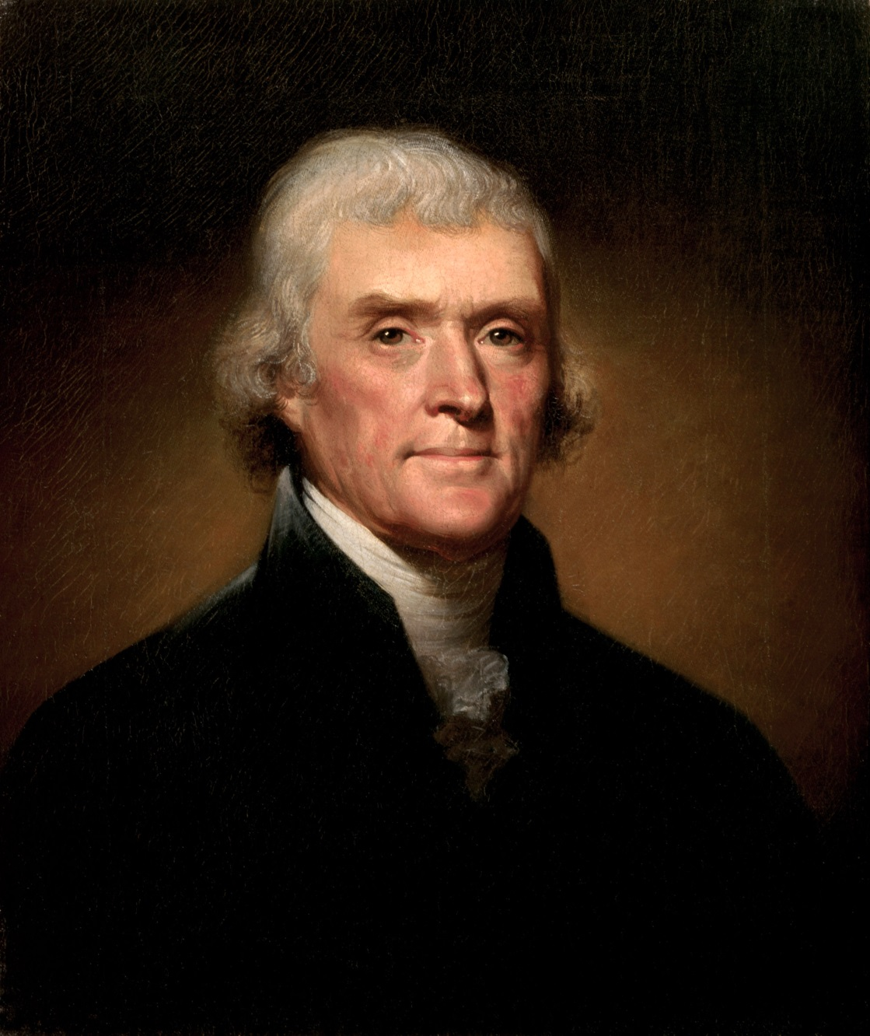
Jefferson

Slide 2
Election of 1800
Presidents and vice presidents were once all part of the same big election
Jefferson and Burr (who ran together) both got the same number of votes
The House of Reps took 35 votes to break the tie
Alexander Hamilton ended the tie.

Slide 3
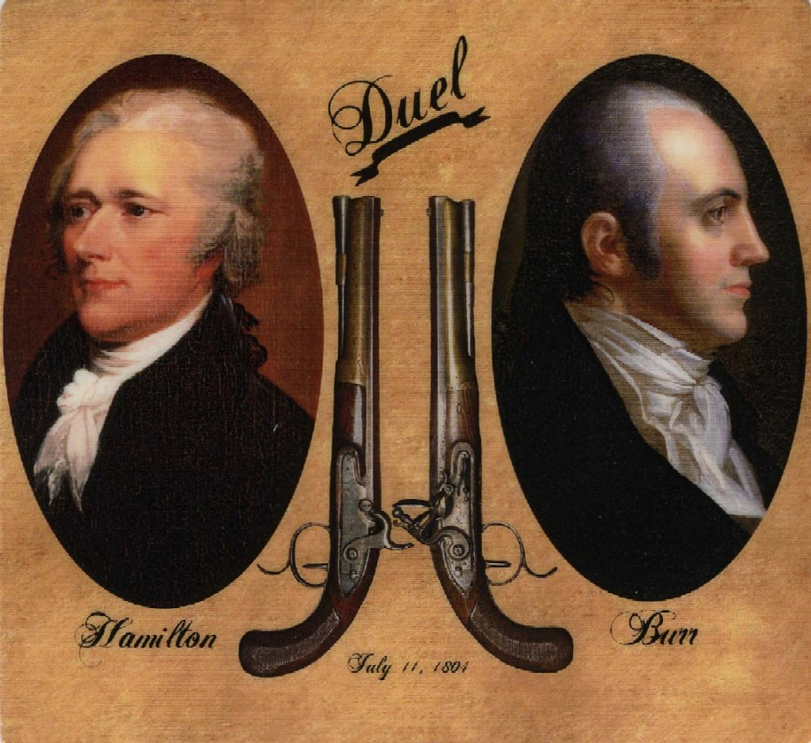
The Duel

Slide 4
Jeffersonian Republicanism
A true Democratic Republican
Shrinks the government
Reduces spending
Cuts back the military
Cuts government social functions
Eliminates all internal tax
Lessons government’s control of banks

Slide 5
Marbury v. Madison
The most important court case of all time?
The event of the case are actually not that important
The precedent or example it made was the important part
Judicial Review- the power to declare acts of government unconstitutional

Slide 6
TRY THIS ONE
Facts of the Case
Both the Executive Director of the Planned Parenthood League of Connecticut and the Medical Director for the League gave information, instruction, and other medical advice to married couples concerning birth control.
They were convicted under a Connecticut law which criminalized the provision of counseling, and other medical treatment, to married persons for purposes of preventing conception.
Question
Does the Constitution protect the right of marital privacy against state restrictions on a couple's ability to be counseled in the use of contraceptives?

Slide 7
Marbury vs. Madison
Decision: 7 votes for Griswold, 2 vote(s) against
Legal provision: Due Process
Though the Constitution does not explicitly protect a general right to privacy, the various guarantees within the Bill of Rights create penumbras, or zones, that establish a right to privacy.
Together, the First, Third, Fourth, and Ninth Amendments, create a new constitutional right, the right to privacy in marital relations. The Connecticut statute conflicts with the exercise of this right and is therefore null and void.

Slide 8
Louisiana Purchase

Slide 9
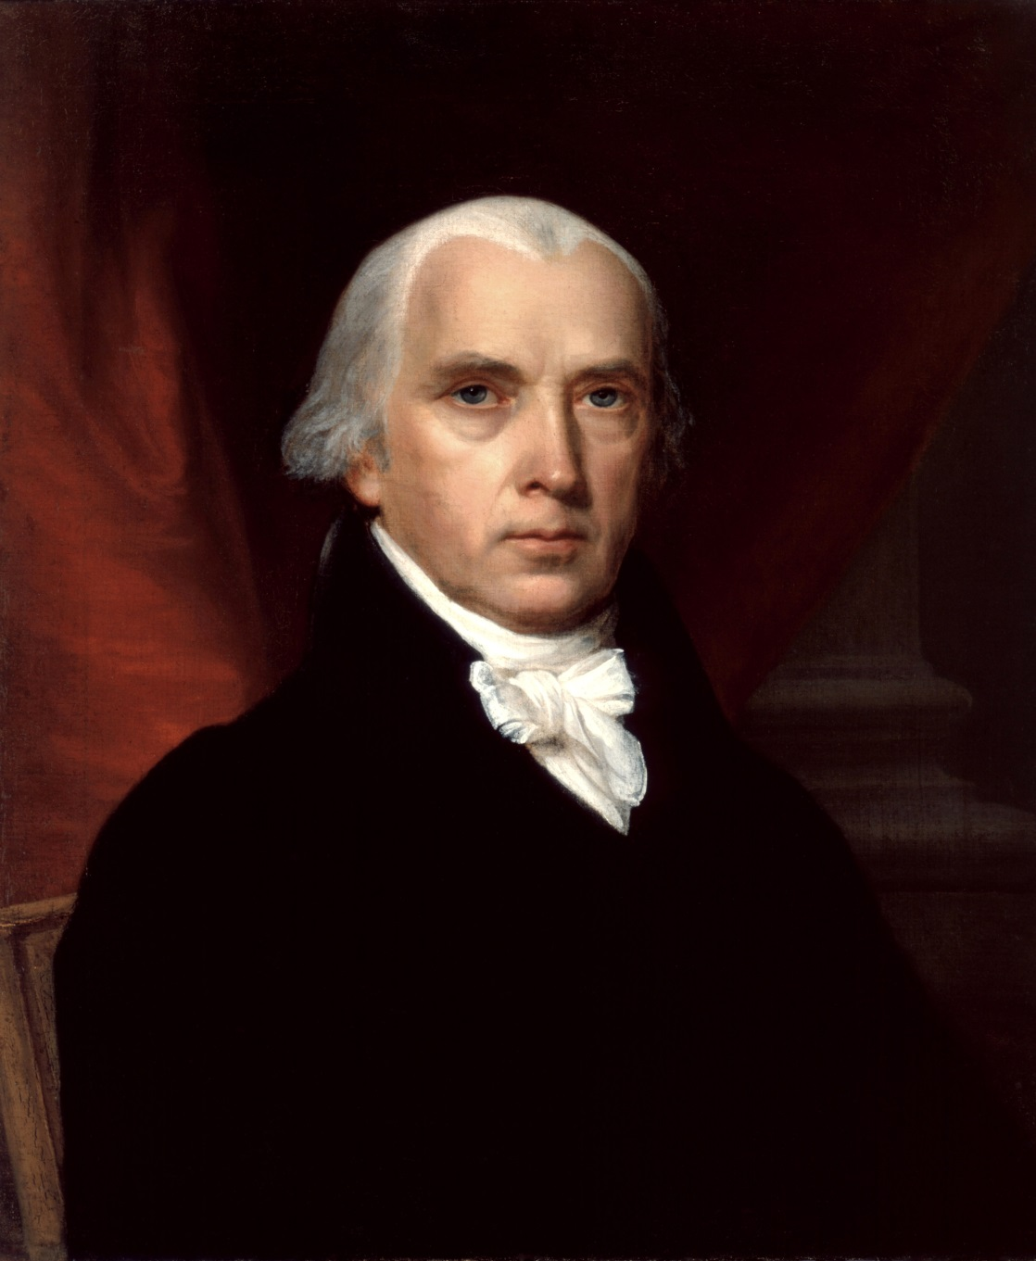
James Madison

Slide 10
The War of 1812
Impressment- capturing people and forcing them to serve in the military
The war
Britain sacked Washington the Capital and Whitehouse are burned
We win at battle of New Orleans but it was over already?
Outcome
Ends the Federalist part
Encourages America to grow it’s industry
Shows the world that we are a serious nation

Slide 11
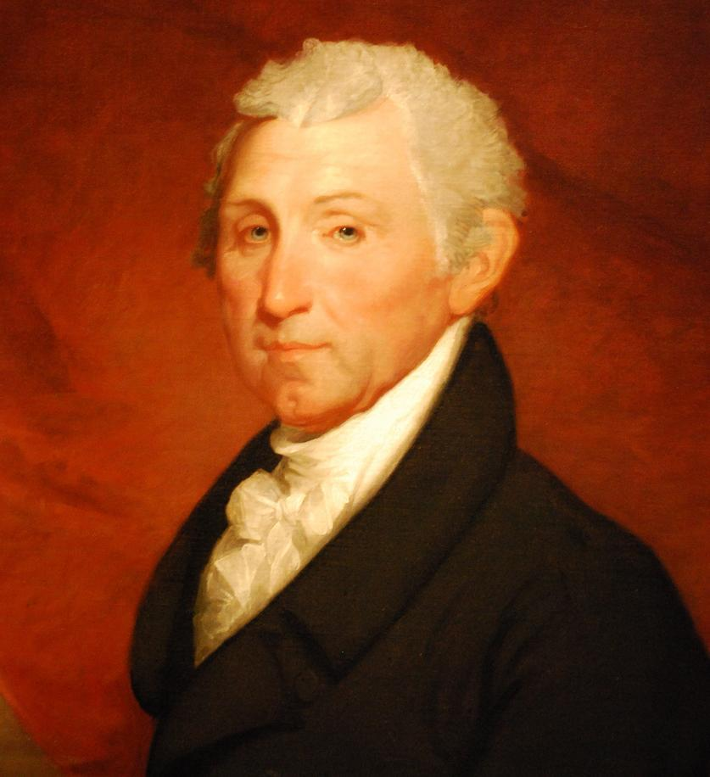
James Monroe

Slide 12
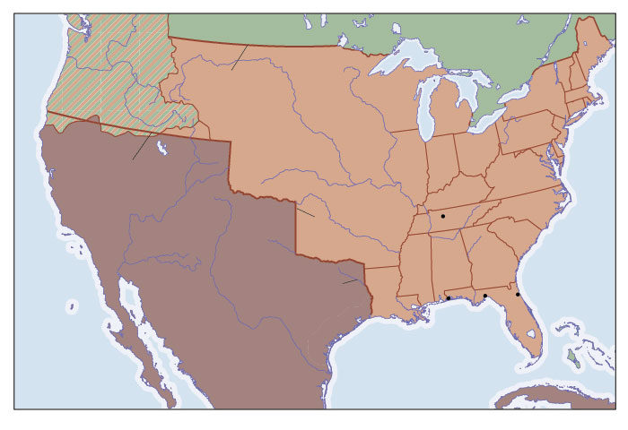
Expansion of Territory
Monroe thinks that the only way to keep us safe is to grow our nation and tighten our boundaries between the Spanish Territory

Slide 13
Monroe Doctrine
European powers want to make colonies in the America.
We see this as a threat to our security and our income
The Doctine
We tell the that to try to make a colony or get involved in the Americas is an act of war
We promise to stay out of European affairs and we won’t mess with their existing colonies
We do neither

Slide 14
Exit Question
What are the biggest results (or effects) of the election of 1800?

Slide 15
Exit Question
What major issues did Federalists have with the decision to buy this land?

