Slide 1
Marbury vs Madison
The power of Judicial Review

Slide 2
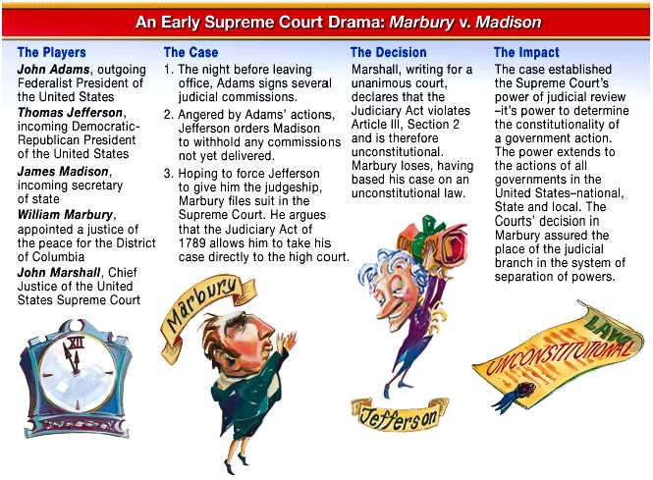

Slide 3
The case
The story- The president and the Congress had tried to make the Supreme Court do something. Its not what you need to remember
The outcome- something that the other branches had done was called unconstitutional by the court. This was a first in American history.

Slide 4
The Precedent
Precedent- a legal example used in future cases
Judicial Review- the supreme courts power to rule on the constitutionality of all laws and actions of the government and citizens of the USA
President/congress
Kentucky
Fern Creek High School
Mr. Sherman

Slide 5
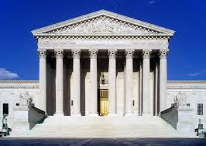
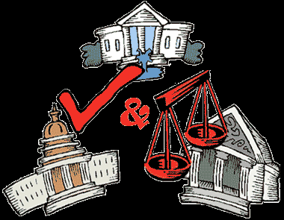
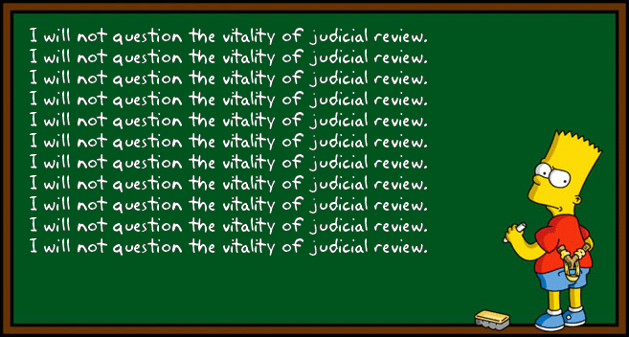

Slide 6
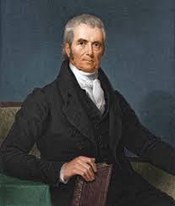
John Marshall
The chief justice of the Supreme Court at the time.
Many groundbreaking decisions were made while he was chief justice
We refer to that time as the “Marshall Court”.
Marbury v Madison- Judicial Review
McCullough v Maryland- Congress implied powers, supremacy clause
Gibbons v Ogden- upholding and expanding the power of the interstate commerce clause

Slide 7
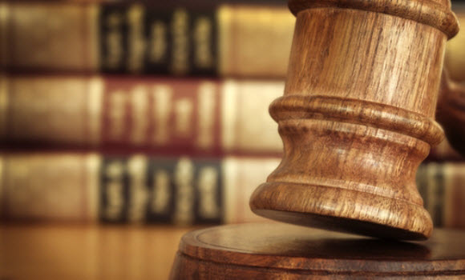
Judicial Review

