Slide 1
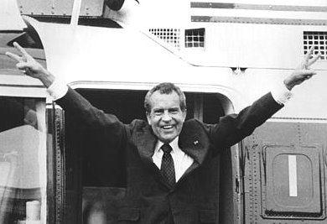
Nixon
“I am not a crook”

Slide 2
Domestic Policy
New Federalism
Wants to give more power back to the states
He basically attempts to reverse many “Great Society” programs
Nixon also tried to slow down the implementation of desegregation rules in the south to appeal to southern voters
Nixon came into conflict with the Supreme Court. He appointed 4 justices to the court during his presidency
He thought the Warren Court was too liberal and his appointments were more conservative

Slide 3
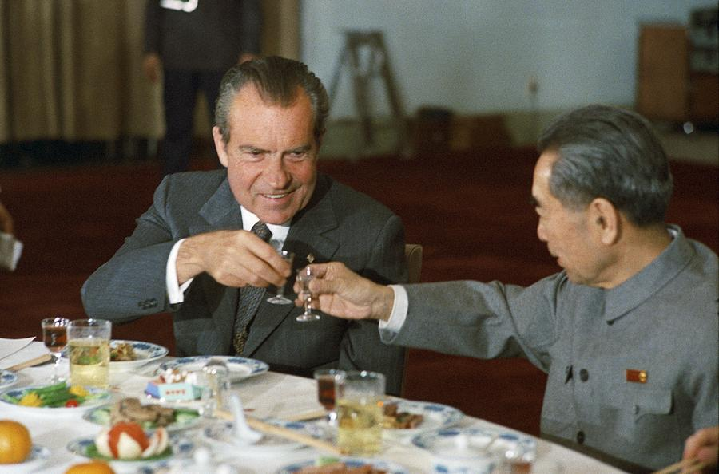
Foreign Policy
Henry Kissenger- Nixon’s secretary of state
Realpolitik- stop trying to take on every problem.
Ignore the small countries and focus on the big ones (end of containment)
Try to avoid another Vietnam
Détente-Trying to ease tensions with the Soviet Union
Nixon visits China previous presidents refused to recognize the communists as the legitimate government there
Salt I- the 1st agreement with the Soviets to begin to limit nuclear weapons

Slide 4
Stagflation
Since WWII our economy had been fairly strong in the late 60s and early 70s inflation and unemployment both go up= STAGFLATION
The economic troubles affect our ability to:
Spend on Vietnam
Continue to go to the Moon
Spend on many of the great society programs

Slide 5
Environmental Movement
Silent spring- book written by Rachael Carson exposing the effects of pesticides on the environment.
1st Earth Day- April 22nd 1970
Environmental Protection Agency (EPA)- created to regulated pollution caused by industry and private citizens

Slide 6
Watergate
A really small event with big consequences
A group of Nixon supporters break into the democratic headquarters located at the Watergate building in D.C.
Absolutely nothing is accomplished by this Nixon was going to win big in 72 anyway
The scandal comes from the cover-up
the president and other top officials attempt to obstruct the investigation of the robbery
Nixon actually records many of his conversations proving that he did know about and covered-up the crime

Slide 7
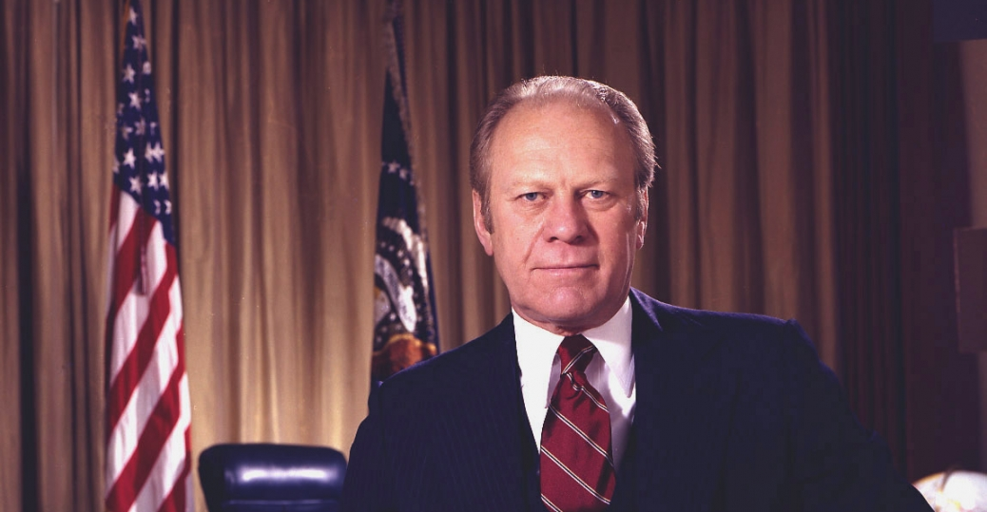
Ford
Our only unelected president

Slide 8
Pardoning of Nixon
Nixon is forced to resign the only president to ever do that
The Vice president (Spiro Agnew) had already resigned
Ford was appointed from the House of Reps to VP and then he became president
The only president to never win an electoral vote
His first act is to grant Nixon a presidential pardon
Americans are angry they think it was arranged before Nixon left office
This ends any chance Ford has of being elected or getting anything passed

Slide 9
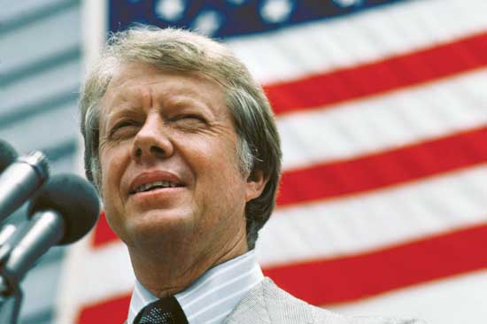
Jimmy Carter
Nice guys finish last

Slide 10
Middle East Success
The Camp David Accords
Fighting between Muslims and Jews in Israel had been going on since the end of WWII
Many people and groups had tried to get them to make some kind of peace agreement but both sides refused to even talk to one another
During secret meeting as the Presidents vacation home the first ever peace agreement between the two sides is signed
It was a huge symbol but accomplished very little

Slide 11
Middle East Failures
Oil/Gas Shortages
OPEC- Organization of the Petroleum Exporting Countries
These countries are Muslim and they did not like our military support of Israel
They issue and Embargo (refusal to sell) of oil against the US and our allies
Prices quadruple
The economy drops severely

Slide 12
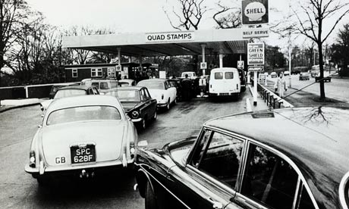
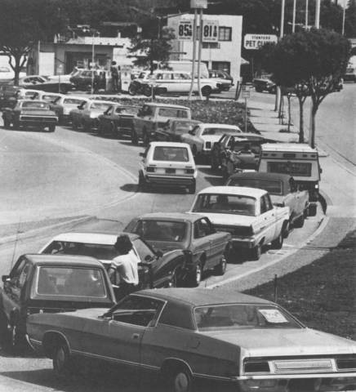
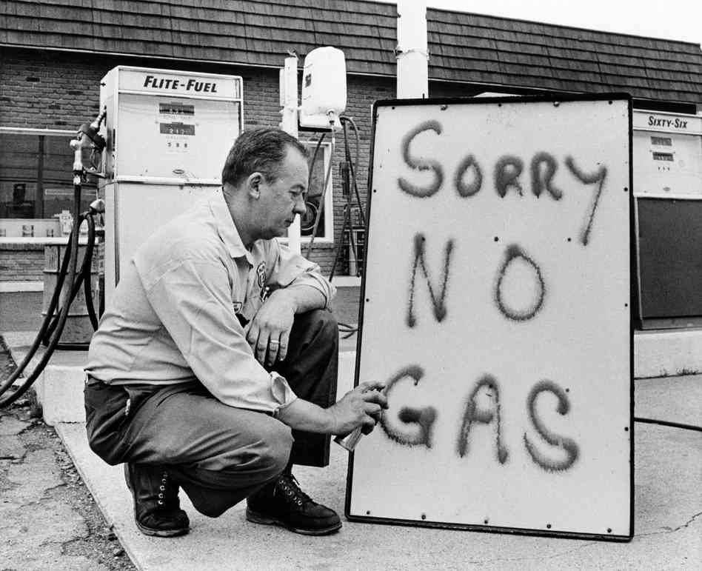
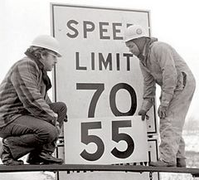

Slide 13
Middle East Failures
Iranian Hostage Situation
Muslim Fundamentalists lead and revolt and take over Iran
A group of Iranian revolutionaries seize the US Embassy in Iran
Fifty-two American diplomats and citizens were held hostage for 444 days
This is the #1 news story for over a year
Carter tries to negotiate their release several times but is unsuccessful
Because of this and the Oil crisis many Americans think Carter is not tough enough
The hostages are released the day Ronald Reagan is inaugurated as president

Slide 14
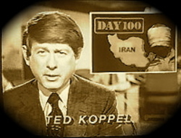
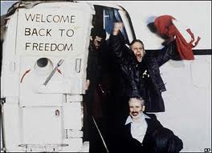
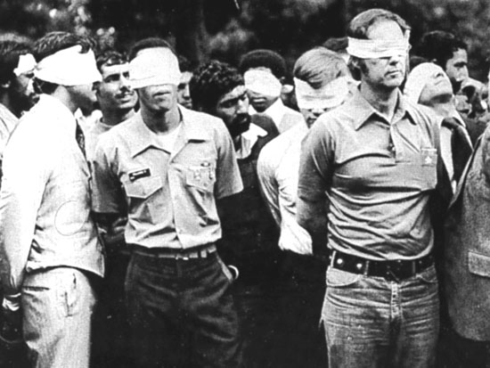
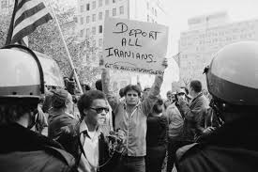

Slide 15
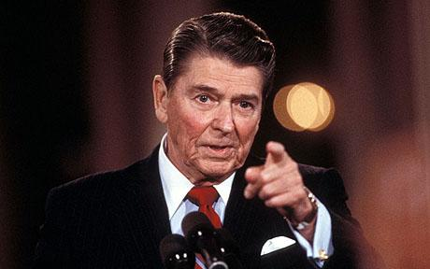
Ronald Reagan
$$$$$$$$$$$$$$$$$$$$$$$$$$$$$$$

Slide 16
Differences in Party Ideology see page 252
Liberals
More disposed to government spending.
Try to advance social welfare
Use government to promote equality
Conservatives
Opposed to massive spending
Unless it is a project they consider important (defense)
Use government to promote social order

Slide 17
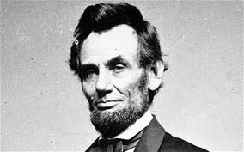
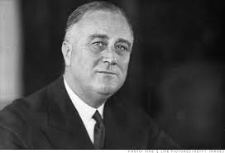
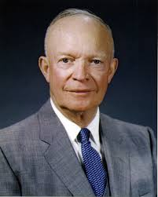
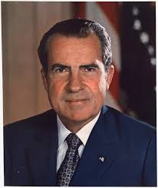
Liberal or Conservative

Slide 18
“Reaganomics”
Supply side economic theory- cutting taxes creates wealth by encouraging spending and economic growth.
Cut taxes on corporations and they can hire more people, lower taxes on people and they will spend more, giving more money to stores who hire more people, who spend more money creating more wealth for business who hire more people, etc.
Deregulation- removed many restrictions and controls government had over business a move back towards laissez faire

Slide 19
Deficit Spending
Not the first or the last president to do this
We spend massive amounts of money on space travel and defense
In the end this is what ends the cold war, they can compete with our spending
After years of trying to contain communism we defeated it by spending them into poverty

Slide 20
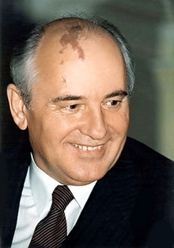
End of the Cold War
Reagan was seen as being very though on the cold war
Mikhail Gorbachev- the leader of the Soviet Union
They begin a dialogue that leads to the end of the cold war
Glasnost- the Russian word for openness
Perestroika- a restructuring of the Soviet Union

Slide 21
