Slide 1
North vs. South
Not Just Slavery

Slide 2
Key Terms
By the end of this lesson you should be able to define the following terms:
Popular Sovereignty
Manufactured Goods
Agrarian

Slide 3
North vs. South
North
South
Industrial Economy
Manufacturing
Shipping
Unitarian/Transcendentalism
Public schools
Girls educated (eventually)
Mostly Free
Agrarian Economy
Raw materials
Dependant on the North
Religious Fundamentalism
Lacked public education
Girls seldom educated
Slaves

Slide 4
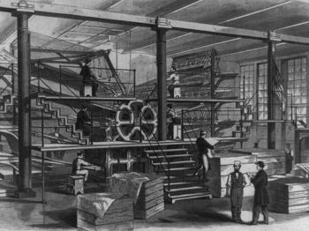
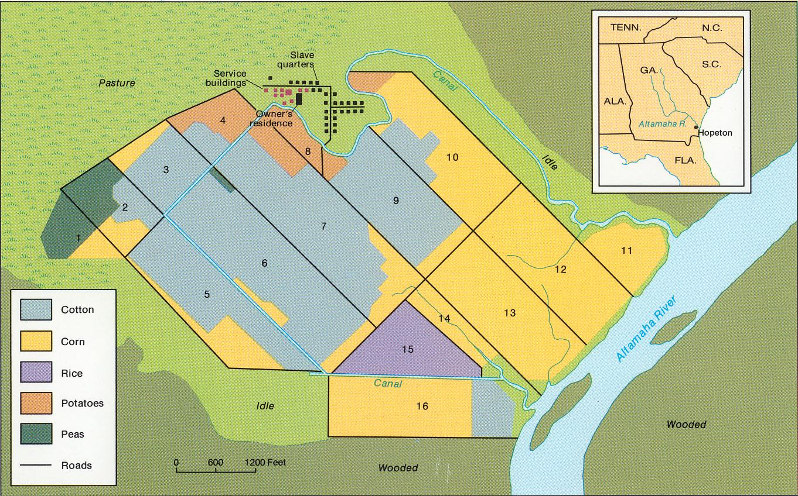
North vs. South
Northern Economy
Southern Economy

Slide 5
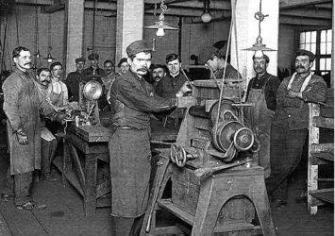
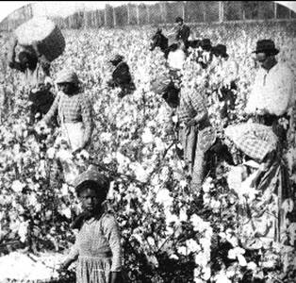
North vs. South
Northern Workers
Southern “Workers”

Slide 6
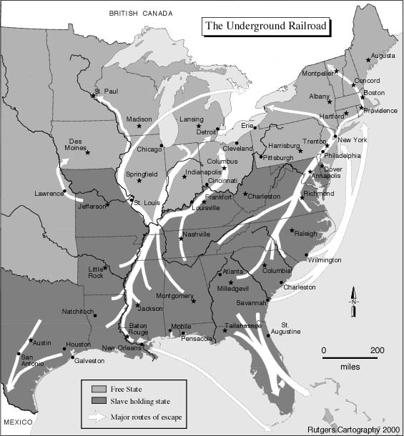
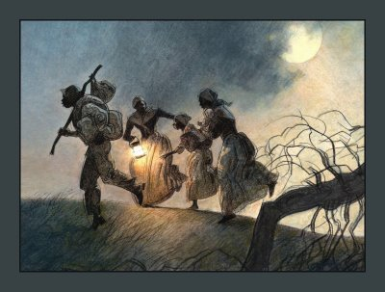
Not really underground, not really a railroad
Harriet Tubman

Slide 7
Missouri Compromise 1820
Establishes the lines between slave and free states
Designates what territories will be open to slavery and what territories will be closed to slavery

Slide 8
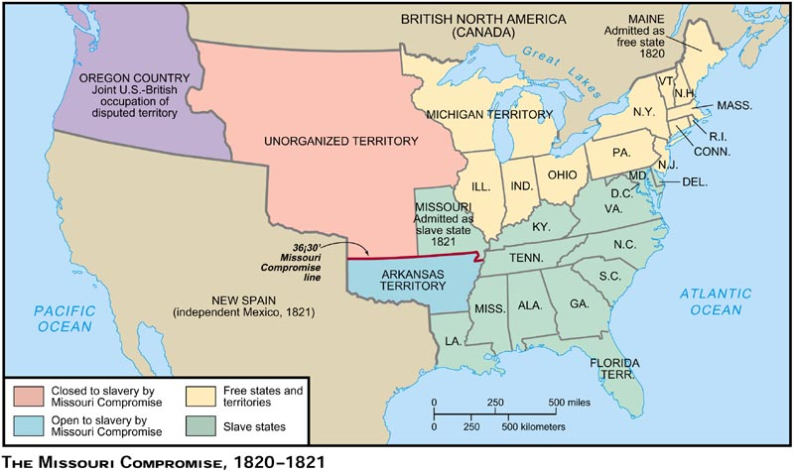
Missouri Compromise 1820

Slide 9
Compromise of 1850
Who got what?
What did the Fugitive Slave Act do?

Slide 10
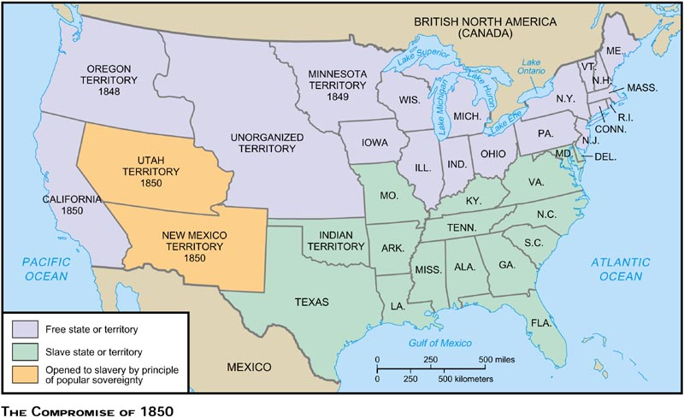
Compromise of 1850

Slide 11
Kansas Nebraska Act 1854
How did it change the boundaries of slavery?
Who were the “Border Ruffians”?
What is popular sovereignty?

Slide 12
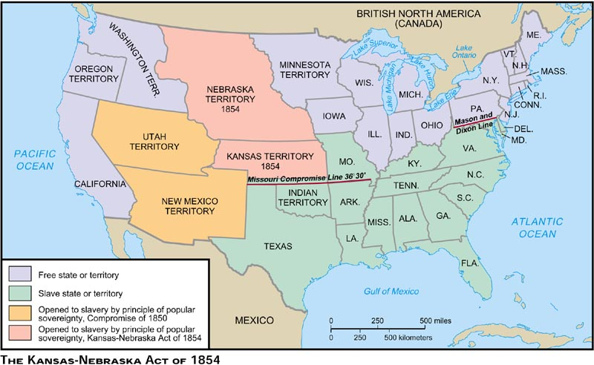
Kansas Nebraska Act 1854

Slide 13
Political Conflicts
Democrats- pro-slavery & popular sovereignty
Whigs- split over the issue of slavery
Republicans- start as an anti-slavery party
John Brown

Slide 14
Dred Scott Page 166
What was the case?
What was the decision?
What amendment was used to support the decision?

Slide 15
Dredd Scott Decision
A slave who sued for his freedom
Made it to the north and said he should no longer be a slave
His owner tires to take him back to the south
Takes his case to the supreme court
Court says you are a slave and YOU DON’T HAVE A RIGHT TO SUE IN COURT!!!!!!!!! YOU ARE PROPERTY!!!!!!!!!

Slide 16
Lincoln
Every body loved him, right?
conflict in the states

Slide 17
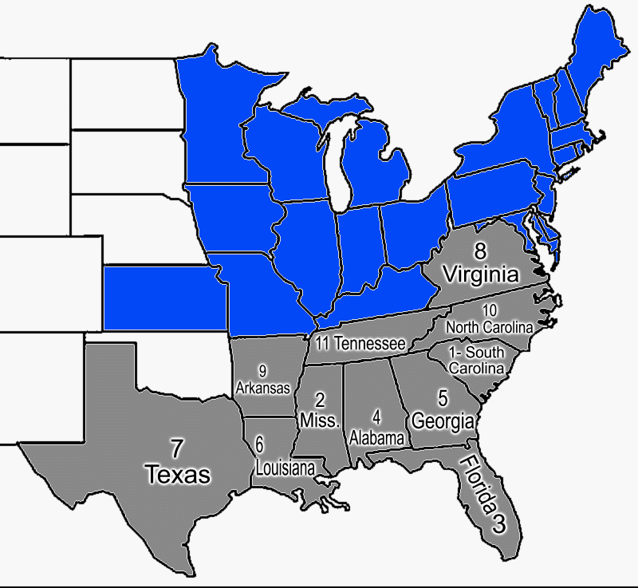
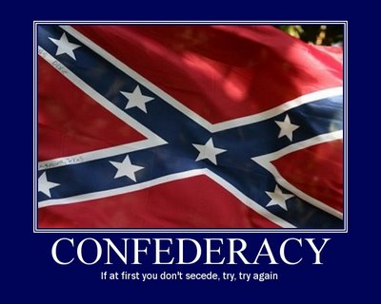
Secession

Slide 18
Timeline
Place the following events on your time line:
Southern Secession
Lincoln is elected
Harpers Ferry
Provide a short description of each event

