Slide 1
North vs. South
Not Just Slavery

Slide 2
Key Terms
By the end of this lesson you should be able to define the following terms:
Popular Sovereignty
Manufactured Goods
Agrarian

Slide 3
North vs. South
North
South
Industrial Economy
Manufacturing
Shipping
Unitarian/Transcendentalism
Public schools
Girls educated (eventually)
Mostly Free
Agrarian Economy
Raw materials
Dependant on the North
Religious Fundamentalism
Lacked public education
Girls seldom educated
Slaves

Slide 4
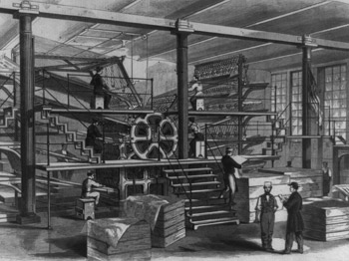
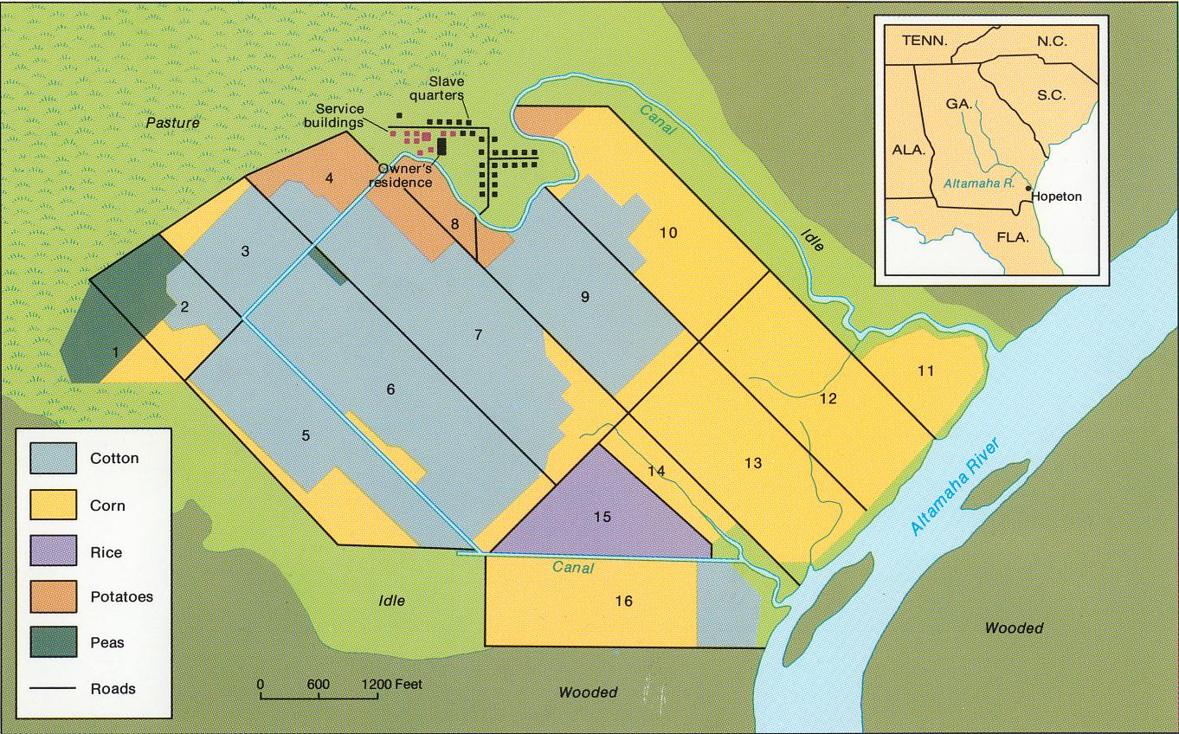
North vs. South
Northern Economy
Southern Economy

Slide 5
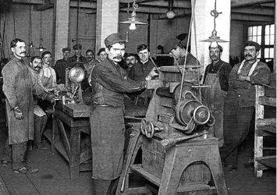
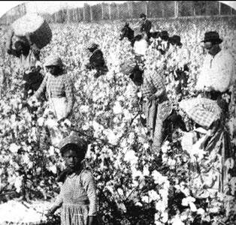
North vs. South
Northern Workers
Southern “Workers”

Slide 6
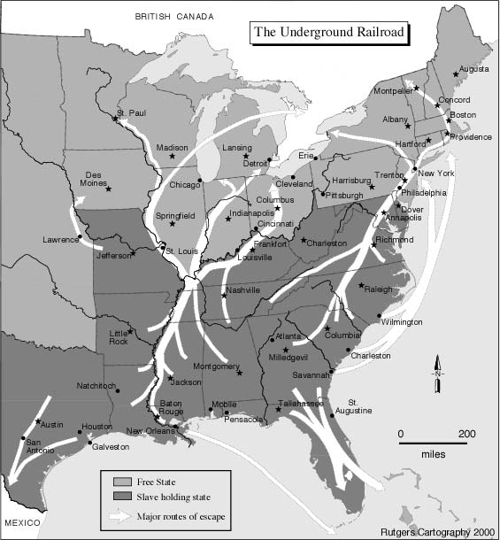
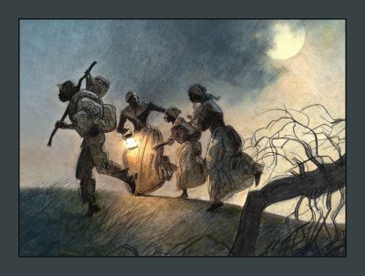
Not really underground, not really a railroad
Harriet Tubman

Slide 7
Fugitive Slave Laws
passed by the United States Congress in 1850 to provide for the return of slaves who escaped from one state into another state or territory.
Many blacks were sent back to the south as runaway slaves. Some were never even slaves before.
Northern lawyers get very good a dragging these cases out as long as possible.

Slide 8
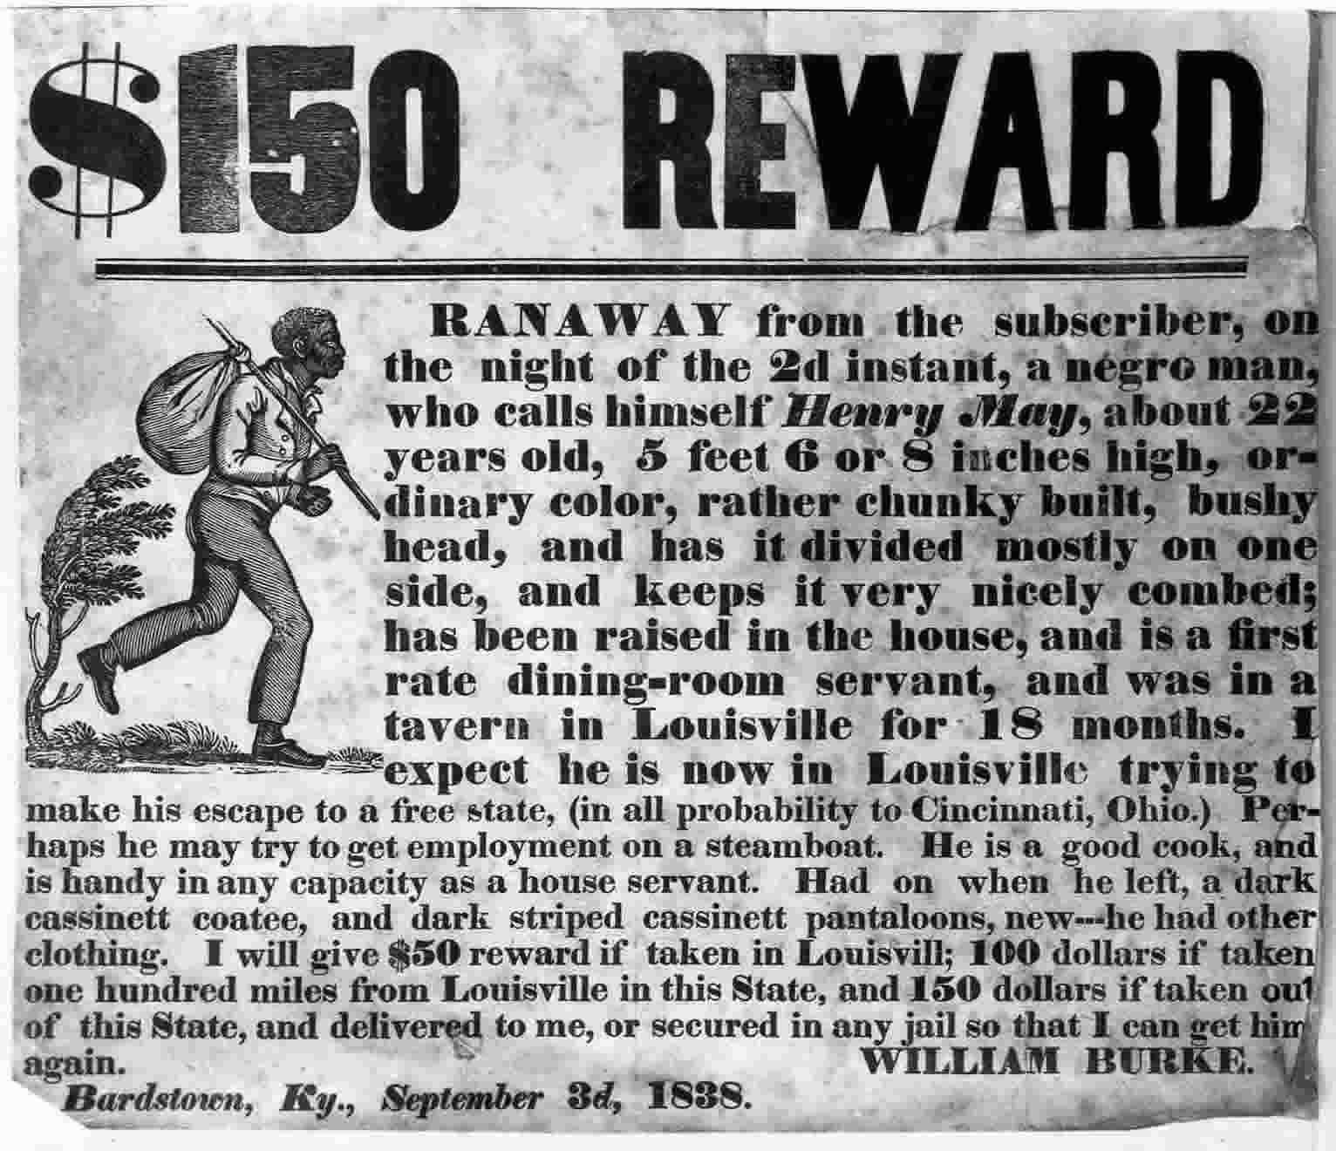

Slide 9
Remember this?

Slide 10
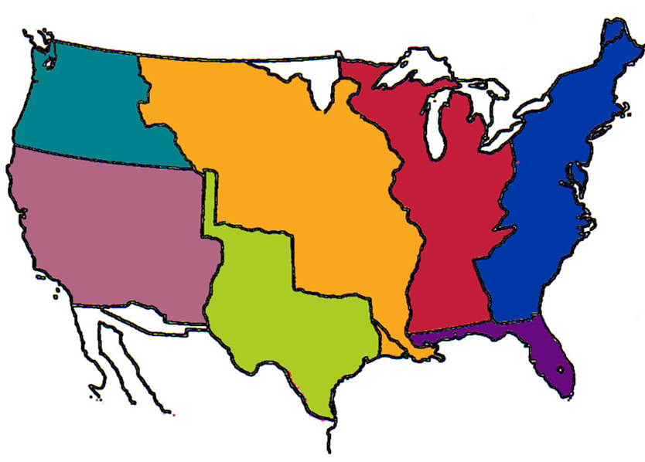
Slave or Free
Once we start to cut these big chunks of land into states what will the rules be?

Slide 11
Missouri Compromise 1820
Establishes the lines between slave and free states
Designates what territories will be open to slavery and what territories will be closed to slavery

Slide 12
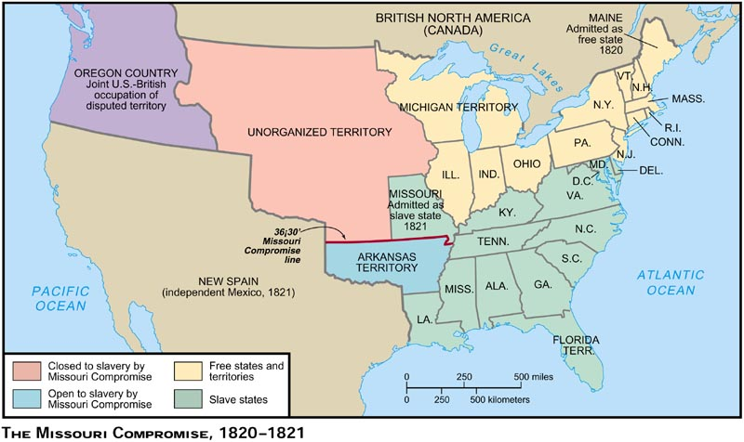
Missouri Compromise 1820

Slide 13
Compromise of 1850
In this compromise some areas were open to slavery and some were free.
The problem was California it was free but much of it is well south of the line established by the Missouri compromise
The arguments only got worse

Slide 14
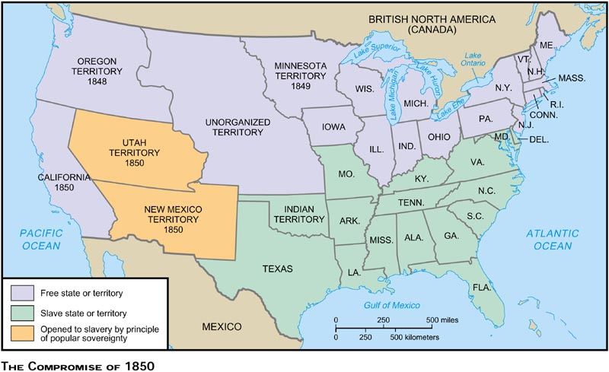
Compromise of 1850

Slide 15
Kansas Nebraska Act 1854
Open the Territories to Popular Sovereignty
Now the people in the states get to choose not congress

Slide 16
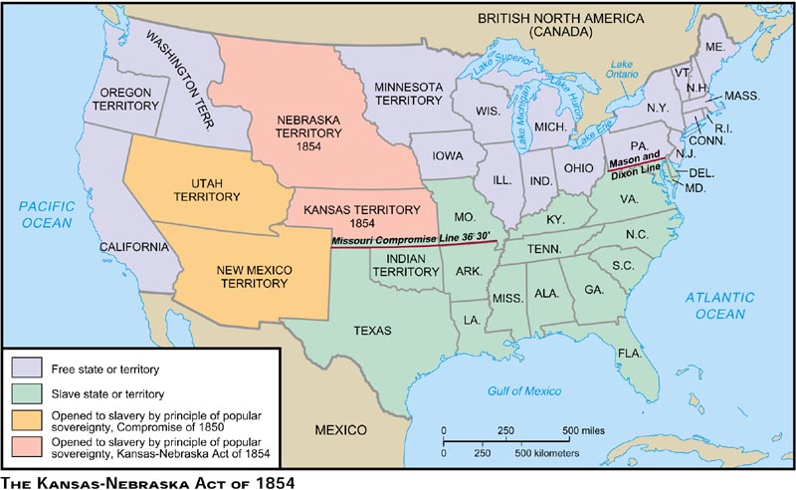
Kansas Nebraska Act 1854

Slide 17
Bleeding Kansas
Border Ruffians- people who rush to Kansas to influence the vote.
Some really wanted slavery or freedom others just like the violence
“pro slave” and “free towns” spring up on the borders
Often in attacks entire towns are destroyed

Slide 18
Political Conflicts
Democrats- pro-slavery & popular sovereignty
Whigs- split over the issue of slavery
Republicans- start as an anti-slavery party
John Brown

Slide 19
Dred Scott Page 166
What was the case?
What was the decision?
What amendment was used to support the decision?

Slide 20
Dredd Scott Decision
A slave who sued for his freedom
Made it to the north and said he should no longer be a slave
His owner tries to take him back to the south
Takes his case to the supreme court
Court says you are a slave and YOU DON’T HAVE A RIGHT TO SUE IN COURT!!!!!!!!! YOU ARE PROPERTY!!!!!!!!!
Says Congress does not have the authority to make a decision on slavery in the new states & territories

Slide 21
Lincoln
Every body loved him, right?
conflict in the states

Slide 22
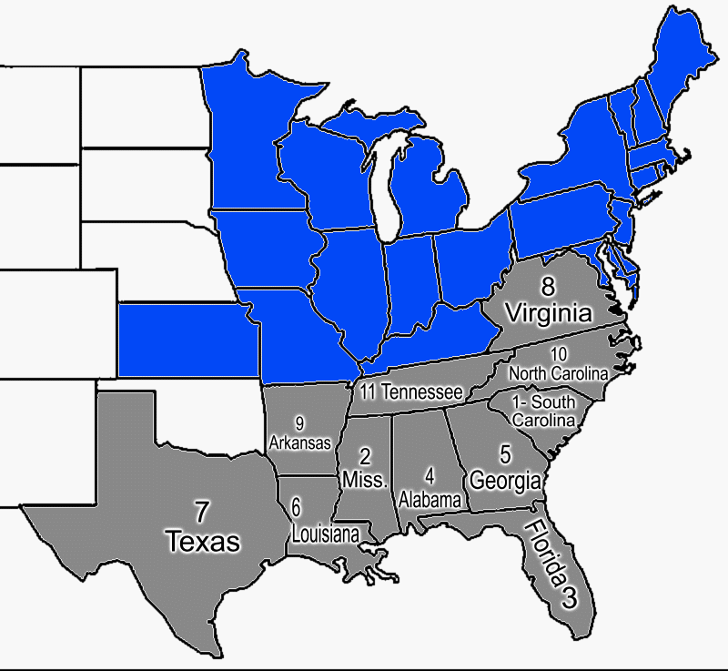
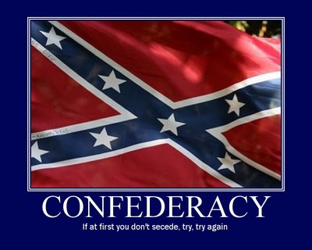
Secession

Slide 23
Timeline
Place the following events on your time line:
Southern Secession
Lincoln is elected
Harpers Ferry
Provide a short description of each event

