Slide 1
Let’s see your cell phones.
But Equal???

Slide 2
Apple or Other

Slide 3
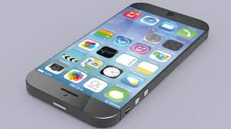
Attention: New Apple Class Rule
Apple devices are inherently better devices.
Those who own Apple tend to work harder and earn more $$$.
Therefore, Apple owners are now going to be given more opportunities .

Slide 4
Do you favor this rule?
Why or why not?
How would you support your view citing the Constitution?

Slide 5
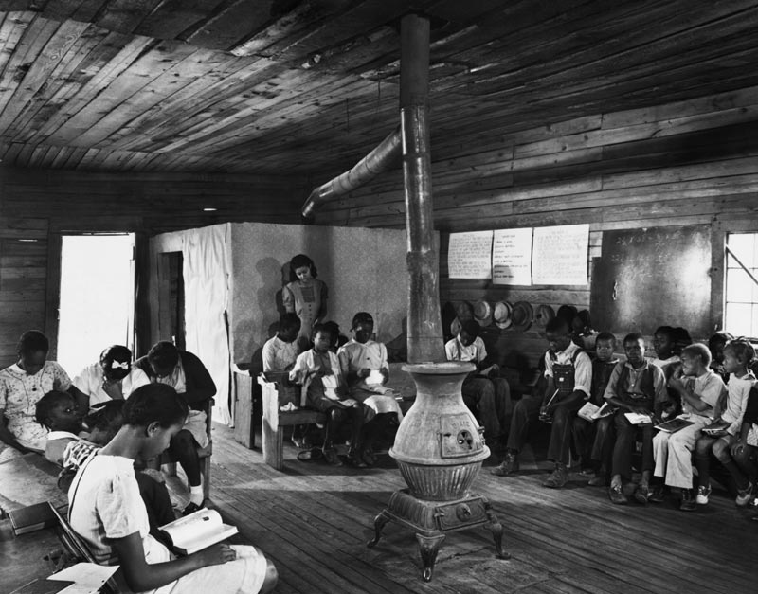
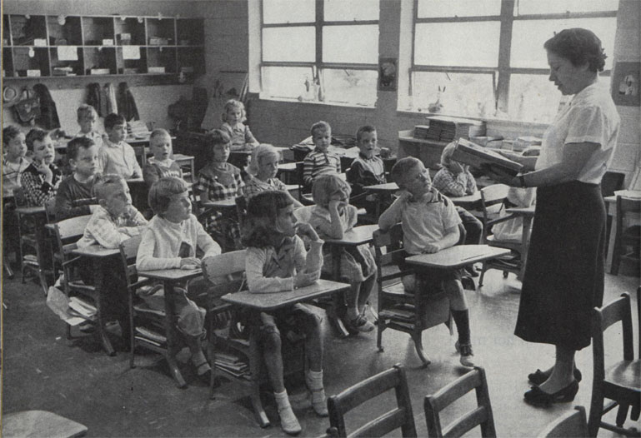
Plessy v. Ferguson
Separate!!!
But Equal???

Slide 6
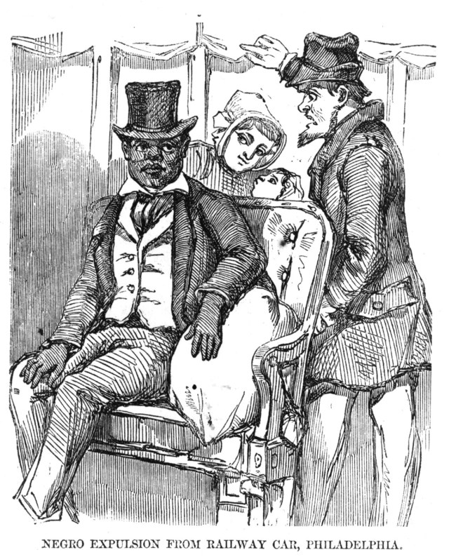
What happened?
The year is 1896
South has “Black Codes” & segregation
Louisiana forbids blacks and whites from riding in the same railroad cars
Homer Plessy sits down in a “white” train car & gets arrested

Slide 7
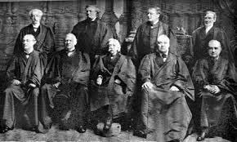
Is segregation legal?
What does the Supreme Court say to Homer Plessy?

Slide 8
Plessy v. Ferguson says Separate IS Equal
=
Segregation IS Constitutional

