Slide 1
Progressivism By President

Slide 2
Big Question
What did each President do to further the Progressive movement?

Slide 3
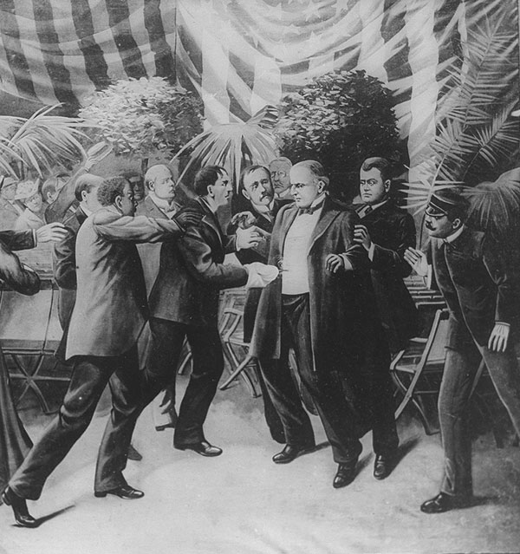
McKinley
Notes:
WJB
Populism done and over
McKinley Tariff - The tariff was detrimental to the American farmers. It drove up the prices of farm equipment (since wages and imported components were more expensive) and failed to halt sliding agricultural prices, possibly since there wasn't much competition with imported goods since American agricultural produce was already cheaper than imports. These price changes upset many rural voters, who voted many Republicans out of office in the next congressional elections (1890).[2] The following agrarian resentment would help give rise to the Free Silver movement and the Populist Party.
Assassination

Slide 4
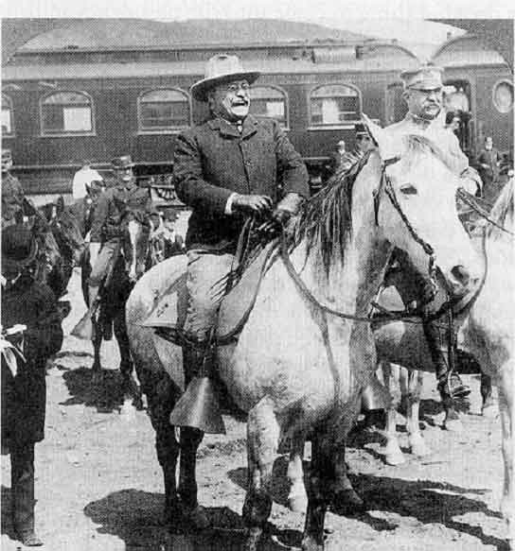
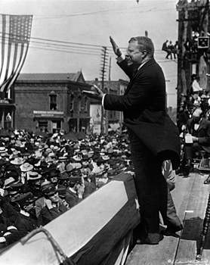
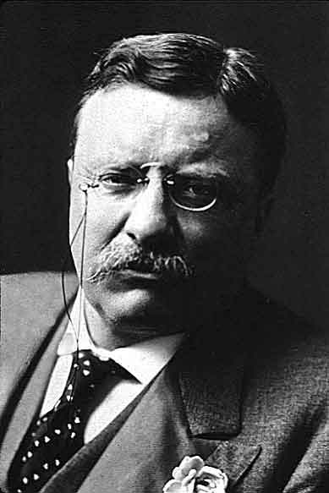
Theodore Roosevelt: the “accidental President”
Republican (1901-1909)
(The New-York Historical Society)
Notes:
“a visible president”
Bully Pulpit speech, Illinois
Powerful Speeches

Slide 5
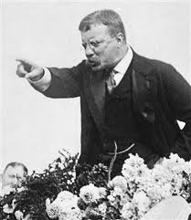
Enter Teddy Roosevelt
http://www.history.com/shows/men-who-built-america/videos/theodore-roosevelt-vs-big-industry?m=5189719baf036&s=All&f=1&free=false
Notes:
Background
- VP of McKinley, served in Spanish American War; Rough Riders; differed from McKinley in a few major issues

Slide 6
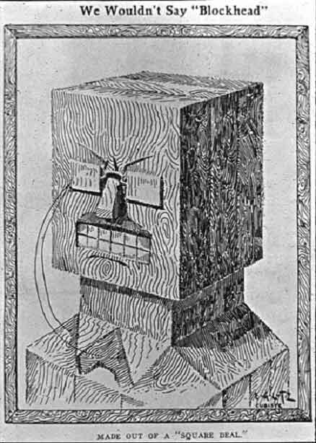
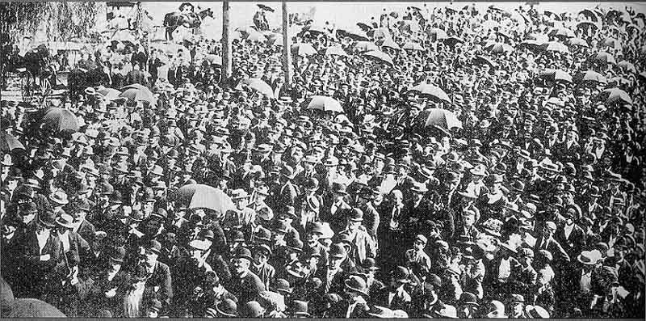
Roosevelt’s “Square Deal”
1902 Anthracite Coal Miners Strike
“Square Deal”
Anthracite miners at Scranton, Pennsylvania, 1900
Notes:
Define Square Deal - plan targeted trust regulation, labor relations, and public health and conservation, the three most reform thirsty areas. His plan targeted the three C's, which were control of the corporations, consumer protection, and conservation of natural resources.
Tell story of Coal Miners Strike
The Anthracite Coal Strike in northeastern Pennsylvania had been going on for over four months with no signs of ending. President Theodore Roosevelt feared “untold misery…with the certainty of riots which might develop into social war.” He felt something must be done. But the federal government had no legal right to intervene in a dispute between capital and labor. With the price of coal skyrocketing to 20 dollars per ton— the equivalent of $12.93 per gallon of gas today—Roosevelt found himself in an impossible situation.
Roosevelt sent telegrams to the laborers and the operators to hold a meeting with him on October 3 in Washington.
“As long as there seemed to be a reasonable hope that these matters could be adjusted between the parties it did not seem proper to me to intervene in any way…but the urgency and the terrible nature of the catastrophe impending over a large portion of our people in the shape of a Winter fuel famine impel me…to believe that my duty requires me to use whatever influence I personally can to bring to an end [the] situation…I appeal to your patriotism, to the spirit that sinks personal considerations, and makes individual sacrifices for the greater good.”
Arbitration Committee – JP Morgan
Mine owners refused, TR threatened military seizure of mines; workers won nine-hour work days and 10% raise
Republican Party sentiment

Slide 7
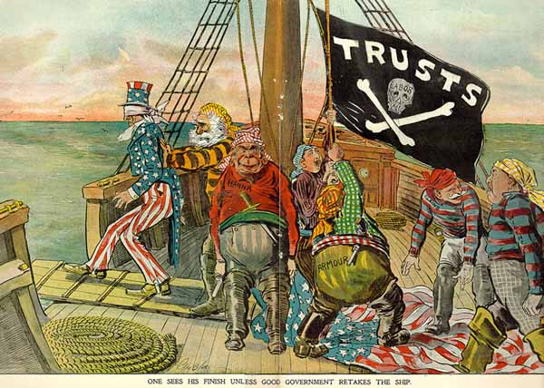
Roosevelt the “Trust-Buster”
Northern Securities Company (1904)
“good trusts” and “bad trusts”
Hepburn Railroad Regulation Act (1906)
“ONE SEES HIS FINISH UNLESS GOOD GOVERNMENT RETAKES THE SHIP”
Notes:
Good trusts vs. Bad trusts – myth is he busted all monopolies but only ones that were bad for consumers
NSC - Northern Securities Company railroad combination. Banker J. P. Morgan had created Northern Securities as a holding company; that is, it held the stock and the control over three large railroad lines in the West. The railroads of Northern Securities controlled most of the transportation lines between the Pacific Ocean and the Great Lakes, thus depriving western customers of the benefits of competition. The Supreme Court agreed with the government and ordered Northern Securities to be dissolved in 1904.
Hepburn Act - gave the Interstate Commerce Commission (ICC) the added regulatory authority to examine the account books of the powerful railroad companies

Slide 8
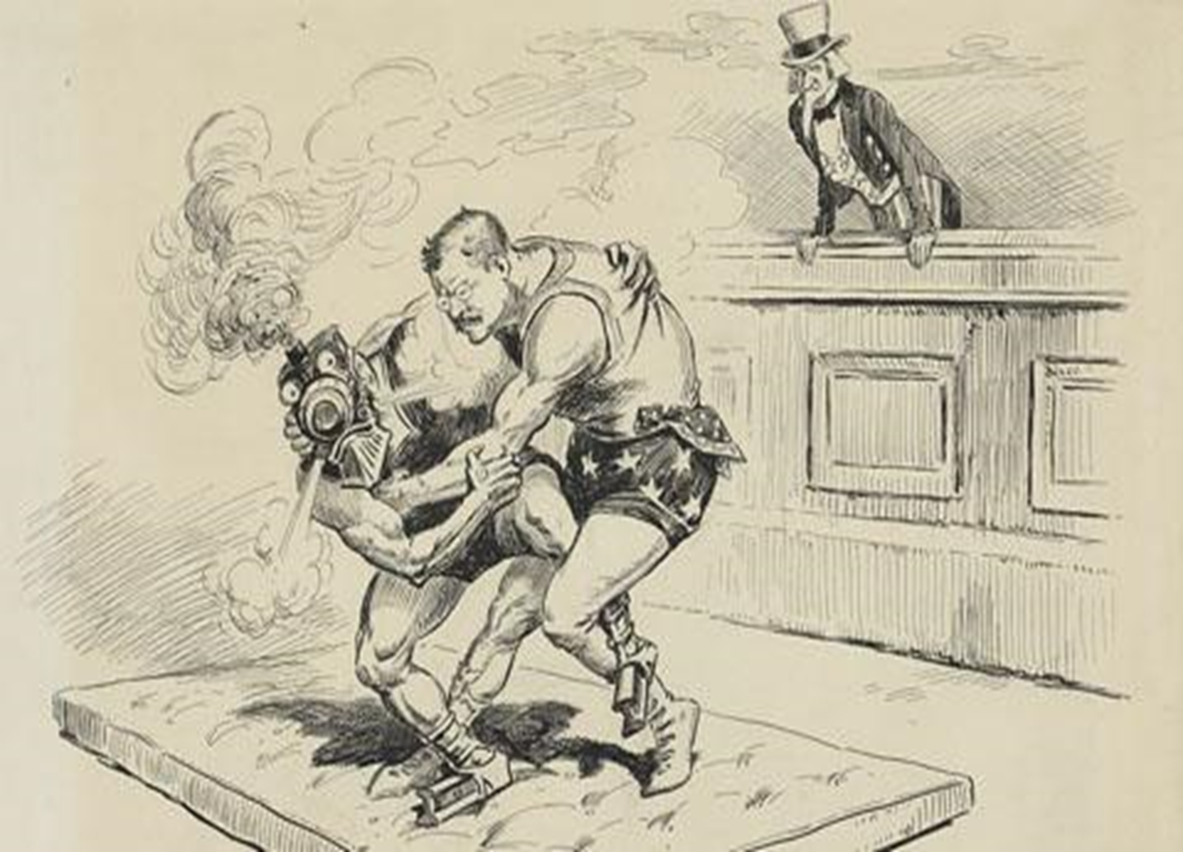
Political Cartoon #1

Slide 9
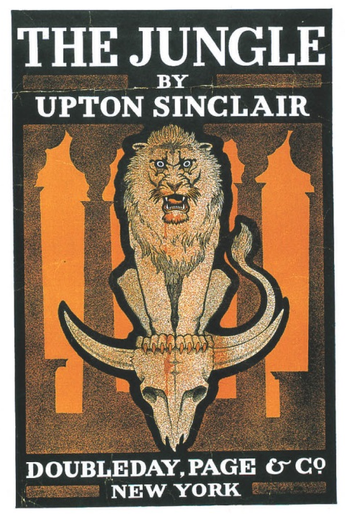
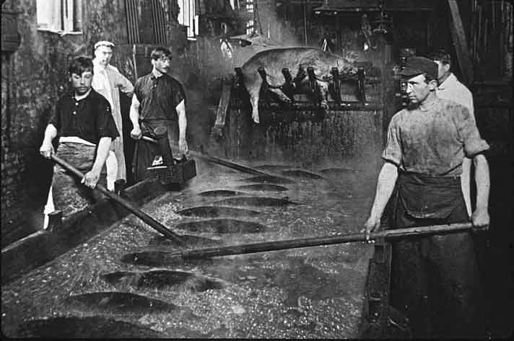
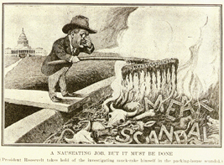
Consumer Protection
Remember The Jungle ???
Pure Food and Drug Act (1906)
Meat Inspection Act (1906)
Chicago Meatpacking Workers, 1905
"A nauseating job, but it must be done"
Notes:
Theodore Roosevelt cartoon "A nauseating job, but it must be done“;
Upton Sinclair's novel, The Jungle, published in 1906, prompted President Theodore Roosevelt to order an investigation of Sinclair's allegations about unsanitary practices.
Roosevelt then used the results of that investigation to pressure Congress into approving new federal legislation to inspect meatpacking.
Meat Inspection Act
Pure Food and Drug Act – drugs and labels

Slide 10
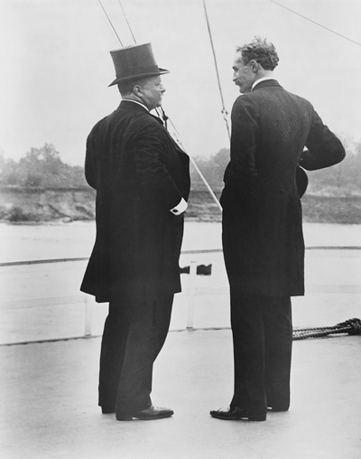
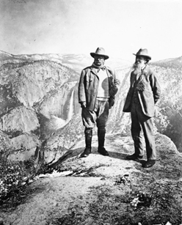
Roosevelt & Conservation
Used the Forest Reserve Act of 1891
U.S. Forest Service (1906)
Gifford Pinchot
White House conference on conservation -1908
John Muir
Theodore Roosevelt and Gifford Pinchot, 1907
Theodore Roosevelt & John Muir at Yosemite
1906
Notes:
Theodore Roosevelt and Gifford Pinchot, 1907; The two friends and allies in the conservation cause aboard the steamboat Mississippi on a 1907 tour
Sierra Club
Pinchot – TR’s forester
5 National Parks
148 million acres of National Forest
23 National Monuments
No private development on public land

Slide 11
CONSERVATION:
National Parks and Forests

Slide 12
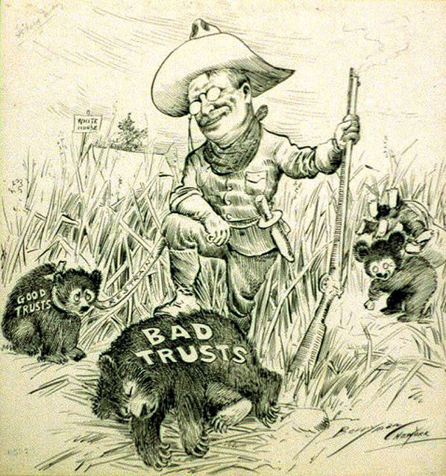
Political Cartoon #2

Slide 13
Enter Teddy Roosevelt
Summary of TR’s terms
  Regulation of Stock Market; Income Tax; Worker’s Compensation
  Financial crisis of 1907
  Handpicking of Taft

Slide 14
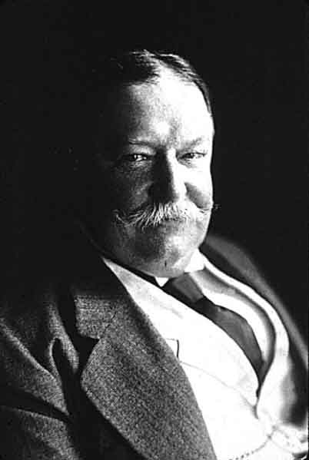
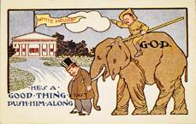
William Howard Taft
President 1909-13
Republican
Postcard with Taft cartoon
Notes:
This postcard depicts how President Theodore Roosevelt, in command of the Republican Party, persuaded his friend William Howard Taft to run for president in 1908. Taft was not eager for that office, but Roosevelt succeeded in convincing him to seek it. With Roosevelt's strong support, Taft was elected, but he proved a disappointment to Roosevelt. (Collection of Janice L. and David J. Frent)

Slide 15
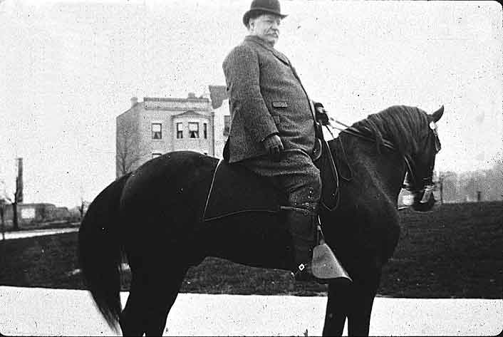
Taft’s Progressive Accomplishments
trust-busting
forest and oil reserves
Sixteenth Amendment
BUT: Caused split in Republican Party
  Payne-Aldrich Tariff (1909)
  Pinchot-Ballinger Controversy
(Taft has) “…completely twisted around the policies I advocated and acted upon.”
-Theodore Roosevelt
Notes:
Defeated WJB…again
Standard Oil (violated Sherman Antitrust Act)
US Steel
ICC Stronger; forms Dept. of Labor
16th Amendment – needed to help pay since lower tariffs on foreign goods, attempting to bring in more goods
Payne-Aldrich - didn't reduce tariffs as much as promised
Pinchot-Ballinger Debacle – Taft promised Ballinger some of the land that was supposed to be reserved and sold it back to private companies; this angered Pinchot and eventually TR

Slide 16
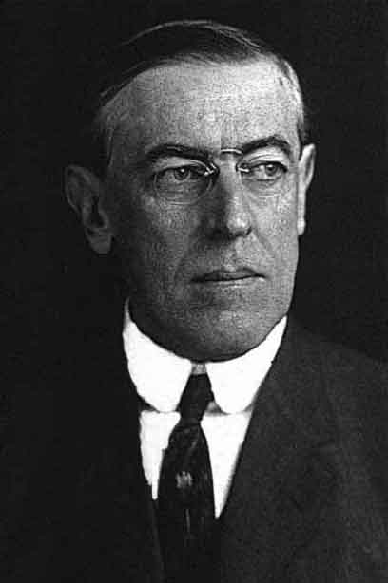
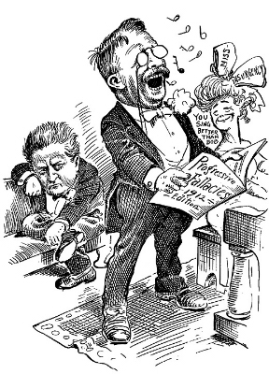
Election of 1912
Woodrow Wilson
Progressive Party (“Bull Moose party”)
“New Nationalism”
significance
Woodrow Wilson
Notes:
New Nationalism - The central issue he argued was government protection of human welfare and property rights, but he also argued that human welfare was more important than property rights. He insisted that only a powerful federal government could regulate the economy and guarantee social justice, and that a President can only succeed in making his economic agenda successful if he makes the protection of human welfare his highest priority. Roosevelt believed that the concentration in industry was a natural part of the economy. He wanted executive agencies (not the courts) to regulate business. The federal government should be used to protect the laboring men, women and children from exploitation. In terms of policy, Roosevelt's platform included a broad range of social and political reforms advocated by progressives
New Freedom – ne free enterprise? No freedom of sorts….
1. Tariff Reform: This came through the passage of the Underwood Tariff Act of 1913,which lowered tariffs for the first time since the American Civil War and went against the protectionist lobby.
2. Business Reform: This was established in 1914 through the passage of the Federal Trade Act, which established the Federal Trade Commission to investigate and halt unfair and illegal business practices by issuing "cease and desist" orders, and the Clayton Anti-Trust Act.
3. Banking Reform: This came in 1913, through the creation of the Federal Reserve System, and in 1916, through the passage of the Federal Farm Loan Act, which set up Farm Loan Banks to support farmers

Slide 17
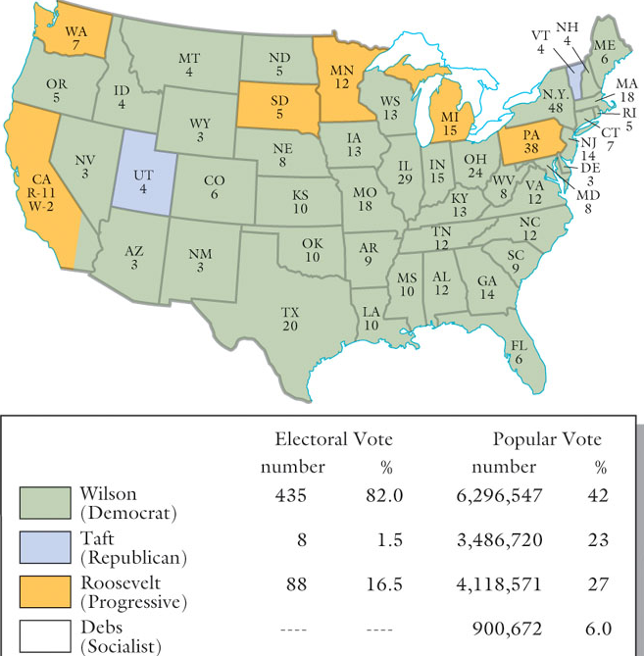
1912 Presidential Election
Notes:
Pol. Cartoon
Debs, TR, Taft, Wilson
Discussion of political parties and corruption of republicans (primaries)
Wilson Wins

Slide 18
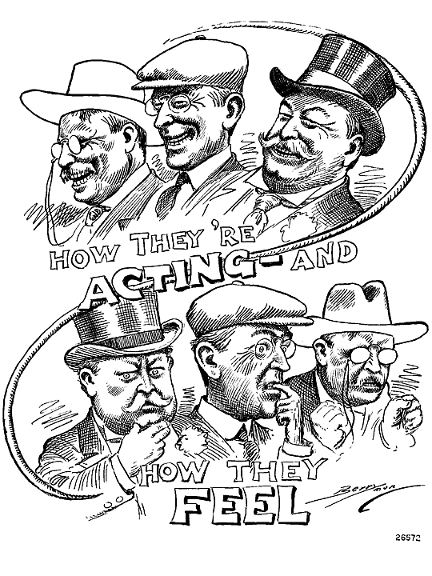
Political Cartoon #3

Slide 19
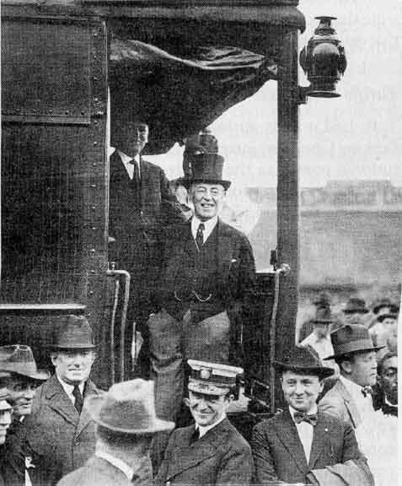
Wilson
Woodrow Wilson
“New Freedom”
Sixteenth Amendment (1913)
Federal Reserve Act (1913)
Federal Trade Commission Act (1914)
Clayton Anti-Trust Act (1914)
“Make the world safe for democracy.”

Slide 20
Wilson
Was he really a progressive?
Segregate
No Women’s Vote
Raised in VA as southerner

Slide 21
Big Question
What did each President do to further the Progressive movement?

