Slide 1
SECTionalism Review

Slide 2
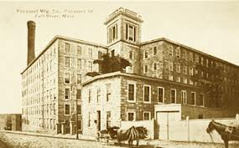
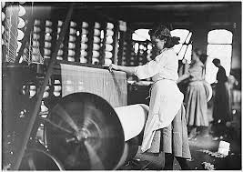
Market Revolution

Slide 3
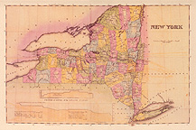
Market Revolution
Steamboats
Lake Erie

Slide 4
Market Revolution

Slide 5
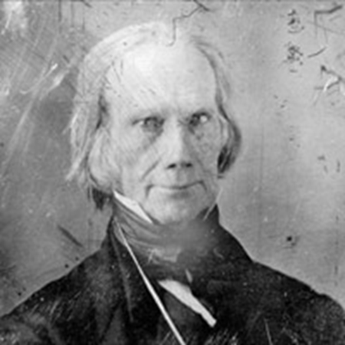
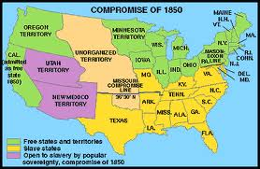
Tension Builds
Compromise of 1850

Slide 6
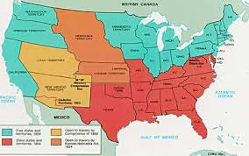
Tension Builds
Kansas – Nebraska Act

Slide 7
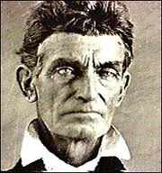
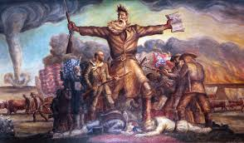
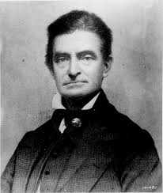
Tension Builds
Bleeding Kansas

Slide 8
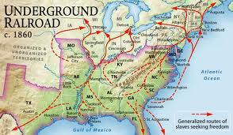
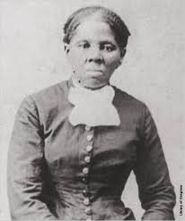
To Slave or Not to Slave????
Underground
Railroad

Slide 9
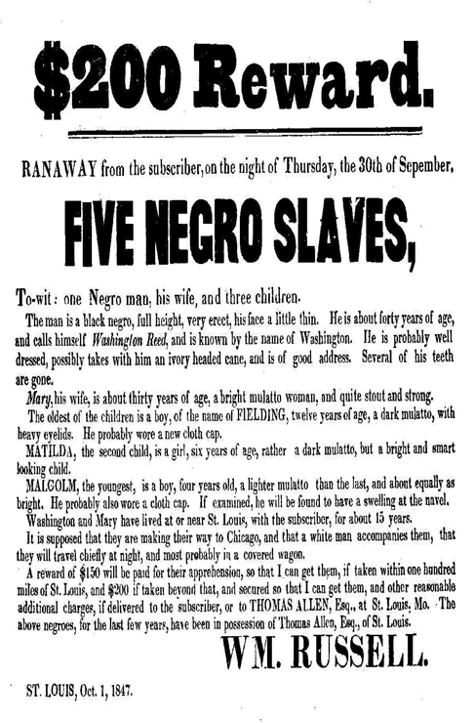
To Slave or Not to Slave????
Fugitive Slave
Act

Slide 10
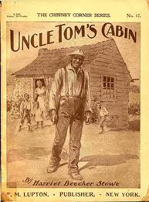
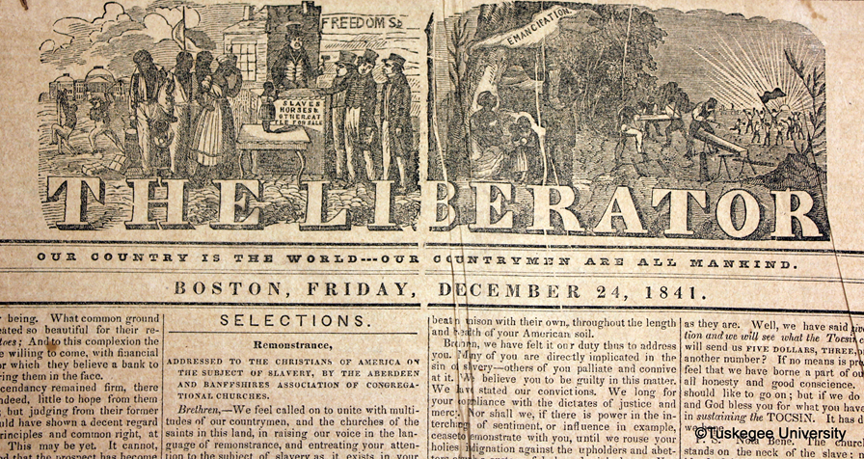
To Slave or Not to Slave????
Abolitionists

Slide 11
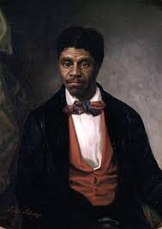
To Slave or Not to Slave????
Dred Scott v.
Sandford

