Slide 1
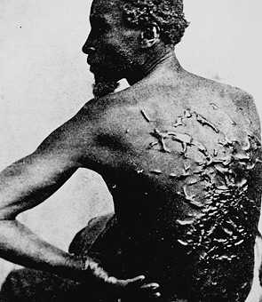
Briefly describe what you see in this photo. Then, discuss any emotions, thoughts or reactions you have upon seeing this image.

Slide 2
Slavery
The mistake we just kept making worse!

Slide 3
Slavery
How long has it been in existence?
Has it only effected Africa?
Is it still around?

Slide 4
Chances to eliminate slavery
Declaration of Independence
3/5 Compromise
Slave trade compromise (interstate commerce)

Slide 5
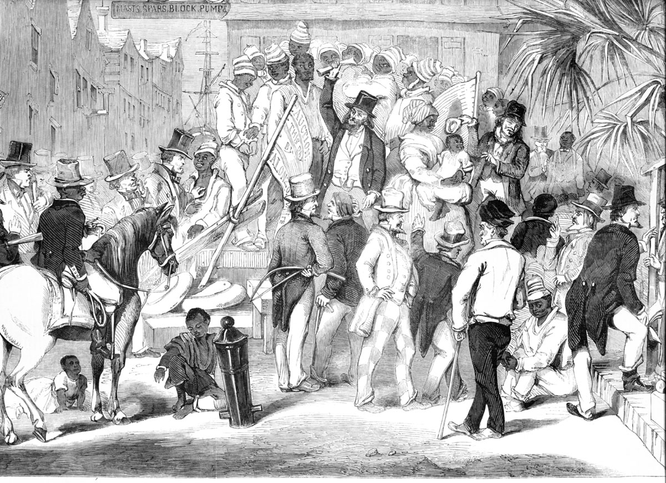
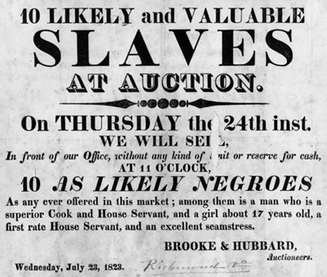
Slave Auction Notice, 1823

Slide 6
Slave Trade
Slavery had been around for centuries and it did not include just one race or ethnic group
Large plantations in the new world (particularly sugar) increased the need for labor
Europe, Africa and the Americas become connected by triangular trade

Slide 7
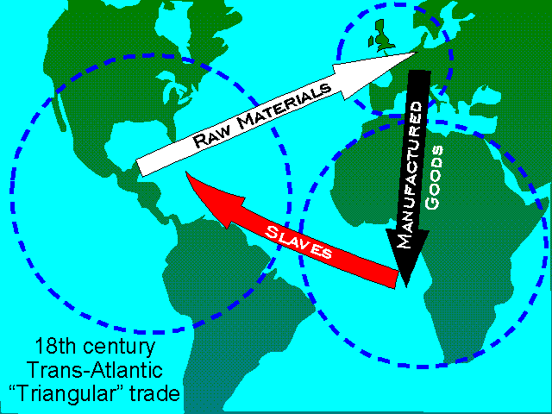
Triangular Trade “middle passage”

Slide 8
Sources of Slavery
African wars create slaves
European demand actually increase the wars (sometimes the war was just to take slaves)
To Africans and Europeans it was a question of commerce $$$$$$$$$$$$$$$$$$$$$$$$$$$$

Slide 9
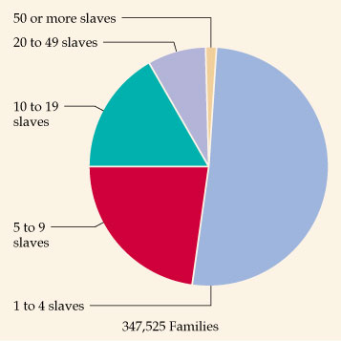
Slave-Owning Population (1850)

Slide 10
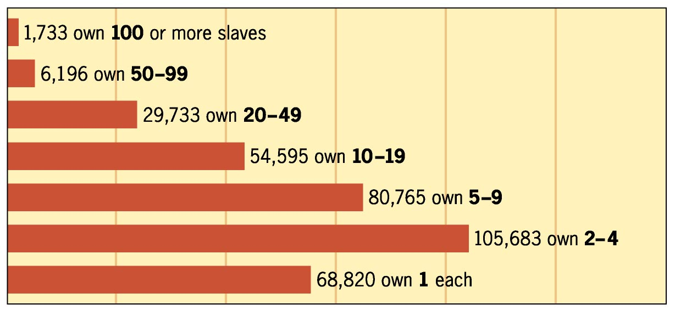
Slave-Owning Families (1850)

Slide 11
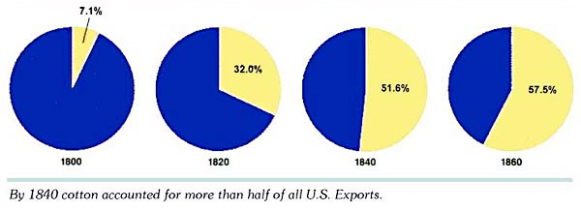
Value of Cotton Exports As % of All US Exports

Slide 12
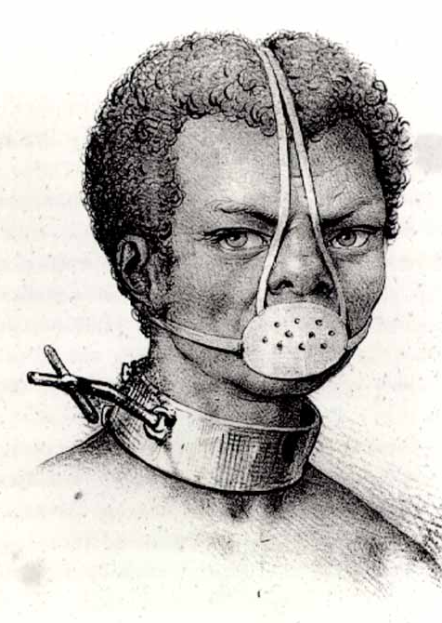
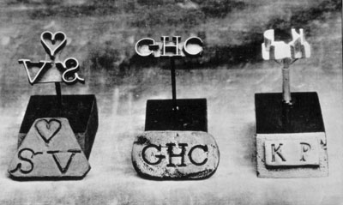
Slave Accoutrements
Slave Master Brands
Slave muzzle

Slide 13
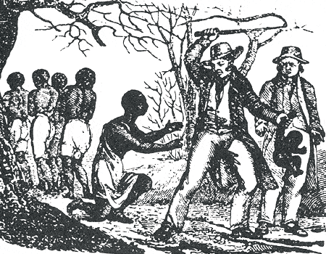

Slide 14
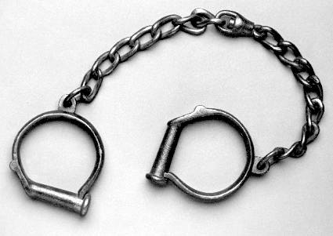
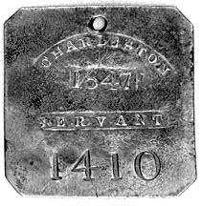
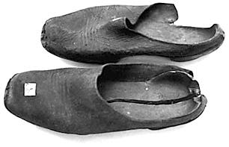
Slave Accoutrements
Slave leg irons
Slave tag, SC
Slave shoes

Slide 16
Your Thoughts
You are an African who has been captured and sold into slavery. You are to write a letter home to your family which gives details of your:
Capture
Voyage (middle passage)
New “home” in America
5 paragraph minimum

Slide 17
Why was it so hard for America to do away with slavery?

Slide 18
Slave
Resistance
&
Uprisings

Slide 19
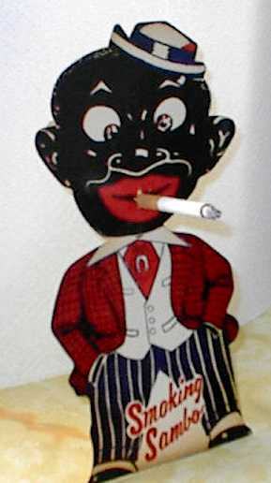
Slave Resistance
“SAMBO” pattern of behavior used as a charade in front of whites [the innocent, laughing black man caricature – bulging eyes, thick lips, big smile, etc.].

Slide 20
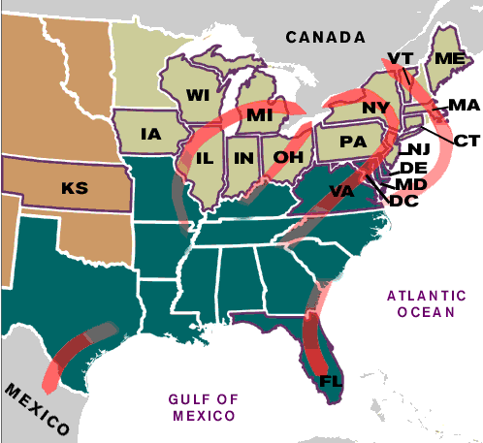
Slave Resistance
Refusal to work hard.
Isolated acts of sabotage.
Escape via the Underground Railroad.

Slide 21
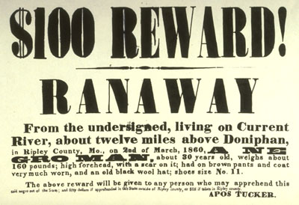
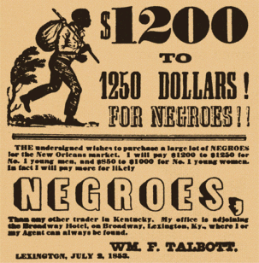
Runaway Slave Ads

Slide 22
Quilt Patterns as Secret Messages
The Monkey Wrench pattern, on the left, alerted escapees to gather up tools and prepare to flee; the Drunkard Path design, on the right, warned escapees not to follow a straight route.

Slide 23
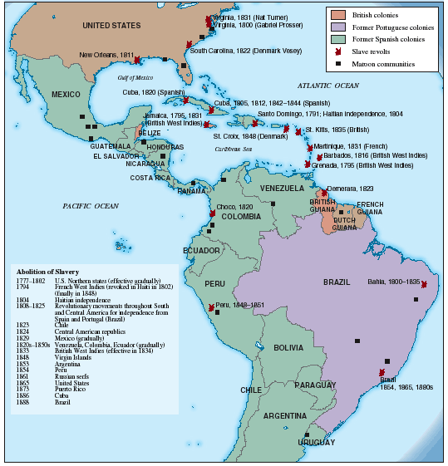
Slave Rebellions Throughout the Americas

Slide 24
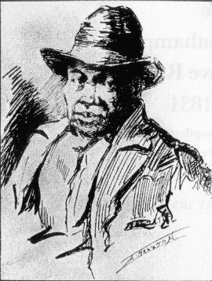
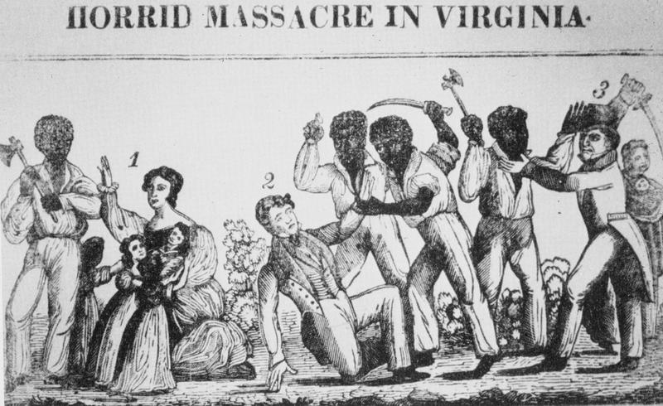
Slave Rebellions in the Antebellum South: Nat Turner, 1831

Slide 25
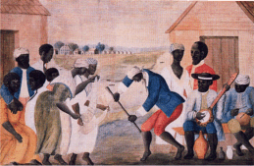
The Culture of Slavery
Black Christianity [Baptists or Methodists]: * more emotional worship services. * negro spirituals.
“Pidgin” or Gullah languages.
Nuclear family with extended kin links, where possible.
Importance of music in their lives. [esp. spirituals].

Slide 26
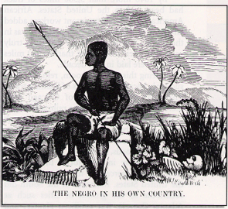
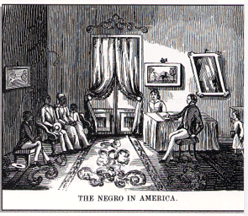
Southern Pro-Slavery Propaganda

Slide 27
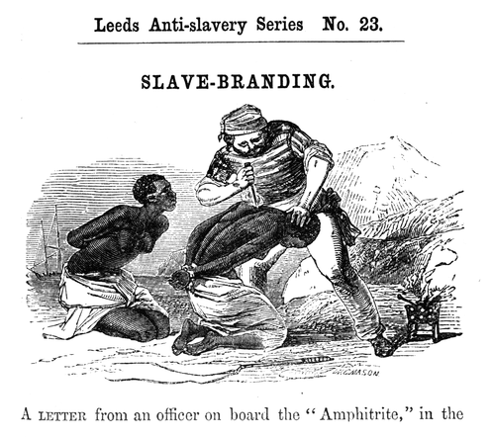
Anti-Slave Pamphlet

Slide 28
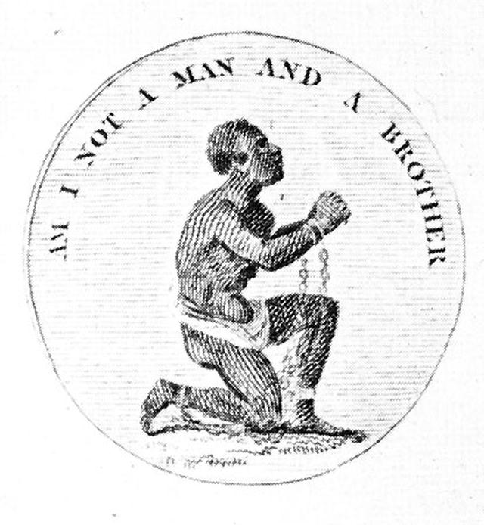
9. Abolitionist Movement
1816 → American Colonization Society created (gradual, voluntary emancipation.
British Colonization Society symbol

Slide 29
Abolitionist Movement
Create a free slave state in Liberia, West Africa.
No real anti-slavery sentiment in the North in the 1820s & 1830s.
Gradualists
Immediatists

Slide 30
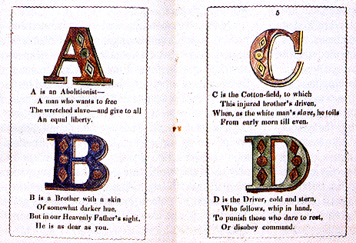
Anti-Slavery Alphabet

Slide 31
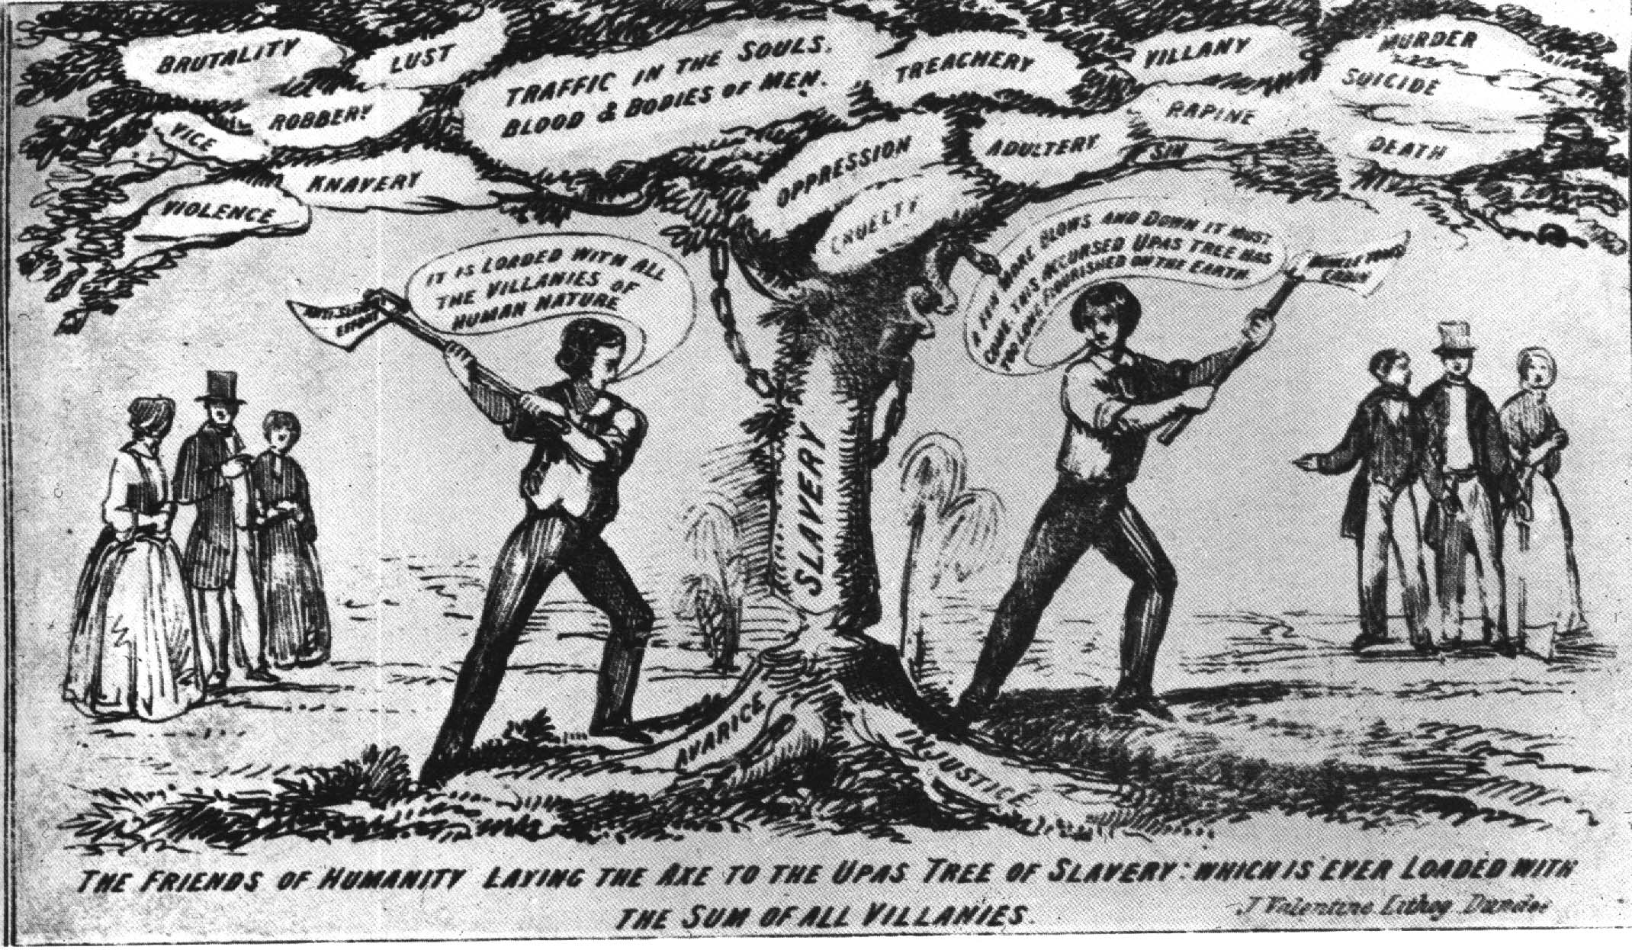
The Tree of Slavery—Loaded with the Sum of All Villanies!

Slide 32
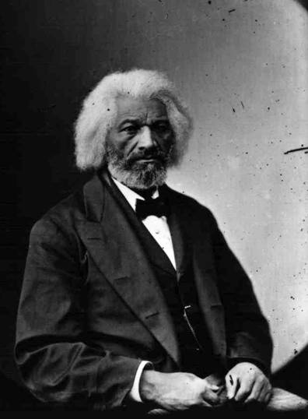
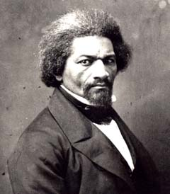
Frederick Douglass (1817-1895)
1845 → The Narrative of the Life Of Frederick Douglass
1847 → “The North Star”
R2-12

Slide 33
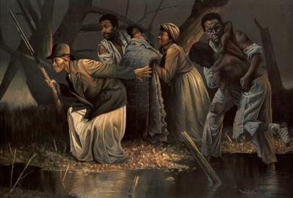
Leading Escaping Slaves Along the Underground Railroad

Slide 34
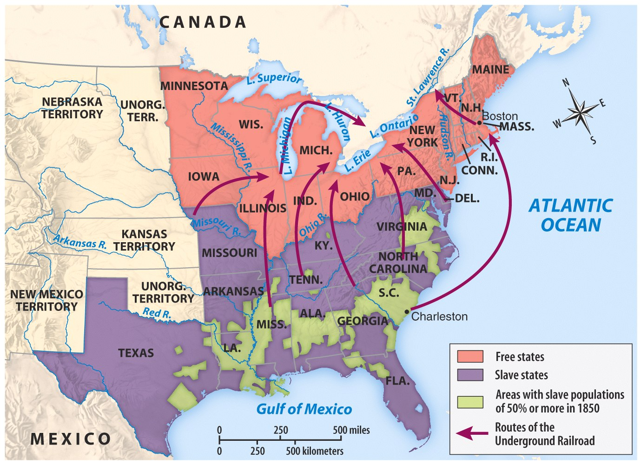
The Underground Railroad

Slide 35
The Underground Railroad
“Conductor” ==== leader of the escape
“Passengers” ==== escaping slaves
“Tracks” ==== routes
“Trains” ==== farm wagons transporting the escaping slaves
“Depots” ==== safe houses to rest/sleep

