Slide 1
Slavery Rebellions
Timeline

Slide 2
1831 (-1862) 1838 1839 1849 1857
Nat Turner’s Revolt
Underground Railroad Begins
Frederick Douglas Escapes
Amistad Mutiny
Harriet Tubman Escapes
Dredd Scott
Vs
Sanford

Slide 3
1859
Harpers
Ferry

Slide 4
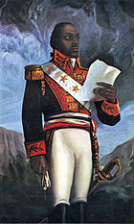

Slide 5
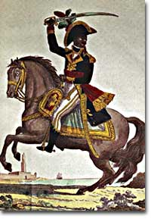

Slide 6
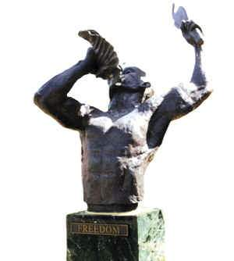

Slide 8
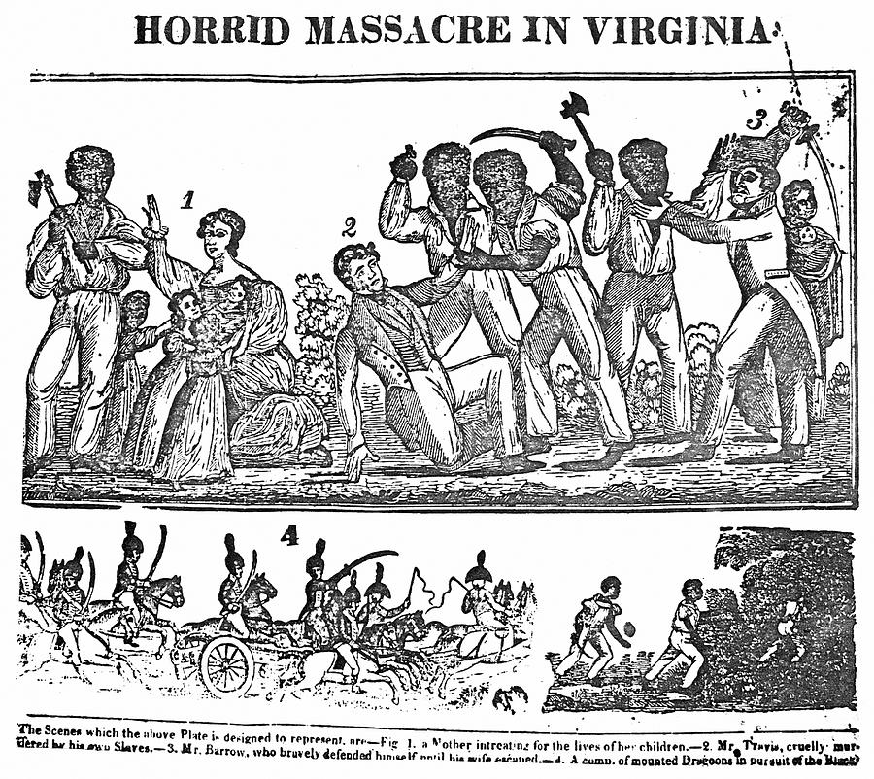
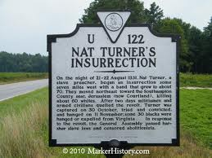
Nat Turners Rebellion
Nat Turner plans a slave revolt in Virginia
The only effective, sustained slave rebellion in U.S. history.
Sixty whites are killed before Turner and his followers are captured and hanged.

Slide 10
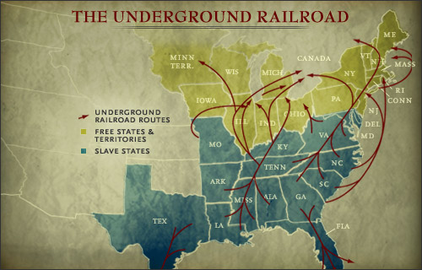
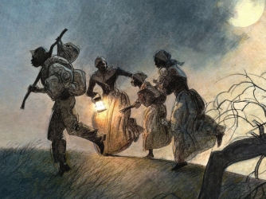
The Underground Railroad
Approximately 75,000 slaves escape to the North and to freedom
a system in which free African American and white "conductors," abolitionists and sympathizers help guide and shelter the escapees.
(not actually underground or a railroad)

Slide 12
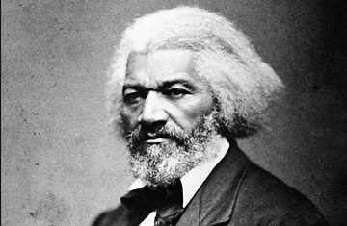
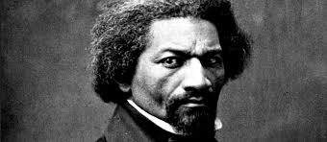
Frederick Douglass
Escaping from slavery, he became a leader of the abolitionist movement
Famous for antislavery writings & speeches
Douglass wrote several autobiographies describing his experiences and arguing against slavery.

Slide 14
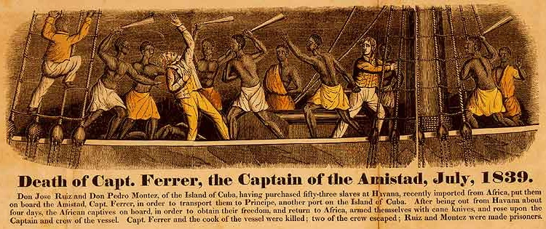
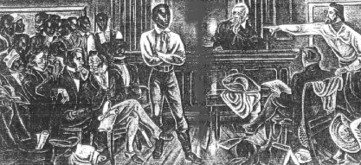
Amistad Mutiny
Slaves transported aboard the Spanish ship Amistad stage a mutiny.
Killing the entire crew except for the first mate and demanding to be sailed back to Africa. Instead, the captain sails to New York.
The slaves eventually win their freedom in a landmark Supreme Court case in which they are defended by former president John Quincy Adams.

Slide 16
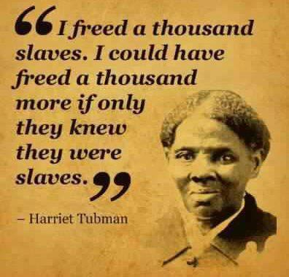
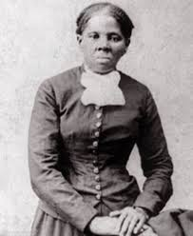
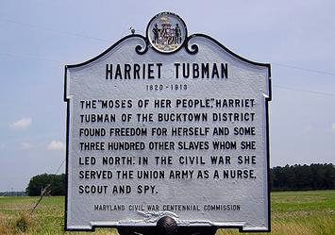
Harriet Tubman
escapes from slavery in Maryland.
She becomes one of the best-known "conductors" on the Underground Railroad
returning to the South 19 times and helping more than 300 slaves escape to freedom.

Slide 17
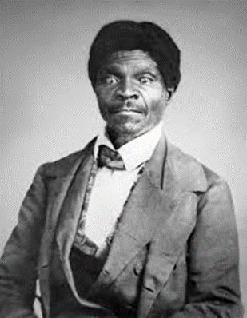

Slide 18
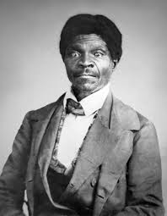
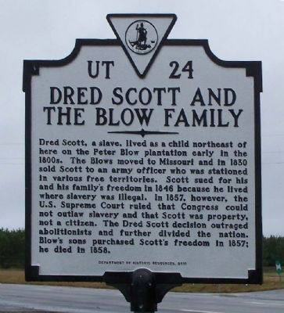
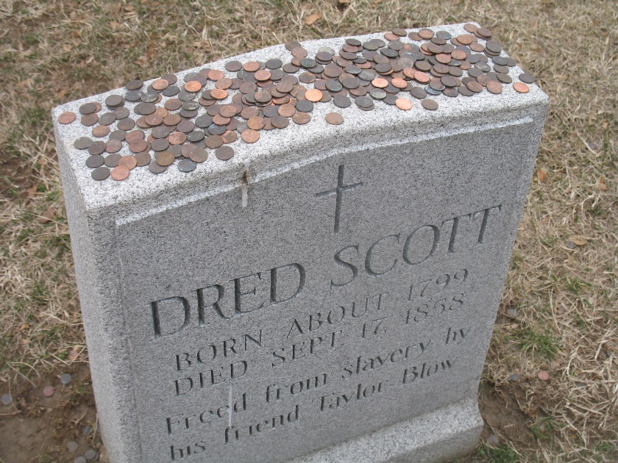
Dredd Scott Decision
A decision by the U.S. Supreme Court in which the Court held:
that African Americans could not be American citizens and therefore had no standing to sue in federal court
that the federal government had no power to regulate slavery in the federal territories acquired after the creation of the United States.

Slide 20
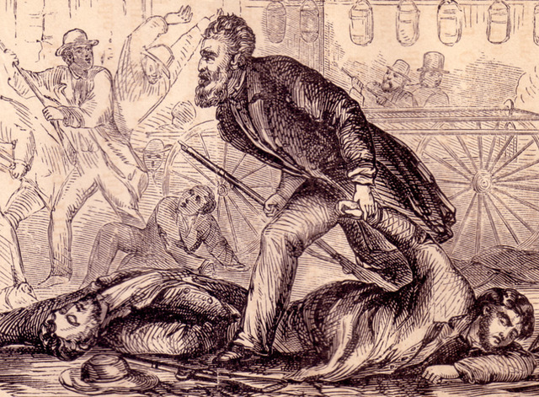
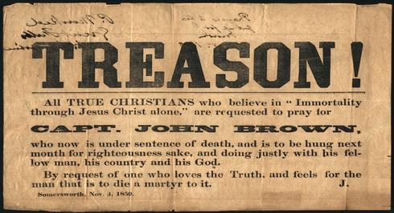
Harpers Ferry
Led by abolitionist John Brown and his sons, a group of slaves and white abolitionists stage an attack on Harper’s Ferry, Virginia.
They capture the federal armory and arsenal before the insurrection is halted by local militia.
Brown and the other captives are tried and executed

