Slide 1
The Bill of Rights
What does it mean to us?

Slide 2
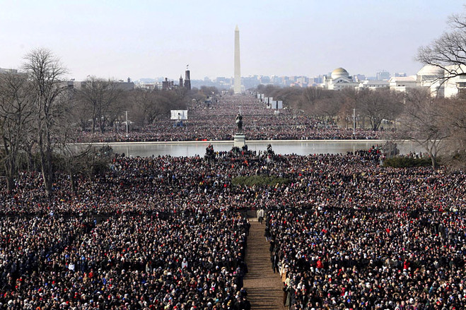
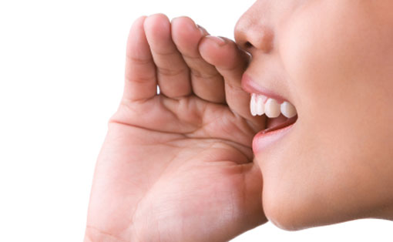
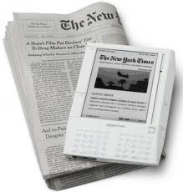
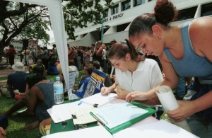
Amendment 1

Slide 3
Are these rights unlimited?
Limits on speech _______________________
Limits on assembly ______________________
Limits on press ________________________
Limits on petition _______________________
Limits on religion _______________________

Slide 4
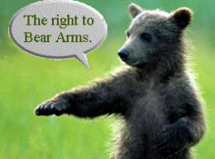
Amendment 2

Slide 5
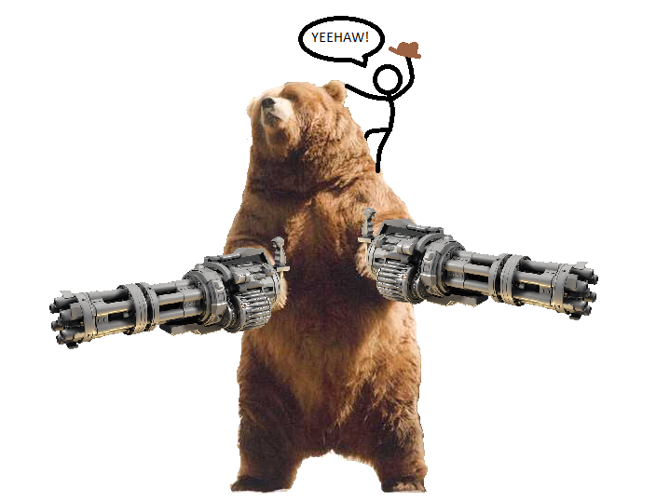
What does bear arms mean?
Why did we include this?
Does this mean all “arms”?
Why do we still argue about this today?
Who doesn’t have that right?

Slide 6
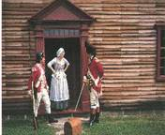
Amendment 3

Slide 7
Why make the third amendment?
Do we still need this amendment today?

Slide 8
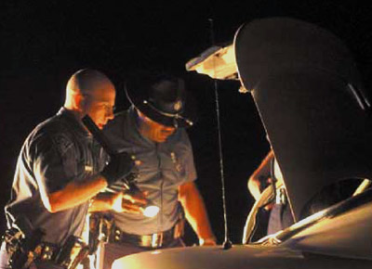
Amendment 4

Slide 9
Legal Searches have
1.
2.
3.

Slide 10
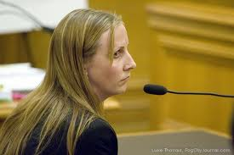
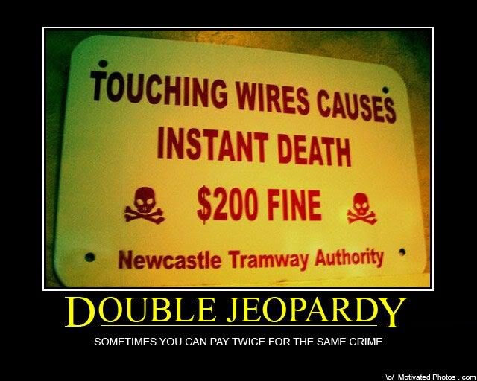
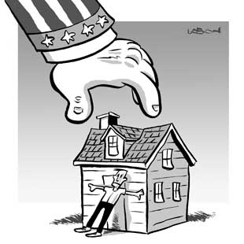
Amendment 5

Slide 11
Limits to the Fifth
When is the only time you can “remain silent”?
Could the movie double jeopardy ever really happen?
Does eminent domain mean the government cannot take your property, ever?

Slide 12
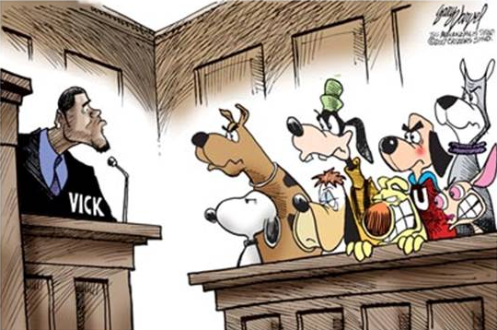
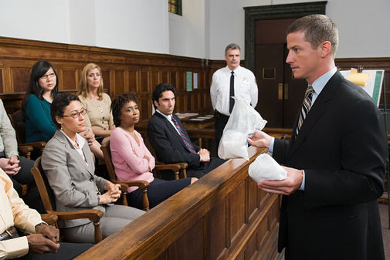
6th Amendment

Slide 13
6th Amendment
Do you have to have a public trial?
Do you have to have a jury at your trial?
How do they get people to be on a jury?
Do you have to have a lawyer?

Slide 14
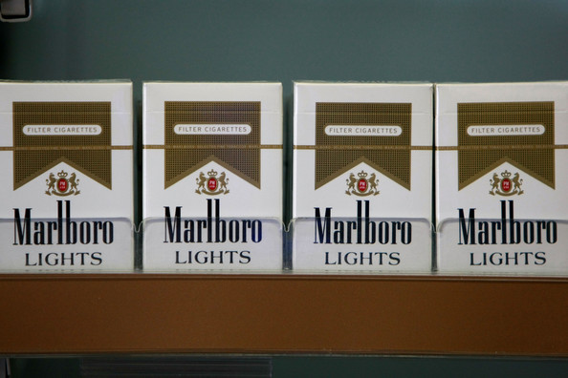
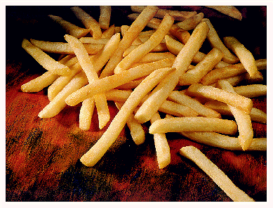
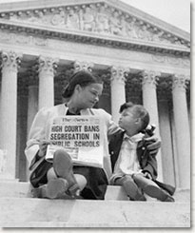
7th Amendment

Slide 15
Limits
What are the limits on law suits?
Should there be more? (give examples)

Slide 16
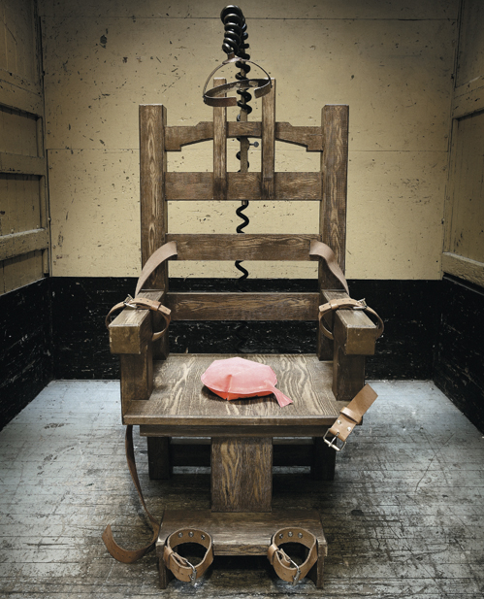
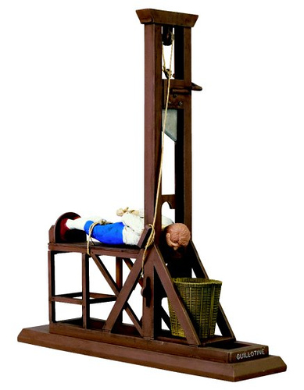
Amendment 8

Slide 17
Agree or Disagree
The 8th amendment is a good idea. Explain!

Slide 18
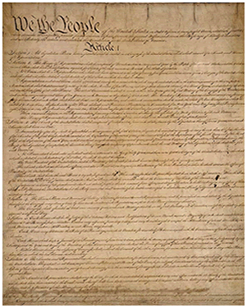
Amendment 9

Slide 19
Why be scared?
Many would not agree with the bill of rights until the 9th amendment was added. What was their fear?
How could the 9th amendment cause confusion?

Slide 20
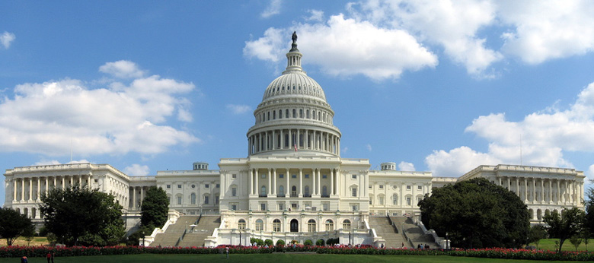
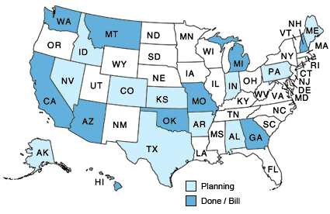
10th amendment

Slide 21
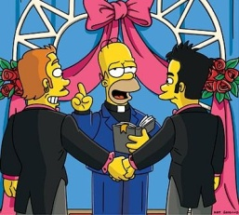
Conflict
Name one conflict in the past that dealt with states rights?
Name one conflict today that exists over state rights?

