Slide 1
The IV Amendment & YOU
The Bill of Rights: the iv amendment

Slide 2
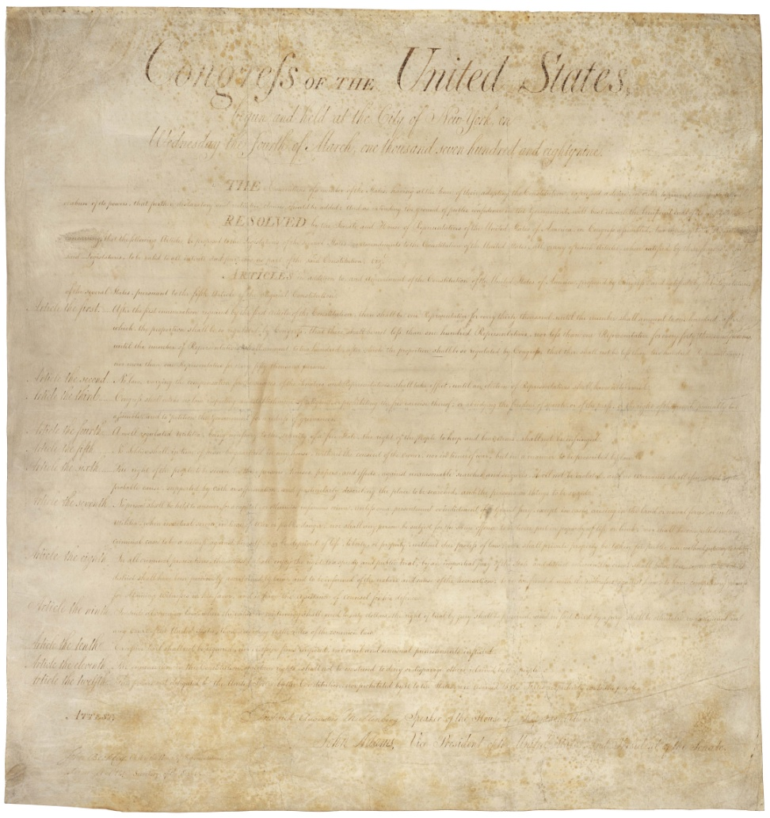
Learning Target
I can explain which right(s) the IV Amendment protects.
The Bill of Rights: the iv amendment

Slide 3
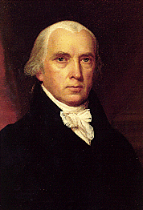
Background
What are the Bill of Rights?
Why did James Madison draft the Bill of Rights?
What are “Individual Rights?”
The Bill of Rights: the iv amendment

Slide 4
The IV Amendment
The right of the people to be secure in their persons, houses, papers, and effects, against unreasonable searches and seizures, shall not be violated, and no Warrants shall issue, but upon probable cause, supported by Oath or affirmation, and particularly describing the place to be searched, and the persons or things to be seized. (1789)
The Bill of Rights: the iv amendment

Slide 5
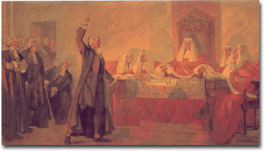
What does it protect?
What do “unreasonable searches and seizures” look like?
Originally protected against a “Writ of Assistance”
Warrant must be specific!
Why should you care?
Do you own a cell phone?
The Bill of Rights: the iv amendment

Slide 6
The IV Amendment
Video: ABC News: The NSA Phone Program the White House Didn't Want Revealed
(http://abcnews.go.com/WNT/video/nsa-phone-program-white-house-didnt-revealed-19343641)
The Bill of Rights: the iv amendment

Slide 7
The NSA Phone Program the White House Didn't Want Revealed
Split into groups and discuss how the NSA/Verizon case relates to the IV Amendment.
President Bush and President Obama believe this program is necessary but privacy-advocates see it as unconstitutional.
With which side do you agree & WHY?
The Bill of Rights: the iv amendment

Slide 8
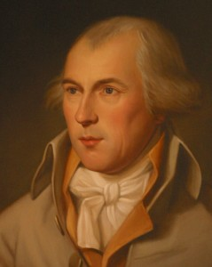
The IV Amendment -- Wrap up
Safety vs. Freedom
The nation is split
on their opinion of
the NSA program.
Edward Snowden has
been charged with Espionage & Theft of Government Property – he resides in a transit zone in Moscow and continues to seek asylum.
“In time of actual war, great discretionary powers are constantly given to the Executive Magistrate. … The means of defence agst. foreign danger, have been always the instruments of tyranny at home.”
James Madison (1787)
The Bill of Rights: the iv amendment

Slide 9
The IV Amendment
Who wrote the Bill of Rights?
John Smith
Alexander Hamilton
James Madison
King George III

Slide 10
The IV Amendment
The IV Amendment does which of these?
Guarantees freedom of press, assembly & religion.
Protects individuals from unreasonable search & seizures.
Affirms the individual right to bear arms.
Ensures healthcare for every citizen.

Slide 11
The IV Amendment
When was the IV Amendment written?
1492
1621
1789
1865

Slide 12
Sources
arcweb.archives.gov/
http://www.awesomestories.com
history.house.gov/
http://abcnews.go.com/WNT/video/nsa-phone-program-white-house-didnt-revealed-19343641

