Slide 1
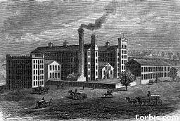
The Market Revolution

Slide 2
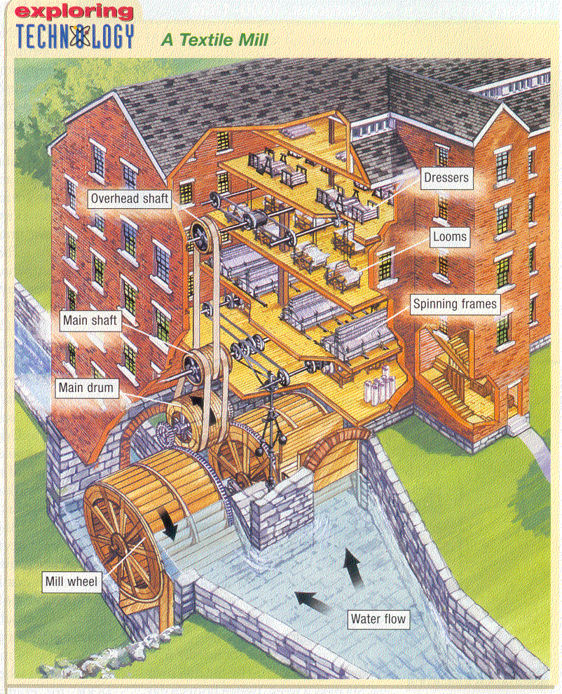

Slide 3
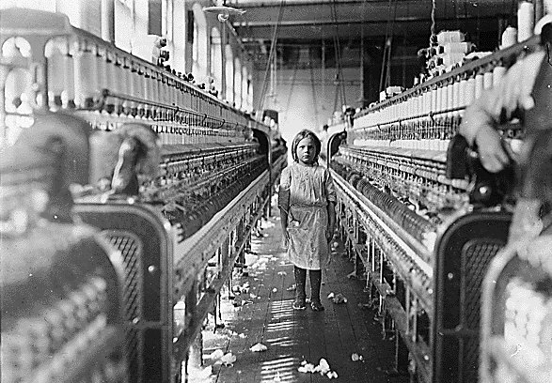
Factory work
Increase demands for products yields mass producing factories
The Lowell textile mills
Preferably women workers.. Why?

Slide 4
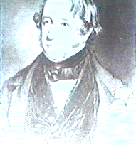
In 1813 group of businessmen led by a Boston merchant named Francis Cabot Lowell built a factory in Waltham, Mass. to manufacture textiles.
Notes:
The FIRST time in the world that spinning and weaving were done in one operation under the same roof.
The FIRST power loom to be used in the United States.
The FIRST time in the United States that young women were employed as the predominant workforce and paid actual cash for their labor.
The FIRST company-sponsored housing provided for employees.
The FIRST textile mill to be built of brick.
The Boston Manufacturing Company was the FIRST large successful manufacturing company in the United States. They raised over $400,000.00 from investors to build the buildings and machinery. The BMC was the prototype of the modern Corporation.
The FIRST industrial labor strike in the United States was in this mill in 1821. The protesters were women and the issue was wages.

Slide 5
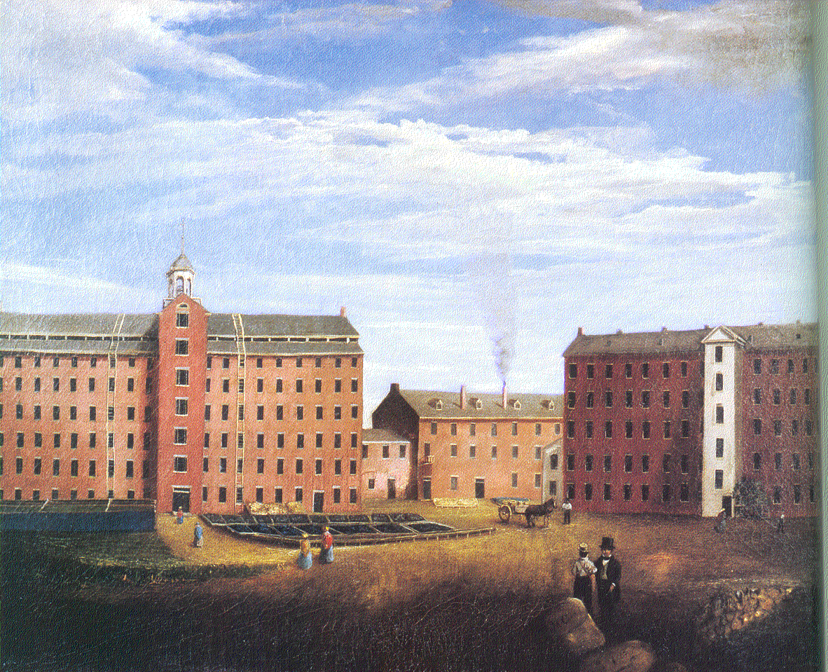
Lowell’s was the world’s first truly centralized textile factory. All the tasks involved in making a product were carried out in one place.
Notes:
Lowell’s Waltham mill and the many later mills that were built along rivers in New England brought together all the tasks of spinning, weaving, and dyeing that turned raw cleaned cotton into finished cloth.

Slide 6
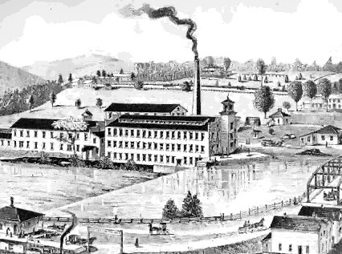
From the 1820s to 1840s, manufacturing industries arose in New England and become the backbone of the North’s economy.

Slide 7
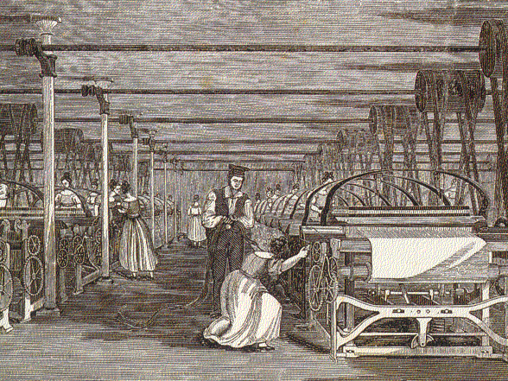
In 1817 New England’s textile mills produced 4 million yards of cotton cloth. 1840 it was 323 million.
Notes:
Centralizing work dramatically increased production.

Slide 8
Water Drives the Engine!
Water was the only reliable power source strong enough and plentiful enough to work.

Slide 9
Erie Canal connects New York to the Great Lakes

Slide 10
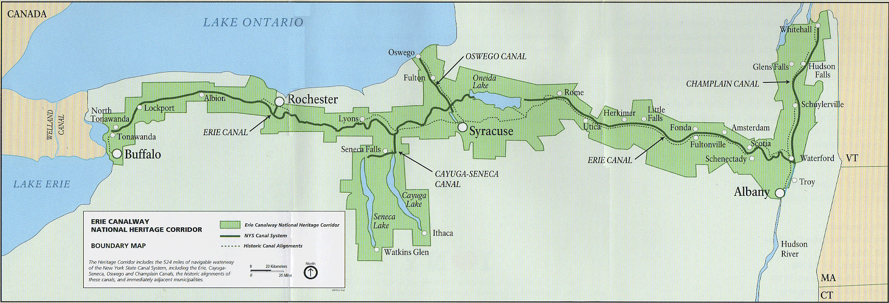
Demand for canals and shipping results in the creation of the:
ERIE CANAL!

Slide 11
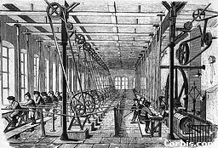
The power harnessed from these moving waters ran the new machines in factories that sprang up in the early 1800s.
Notes:
Products started rolling out of water powered factories at an astounding rate.
The self-sufficient household, where family members spun their own thread or made their own soap, was beginning to disappear.

Slide 12
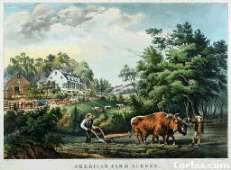
After the War of 1812, the U.S. economy soared although most were farmers.
Notes:
A new generation of Americans began buying and selling goods, borrowing and circulating money, and creation wealth.

Slide 13
The way Americans made, bought, and sold goods is known as the Market Revolution.

Slide 14
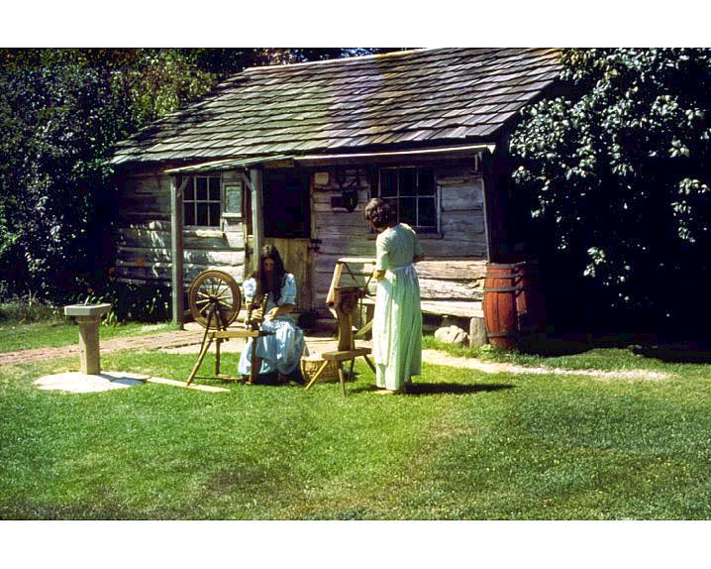
For most Americans, “going to work” in the 1700s generally meant working in the home or around the farm.
Notes:
Some skilled artisans did produce goods such as books or glass that could not be made easily at home. Others were employed in the shipping industry or legal or financial professions. Most people, however, simply labored to make the food, clothing, and shelter they needed.

Slide 15
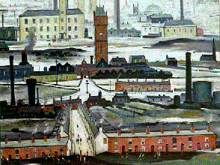
In the 1800s the building of new factories sharply increased the demand for people to work outside the home.

Slide 16
New Inventions
Mechanical Reaper
Steel Plow
Telegraph
Steam Engine
Cotton Gin
Sewing Machine
Steamboat

Slide 17
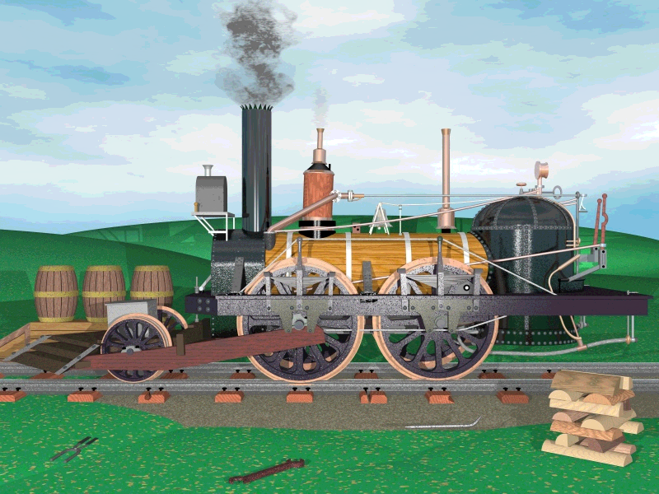
Notes:
It may look pretty modest, but the John Bull locomotive is the world's oldest still operable self-propelled vehicle.
Late in August 1831, after a six-week voyage from Liverpool, England, the Allegheny docked at a Philadelphia wharf. Lashed aboard were the parts for "one locomotive steam engine" that had been purchased by New Jersey entrepreneur and engineer Robert Stevens. Stevens was building a railroad, one of the first in the United States; he had hired Isaac Dripps as a skilled mechanic.
Eleven days later, Dripps and his crew had put the engine together on a short length of track. A fire was lit, and steam raised. To everyone's relief, the machine moved, although it would need considerable fine-tuning before it worked properly. In November, Stevens held a party to display the engine to politicians whose support he needed to complete his railroad.
After the party, Stevens put his engine in a shed for two years while he worked on his railroad, laying rails between Camden and South Amboy, New Jersey (hence the name Camden and Amboy Railroad). Travelers then took ferries at either end to reach the cities of New York or Philadelphia. The Camden and Amboy became one of the most successful early railroads in the U.S.

Slide 18
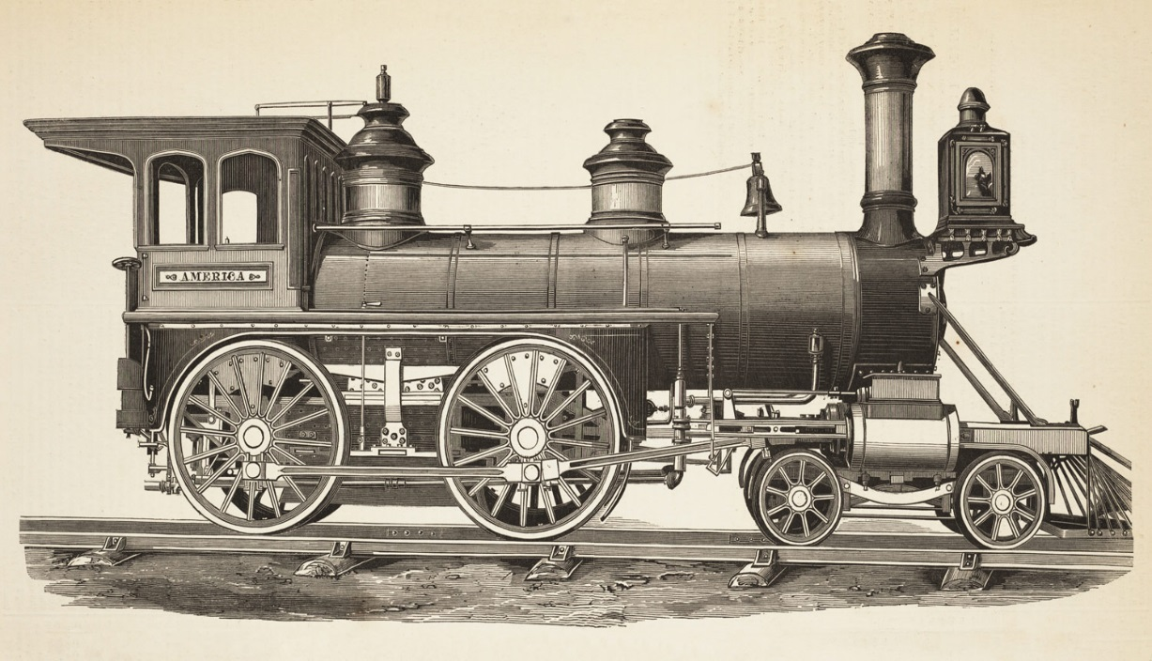
Steam Engines
Early 1800’s, Locomotives in England are developing
Reach the US in 1930
By 1850, more than 9,000 miles of tracks

Slide 19
The first text messaging machine is invented in 1837 by Samuel Morse!
http://www.history.com/topics/telegraph/videos#the-telegraph-and-telephone

Slide 20
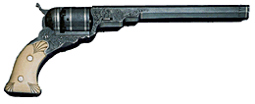
Samuel Colt patented his revolving pistol in 1836.
Notes:
As a direct result of his invention and the marketing and sales success that followed, Sam Colt and his firearms played a prominent role in the history of a developing America. So popular was the Colt revolver during the latter half of the 1800s that it was perhaps the best-known firearm not only in this country but also in Canada, Mexico, and many European countries. To this day, the name Colt suggests firearms to most Americans.
Sam Colt's success story began with the issuance of a U.S. patent in 1836 for the Colt firearm equipped with a revolving cylinder containing five or six bullets. Colt's revolver provided its user with greatly increased firepower. Prior to his invention, only one- and two-barrel flintlock pistols were available. In the 163 years that have followed, more than 30 million revolvers, pistols, and rifles bearing the Colt name have been produced, almost all of them in plants located in the Hartford, Connecticut, area.

Slide 21
Worker’s strike!
When workers go on strike, they are protesting by not working.
Why protest?
Decreased wages, benefits, working conditions.
Increase hours, workload

Slide 22
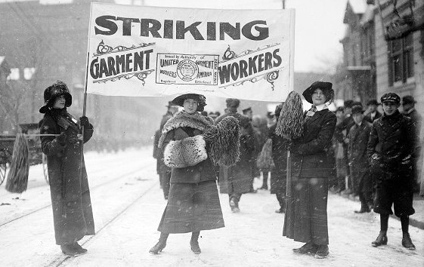
Lowell Strike
In 1834, wages at the Lowell mills were reduced by 15%.
Results= 800 workers went on strike.
More strikes followed. 99% factories won

Slide 23
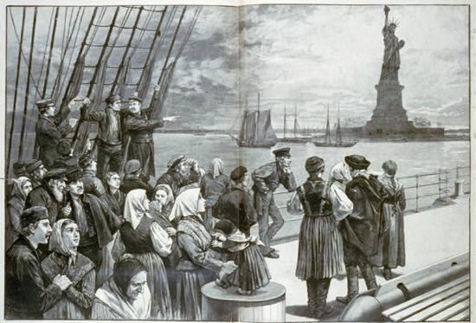
Immigrants
Waves of immigrants from Europe arrive.
Nearly one million Irish immigrants
Question:
Why were Irish immigrants facing prejudice here?

