Slide 1
Teddy Roosevelt The Old Lion
And Progressivism

Slide 2
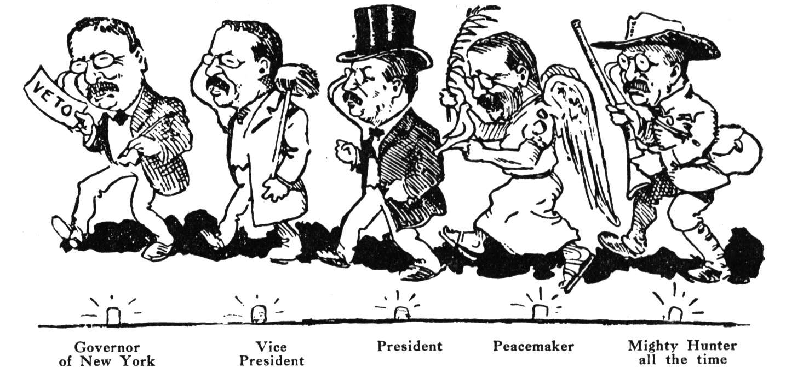
8. Became youngest President (age 42)

Slide 3
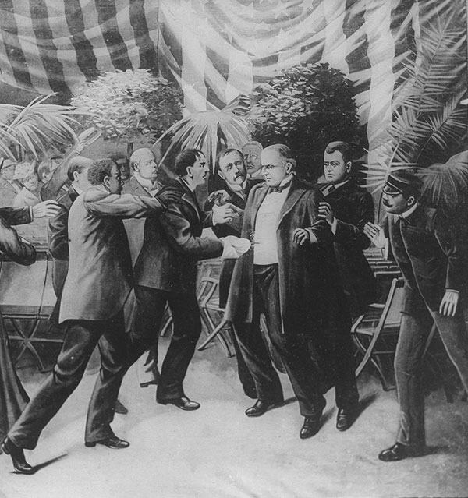

Slide 4
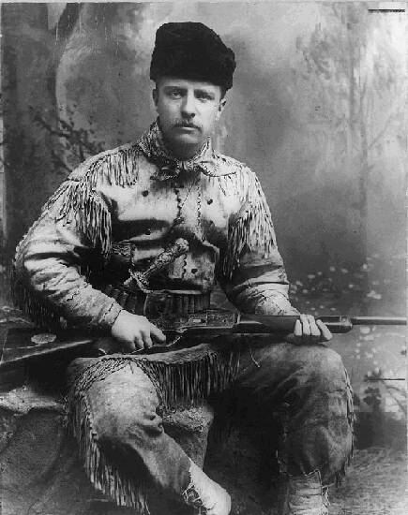
7. Other Jobs
Notes:
His other jobs were quite varied: cattle rancher, deputy sheriff, historian, naturalist, explorer, author of 35 books, police commissioner, assistant Secretary of the Navy, governor of New York, war hero, and lawyer.

Slide 5
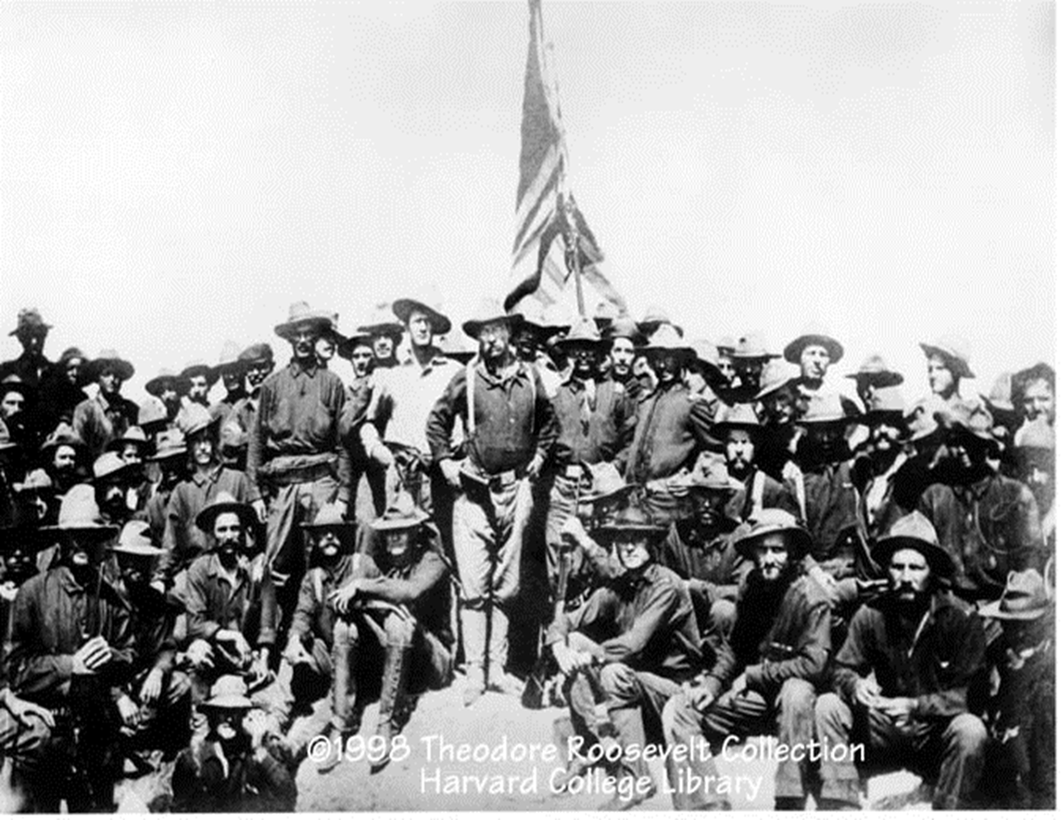
6. Rough Riders!!!!

Slide 6
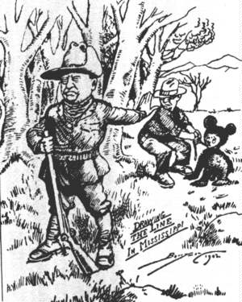
5. The Teddy Bear

Slide 7
"Let the watchwords of all our people be the old familiar watchwords of honesty, decency, fair-dealing, and commonsense."... "We must treat each man on his worth and merits as a man. We must see that each is given a square deal, because he is entitled to no more and should receive no less. "The welfare of each of us is dependent fundamentally upon the welfare of all of us."

Slide 8
4. Conservationist
"We of an older generation can get along with what we have, though with growing hardship; but in your full manhood and womanhood you will want what nature once so bountifully supplied and man so thoughtlessly destroyed; and because of that want you will reproach us, not for what we have used, but for what we have wasted...So any nation which in its youth lives only for the day, reaps without sowing, and consumes without husbanding, must expect the penalty of the prodigal whose labor could with difficulty find him the bare means of life."

Slide 9
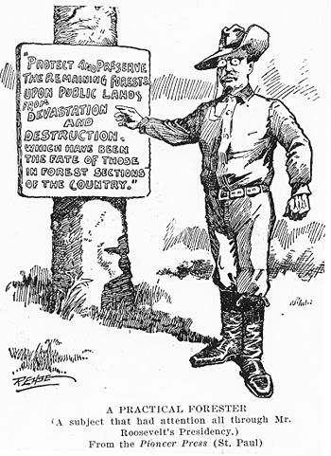

Slide 10
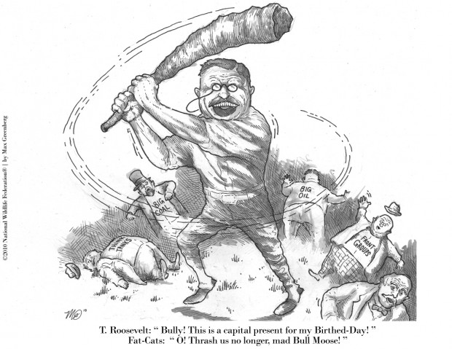
3. Big Stick Policy / Progressivism

Slide 11
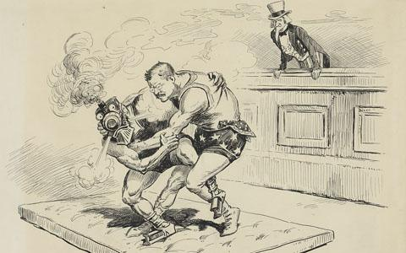

Slide 12
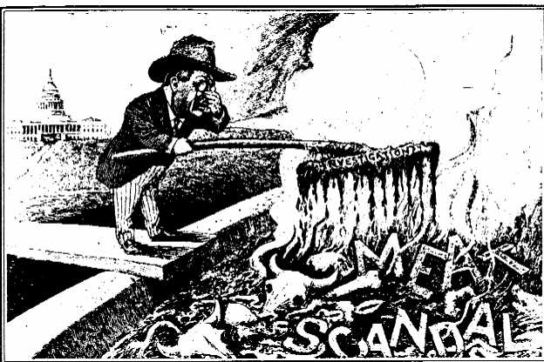

Slide 13
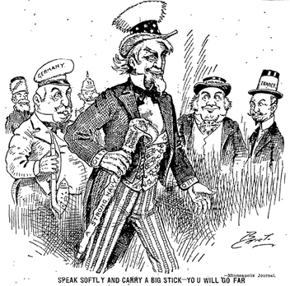

Slide 14
2. Sportsman

Slide 15
Man in the Arena
"It is not the critic who counts: not the man who points out how the strong man stumbles or where the doer of deeds could have done better. The credit belongs to the man who is actually in the arena, whose face is marred by dust and sweat and blood, who strives valiantly, who errs and comes up short again and again, because there is no effort without error or shortcoming, but who knows the great enthusiasms, the great devotions, who spends himself for a worthy cause; who, at the best, knows, in the end, the triumph of high achievement, and who, at the worst, if he fails, at least he fails while daring greatly, so that his place shall never be with those cold and timid souls who knew neither victory nor defeat."
"Citizenship in a Republic," Speech at the Sorbonne, Paris, April 23, 1910

Slide 16
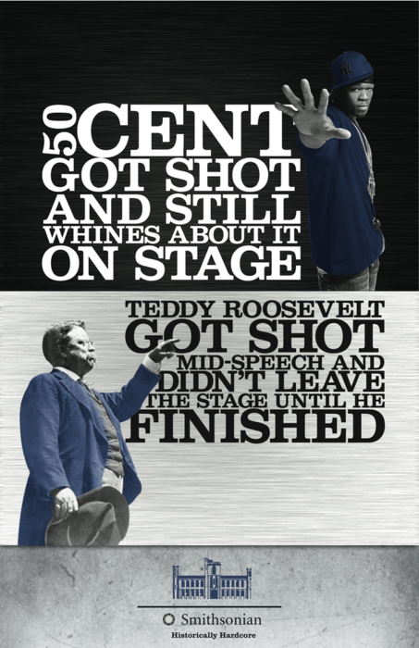
1. Dude Got Shot, Still Finished Speech

