Slide 1
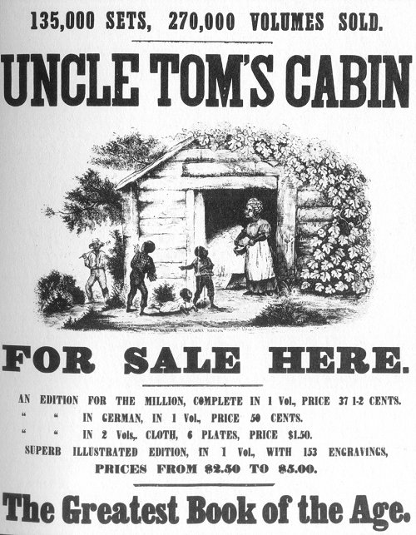
Monday, October 19th
Sporting News:
Football Sr. Night vs Atherton – 7:00 Friday (Field Party Follows)
Boys Soccer – Tuesday 4:30, Thursday 6:00 @ Mercy
Senior Announcements:
Sr. Movie Night – Thursday, October 22nd 7:30
Class Announcements:
Competency Check – TODAY
Map Quiz – Wednesday
Agenda:
Learning Target & Vocab
Academic Advising Concludes – Reflection Sheet!!!!
Mapping the Compromises Activity
Put together Slave Packet
Comp Check

Slide 2
Your Slavery Work Product/Packet
By the end of the period:
Complete all parts of the slavery packet. Staple it, hole-punch it and save it for study use.
The Packet should include the following:
The rebellion timeline & descriptions
The unit vocabulary sheet
The “Fakebook” pages on abolitionists & reformers
The mapping activity (pg. 314)
I will check this right before we take the competency check on slavery.

Slide 3
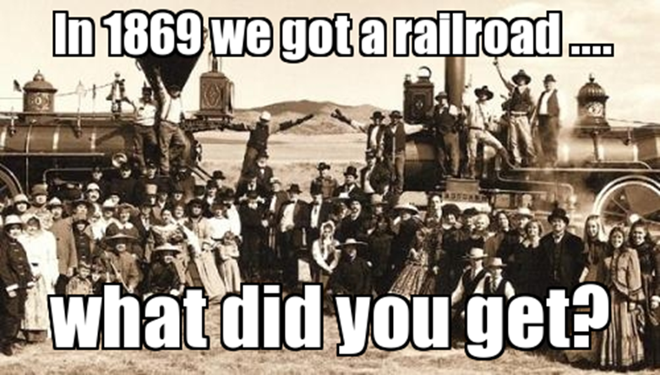
Tuesday, October 20th
Sporting News:
Football Sr. Night vs Atherton – 7:00 Friday (Field Party Follows)
Boys Soccer – Today 4:30, Thursday 6:00 @ Mercy
Senior Announcements:
Sr. Movie Night – Thursday, October 22nd 7:30
Class Announcements:
Map Quiz – next Week (I’ll explain)
Remediation for slavery – on your own
Agenda:
Learning Target & Vocab
Market Revolution Reading
Market Revolution PPT & Notes
Begin Unit Vocab & Timeline

Slide 4
1. The Missouri Compromise of 1820…
a. Admitted Maine as a free state and Missouri as a slave state
b. Divided the line between free and slave states at the line of 36-30.
c. Was proved useless after the Dred Scott decision
d. All of the above.

Slide 5
2.) Charles Sumner was beaten in the Senate because he accused other senators of
a. voting against slavery.
b. called Abraham Lincoln a liar and a thief
c. inciting border ruffians into Missouri.
d. forcing Kansas to become a slave state.

Slide 6
3. The Supreme Court's Dred Scott decision...
won widespread approval in the North.
declared the Missouri Compromise unconstitutional.
granted citizenship to African Americans.
mandated congressional control of slavery in the territories.

Slide 7
4.) Harriett Beecher Stowe famously wrote which of the following?
The Liberator
Uncle Tom’s Cabin
The North Star
A Fault in Our Stars

