Slide 1
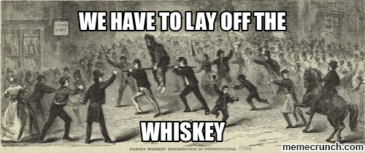
Monday, September 14th
Sporting News:
Friday Night
Soccer vs. Moore @ 5:00
Football vs Desales @ 7:00
Senior Announcements:
PowderPuff Today; HC Dress Down soon
Class Announcements:
First Proficiency – tomorrow!
New Grade Sheet - Friday
Agenda:
Learning Target & Vocab (5 mins)
Quizlet Vocabulary & New Unit Introduction
Comparing the Rebellions (with a partner)

Slide 2
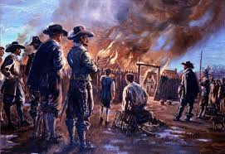
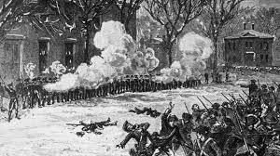
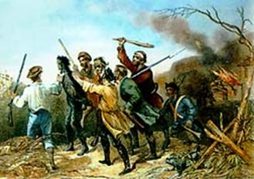

Slide 3
1. Who made the observation “a little rebellion now and then is a good thing,” and what event inspired it?
Benjamin Franklin; Bacons Rebellion
George Washington; Pontiacs Rebellion
Alexander Hamilton; the Whiskey Rebellion
Thomas Jefferson; Shays Rebellion

Slide 4
2. Bacon’s Rebellion resulted in what significant development?
The Virginia House of Burgesses passed a series of laws that guaranteed the property rights of the Powhatans.
Rebels seized the estate of Virginia governor William Berkeley and divided his lands among their Indian supporters.
Antagonism toward native peoples became a dominant characteristic of frontier life in colonial Virginia.
It was the first time colonists took up arms against a British authority and ultimately led to increased slave labor in the colonies.

Slide 5
3. What was the main significance of Shays’ Rebellion?
It exemplified the adverse impact of currency laws on the independence of small farmers.
It established paper currency as a solution to economic problems caused by unfair trade.
It revealed the inability of the weak central government to maintain order.
It suggested merchants’ interests were less significant than those of the agricultural class.

Slide 6
4. Which best describes the end of the Whiskey Rebellion?:
Settlers infringed upon Native American territory and seized it for themselves.
The Supreme Court ruled martial law unconstitutional and reprimanded President Jackson.
President Washington personally led the military to put down the revolt against grain taxes.
Thomas Jefferson’s Democratic-Republican party ascended to the presidency and effectively killed the Federalist party

Slide 7
5. Given that only seven people died in the Boston Massacre, why did Paul Revere characterize it as a “massacre”?
British commanders ordered troops to shoot into a rioting crowd in an effort to restore order
The victims were innocent bystanders who were caught in the barrage of gunfire.
The incident was sensationalized to take advantage of heightened public tensions.
The British response was disproportionate to the crowd’s provocation.

Slide 8
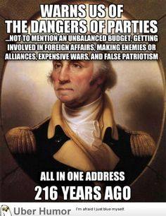
Tuesday, September 15th
Sporting News:
Friday Night
Soccer vs. Moore @ 5:00
Football vs Desales @ 7:00
Senior Announcements:
PowderPuff Today; HC Dress Down
Class Announcements:
First Proficiency – TODAY!
New Grade Sheet - Friday
Agenda:
Learning Target & Vocab (5 mins)
Study briefly and scan exit slip
Proficiency Exam #1
Federalists vs. Dem-Rep PPT & Notes; exit slip follows

Slide 9
1. Which below best summarizes the purpose of the Judiciary Act of 1789?
It established the idea of Judicial Review
The justices needed a way to gain more power
The Supreme Court could not preside over ALL cases so lower courts were needed
The act helped reinforce the philosophy of balancing power

Slide 10
2. George Washington, in his farewell address, discussed all of the following EXCEPT:
Accruing large national debt
Forming alliances
Threats of terrorism from France & Great Britain
The dangers of party ideology

Slide 11
3. What was the main significance of Shays’ Rebellion?
It exemplified the adverse impact of currency laws on the independence of small farmers.
It established paper currency as a solution to economic problems caused by unfair trade.
It revealed the inability of the weak central government to maintain order.
It suggested merchants’ interests were less significant than those of the agricultural class.

Slide 12
4. Which event sparked debate on the appropriate power of the federal government?
Shay’s Rebellion
The XYZ Affair
Whiskey Rebellion
The Alien & Sedition Acts

Slide 13
5. The Alien and Sedition Acts were designed to…
encourage foreign immigration.
promote freedom of speech and of the press.
promote friendship between the United States and France.
suppress foreign immigration.

Slide 14
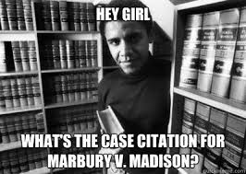
Wednesday, September 16th
Sporting News:
Friday Night – tix on sale now! $5.00
Soccer vs. Moore @ 5:00
Football vs Desales @ 7:00
Senior Announcements:
HC Dress Down Handout
Class Announcements:
First Proficiency – if you were absent, schedule make-up w/ Coach Abell ASAP
New Grade Sheet - Friday
Agenda:
Learning Target & Vocab (5 mins)
Early Justice System Assignment – submit to Mr. Fowler at the end of the day.

Slide 15
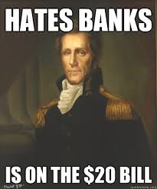
Thursday, September 17th
Sporting News:
Friday Night – tix on sale now! $5.00
Soccer vs. Moore @ 5:00
Football vs Desales @ 7:00
Senior Announcements:
HC Dress Down Handout
Class Announcements:
First Proficiency – if you were absent, schedule make-up w/ Coach Abell ASAP
New Grade Sheet - Friday
Agenda:
Learning Target & Vocab (5 mins)
Government in Action PPT & Cornell Notes
King Andrew Cartoon Analysis

Slide 16
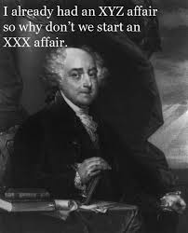
Friday, September 18th
Sporting News:
Friday Night – tix on sale now! $5.00
Soccer vs. Moore @ 5:00
Football vs Desales @ 7:00
Senior Announcements:
HC Dress Down Handout
Class Announcements:
First Proficiency – if you were absent, schedule make-up w/ Coach Abell ASAP
New Grade Sheet - Friday
Agenda:
Submit Hmwk - King Andrew Cartoon Analysis
Learning Target & Vocab (5 mins)
Review Government in Action
Begin Foreign Policy w/videos

Slide 17
1. Which below best summarizes the purpose of the Judiciary Act of 1789?
It established the idea of Judicial Review
The justices needed a way to gain more power
The Supreme Court could not preside over ALL cases so lower courts were needed
The act helped reinforce the philosophy of balancing power

Slide 18
2. George Washington, in his farewell address, discussed all of the following EXCEPT:
Accruing large national debt
Forming alliances
Threats of terrorism from France & Great Britain
The dangers of party ideology

Slide 19
3. What was the name of the site for the White House?
Soggy Bottom
Foggy Bottom
Rachet Bottom
Richmond

Slide 20
4. Which event sparked debate on the appropriate power of the federal government?
Shay’s Rebellion
The XYZ Affair
Whiskey Rebellion
The Alien & Sedition Acts

Slide 21
5. The Alien and Sedition Acts were designed to…
encourage foreign immigration.
promote freedom of speech and of the press.
promote friendship between the United States and France.
suppress foreign immigration.

