Slide 1
Immigration & Urbanization
Challenges caused by the rise of cities.

Slide 2
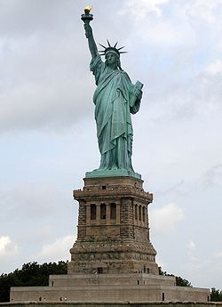

Slide 3
Immigration
Because of the factories being built millions of immigrants flood into the North Eastern United States and Great Lakes areas.
Very few European immigrants go west until it is more settled
Very few immigrants go south because of “competition” from freed slaves and fear of the Klan

Slide 4
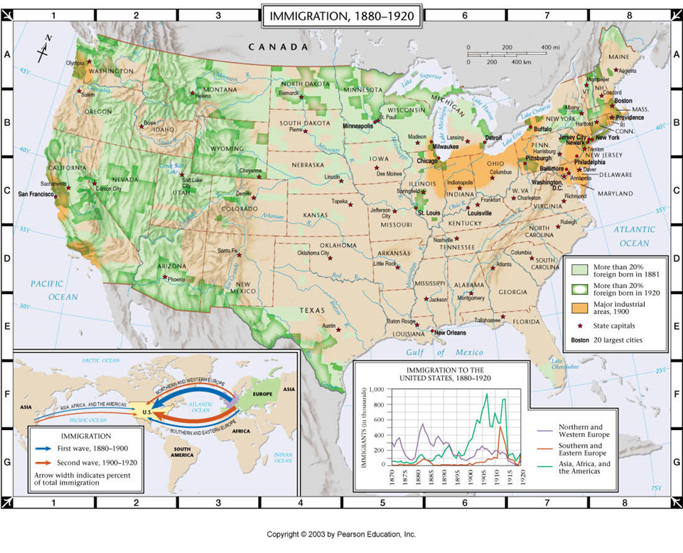

Slide 5
Got Room?
As cities swell in size land gets very expensive
Steel allows architects to build “up” instead of “out”.
The modern city is born

Slide 6
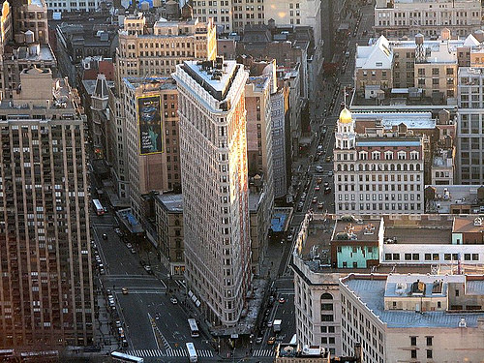

Slide 7
Immigrant life
Most immigrants remain “packed” into certain areas of cities (slums)
Many cities pass laws assigning areas to races and nationalities (this is illegal today)
Tenements- housing quickly and cheaply built to house as many immigrants as possible
poor construction, no sanitation, no heat etc.
Jacob Riis documents this using photography
“How the other half lives”
jacob riis- video link

Slide 8
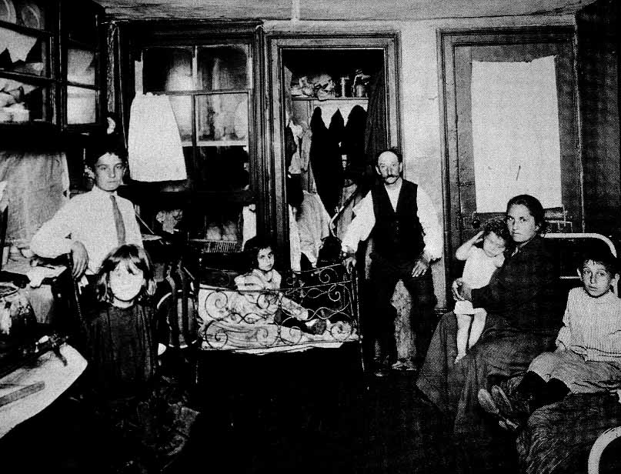

Slide 9
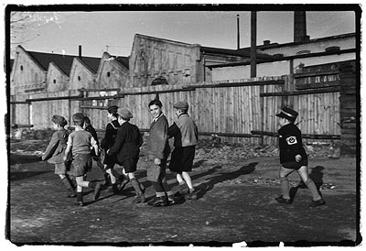
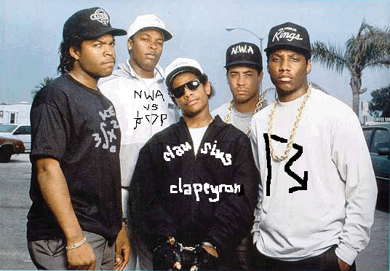

Slide 10
Ghetto Life
Little opportunity- few jobs, no education
desrimination
Birth of organized crime- gangs create “opportunity” and a chance to make money
Many live in fear of gangs
“Political Bosses”- take full advantage of this situation

Slide 11
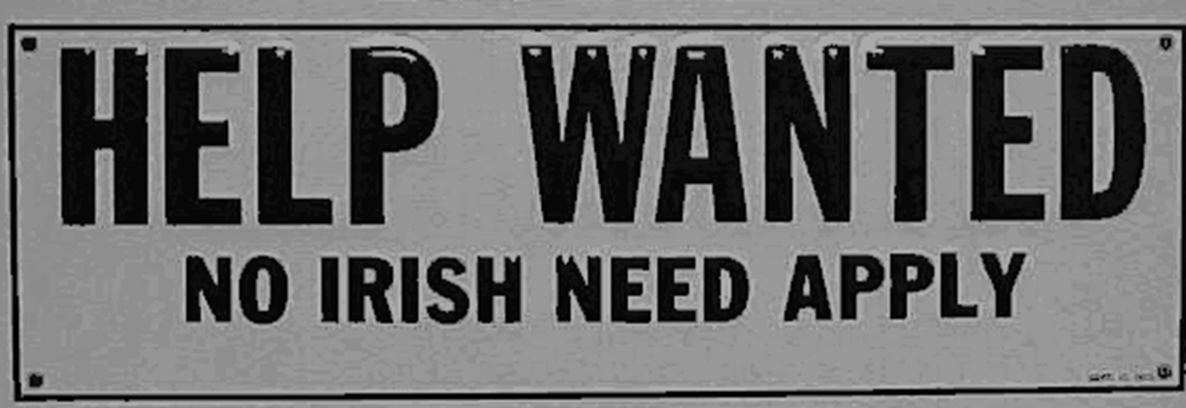

Slide 12
Political Bosses
Political Machine- an organization that controls a political party in a city and offers services to voters and businesses in exchanges for votes and/or money. (not a real machine)
Basically they will protect you from gangs and work to get your building fixed as long as you help them (cash or votes)
Political Boss- someone who runs a political machine
Immigrants like political bosses because they help when no one else will

Slide 13
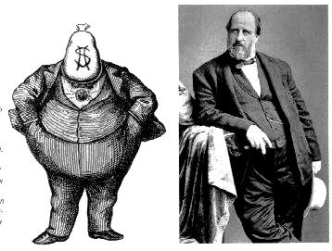
Boss Tweed & Tammany Hall

Slide 14
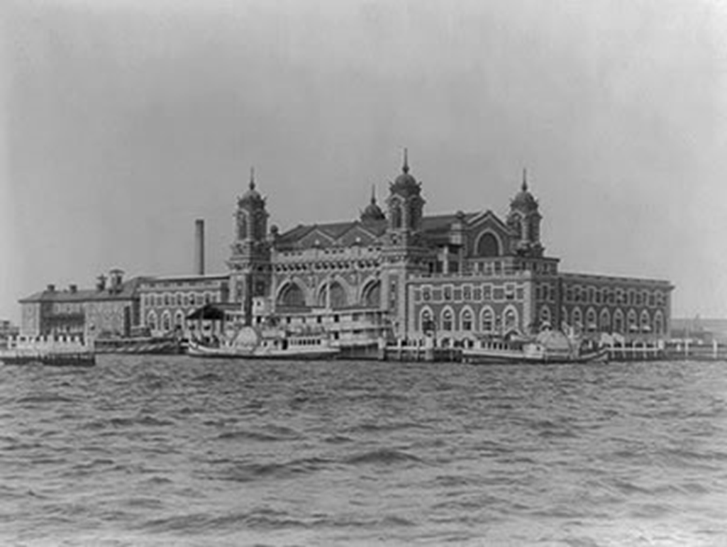
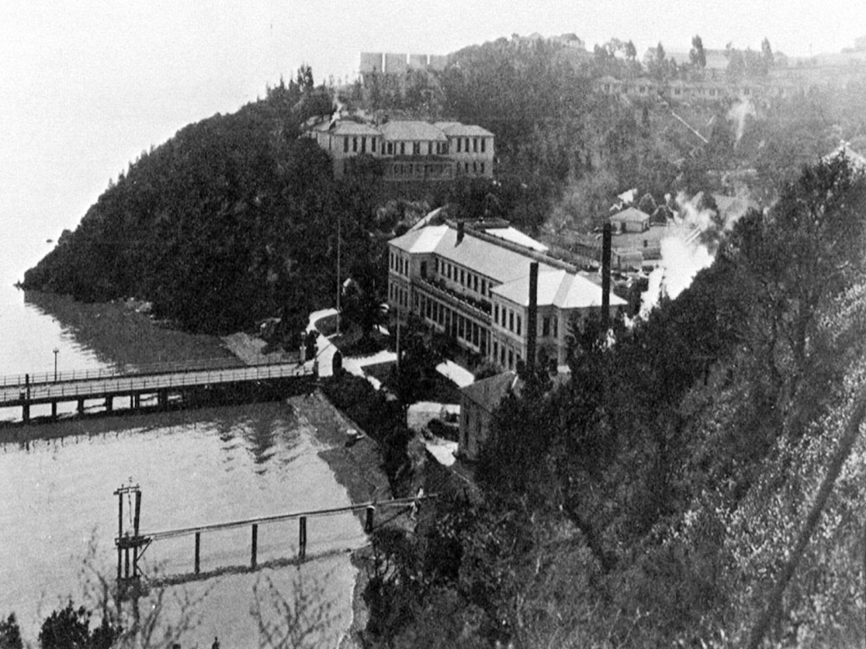
Immigration Destinations
Ellis Island, NY
Angels Island, CA

Slide 15
US Immigration Laws
Chinese exclusion act (1882)- prohibits immigration of Chinese workers for 10 years
Gentleman's agreement- kept Japanese from being segregated as other Asians in California
Our first real Immigration limit.
The Immigration Act of 1903, also called the Anarchist Exclusion Act, added four inadmissible classes: anarchists, beggars, and importers of prostitutes

Slide 16
More Immigration laws
The Naturalization Act of 1906 standardized naturalization procedures, made some knowledge of English a requirement for citizenship, and established the Bureau of Immigration and Naturalization
The Immigration act of 1907 restricted immigrant for certain classes of disabled and diseased people.
The Immigration Act of 1917 (Barred Zone Act) restricted immigration from Asia by creating an "Asiatic Barred Zone" and introduced a reading test for all immigrants over fourteen years of age, with certain exceptions for children, wives, and elderly family members.

Slide 17
More Immigration Laws
Quota systems- limit the numbers of people who can enter the US and limit the areas from which they come
The Emergency Quota Act of 1921 restricted annual immigration from a given country to 3% of the number of people from that country living in the U.S. in 1910\
The Immigration Act of 1924 (also known as the Johnson Act) aimed at freezing the current ethnic distribution in response to rising immigration from Southern and Eastern Europe, as well as Asia. Introduced nationality quotas
(basis of our system until 1965)

Slide 18
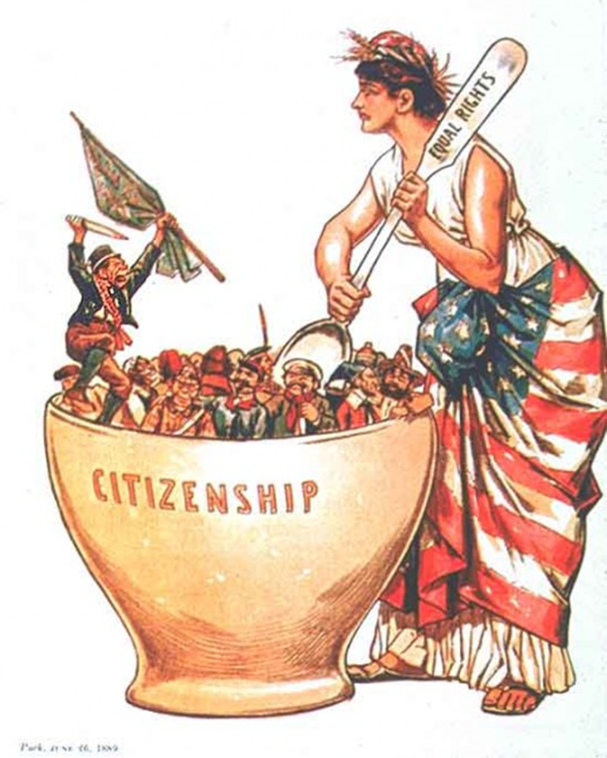
Writing Assignment

Slide 19
Wrap-Up Question
Answer the Learning Target:
Explain how the growing number of immigrants and the growth of cities led to issues in early 20th century America.

