Slide 1
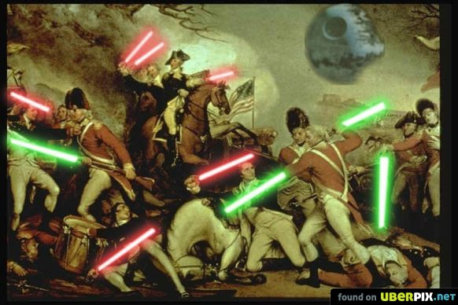
Monday, August 24th
Senior Announcements:
Girls Soccer @ 5:30
JV Football @ Manual
Class Announcements:
Submit Timeline Activity
Tuesday – 1st Competency Check; map test
Agenda:
Political Cartoon Analysis (20 mins)
Battles of the Revolution PPT & Notes (12 mins)
Movie / Video Clips (15 mins)
Review Exit Slips
Today’s Exit Slip (5 mins)

Slide 2
1.) What was the main significance of the Battle of Yorktown?
It was the site of the surrender of the British
This is where the French decide to join the war and aide the colonists
The number casualties suffered by the British serve as a moral victory for the Americans
The Americans surrender during this battle, thus ending the Revolution

Slide 3
2.) What was the main significance of the Battle of Saratoga?
It was the site of the surrender of the British
This is where the French decide to join the war and aide the colonists
The number casualties suffered by the British serve as a moral victory for the Americans
The Americans surrender during this battle, thus ending the Revolution

Slide 4
3.) What was the main significance of the Battle of Bunker Hill?
It was the site of the surrender of the British
This is where the French decide to join the war and aide the colonists
The number casualties suffered by the British serve as a moral victory for the Americans
The Americans surrender during this battle, thus ending the Revolution

Slide 5
4.) Which of the following was NOT a term within the Treaty of Paris 1783?
A. All loyalists had to leave the country. B. The US territory expanded past Appalachia. C. the British soldiers had to leave all posts at existing forts. D. the colonists and British had to return all slaves to their owners.

Slide 6
5.) Which of the following is NOT a reason the colonists win the war?
Their use of unconventional warfare
The knowledge of the land on which the war was fought
The superior naval power of the colonists after being trained by the Spanish
The aid from the French in the form of supplies and training

Slide 7
Tuesday, August 25th
Senior Announcements:
Boys Soccer Thursday @ 5:30
Friday Football & Girls Soccer
Vs. Mercy @ 5:30
Vs. Manual @ 7:30
Class Announcements:
Join the class Celly
Agenda:
Review Exit Slips (10 mins)
Scan Yesterday’s Exit Slip (5 mins)
Colonial America Competency Check
13 Colonies Map Test

Slide 8
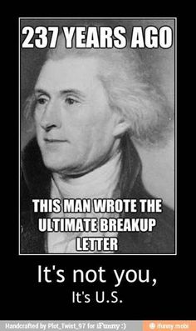
Wednesday, August 26th
Senior Announcements:
Handouts
Boys Soccer Thursday @ 5:30
Friday Football & Girls Soccer
Vs. Mercy @ 5:30
Vs. Manual @ 7:30
Class Announcements:
Join the Celly; get familiar with the Weebly
Agenda:
2nd Period – Suicide Prevention
Learning Target & Vocab
Colonies to Revolution Remediation / Enrichment
Benchmark = 12
> 12 – Declare Your Own Independence
< 12 – Scavenger Hunt w/the iPads
Exit Slip

Slide 9
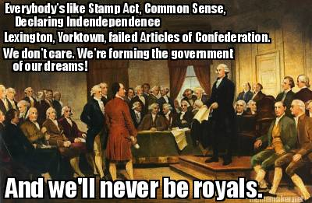
Thursday, August 27th
Senior Announcements:
Volleyball vs. Moore @ 7:00
Friday Football & Girls Soccer
Vs. Mercy @ 5:30
Vs. Manual @ 7:30
Class Announcements:
Join the Celly; get familiar with the Weebly
Reminders about when you’re absent
Agenda:
Learning Target & Vocab
Vocabulary Sheet
Articles of Confederation Intro
Articles of Confederation Translastion
Exit Slip

Slide 10
Friday, August 28th
Senior Announcements:
Friday Football & Girls Soccer
Vs. Mercy @ 5:30
Vs. Manual @ 7:30
Class Announcements:
Agenda:
Learning Target & Vocab
Finish Articles of Confederation Translation
Debating the articles
AOC PPT & Notes
Articles of Confederation Exit Slip

Slide 11
1.) What was the main significance of the Battle of Yorktown?
It was the site of the surrender of the British
This is where the French decide to join the war and aide the colonists
The number casualties suffered by the British serve as a moral victory for the Americans
The Americans surrender during this battle, thus ending the Revolution

Slide 12
2.) What was the main significance of the Battle of Saratoga?
It was the site of the surrender of the British
This is where the French decide to join the war and aide the colonists
The number casualties suffered by the British serve as a moral victory for the Americans
The Americans surrender during this battle, thus ending the Revolution

Slide 13
3.) What was the main significance of the Battle of Bunker Hill?
It was the site of the surrender of the British
This is where the French decide to join the war and aide the colonists
The number casualties suffered by the British serve as a moral victory for the Americans
The Americans surrender during this battle, thus ending the Revolution

Slide 14
4.) Which of the following was NOT a term within the Treaty of Paris 1783?
A. All loyalists had to leave the country. B. The US territory expanded past Appalachia. C. the British soldiers had to leave all posts at existing forts. D. the colonists and British had to return all slaves to their owners.

Slide 15
5.) Which of the following is NOT a reason the colonists win the war?
Their use of unconventional warfare
The knowledge of the land on which the war was fought
The superior naval power of the colonists after being trained by the Spanish
The aid from the French in the form of supplies and training

