Slide 1
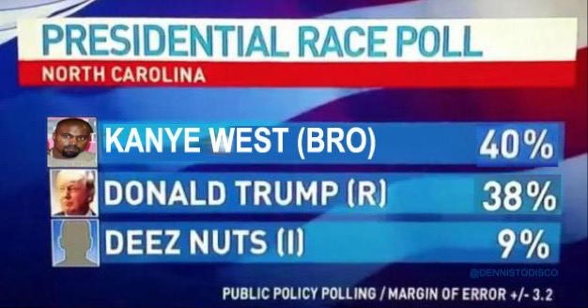
Monday, August 31st
Sporting News:
Boys soccer @ Southern
Girls soccer @ Valley
JV Football vs. Moore
Senior Announcements:
PowderPuff Begins today
Class Announcements:
Vocab – Wednesday; Comp Check - Friday
Agenda:
Review of the Articles of Confederation (5 mins)
Intro to Constitutional Convention (5 mins)
Constitutional Reading & Questions w/partner (45 mins)
Overview Questions
Today’s Exit Slip (5 mins)

Slide 2
1.) The plan for the small states was also known as the…
New Jersey Plan
Virginia Plan
Connecticut Plan
Delaware Plan

Slide 3
2.) An early struggle of the first convention was which of the following?
Keeping the convention a secret
Preventing delegates from violently confronting each other
Ensuring that each state sent delegates
Deciding on with whom to side – Miley or Nicki

Slide 4
3.) WHO IS CONSIDERED THE “Father of the constitution?”
George Washington
Thomas Jefferson
Benjamin Franklin
James Madison

Slide 5
4.) Shays’s Rebellion started because which of the following reasons?
Massachusetts issued paper money to pay off its debts instead of raising taxes.
Merchants refused to pass the twerking act of 1779.
Massachusetts was repossessing farms to pay back war debts
New York taxed goods coming into the state from Connecticut and New Jersey.

Slide 6
5.) The real issue for opponents of the Constitution was whether a national government…
was really needed.
would be too strong
could regulate trade.
should impose taxes.

Slide 7
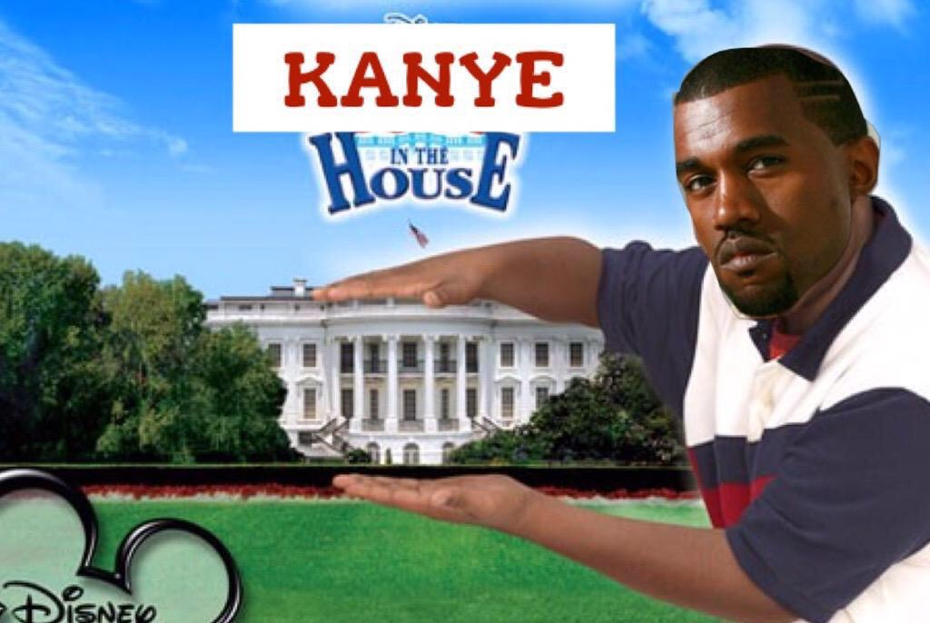
Monday, August 31st
Sporting News:
Boys soccer @ Southern
Girls soccer @ Valley
JV Football vs. Moore
Senior Announcements:
PowderPuff Begins today
Class Announcements:
Vocab – Wednesday; Comp Check - Friday
Agenda:
Review of the Articles of Confederation (5 mins)
Intro to Constitutional Convention (5 mins)
Constitutional Reading & Questions w/partner (45 mins)
Overview Questions
Today’s Exit Slip (5 mins)

