Slide 1
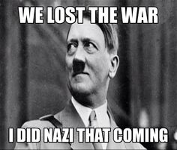
Monday, February 22
Sporting News:
Playoff Bball – Girls Tuesday vs. Mercy 7:30 @ CAL
Boys Wednesday vs. Jtown 7:30 @ Mercy
Senior Announcements:
Malibu Jack’s – This Thursday, February 25th @ 6:30
Class Announcements:
US History Agreements due Wednesday
Agenda:
Review Syllabus & New Rules; new daily sheet
Seating Assignments
Begin WWII Unit
Compare Treaty of Versailles & 14 Points
Dictators Group Assignment
Cornell & PPT on Entering the War

Slide 2
Monday, February 22
Learning Target:
I can explain why dictators took over in 1930s Europe and why the Japanese bomb Pearl Harbor
Vocabulary:
Fascism: system of government under a dictator, a capitalist economy subject to strict governmental controls, violent suppression of the opposition, and typically a policy of belligerent nationalism and racism.
Socialism: political and economic theory of social organization that advocates that the means of production, distribution, and trade should be owned or regulated by the community as a whole.

Slide 3
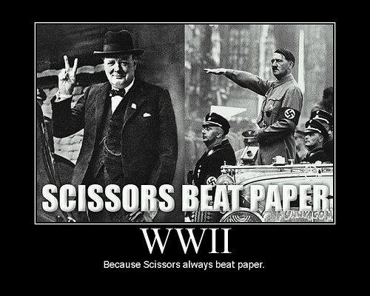
Tuesday, February 23
Sporting News:
Playoff Bball – Girls TONIGHT vs. Mercy 7:30 @ CAL; Boys Wednesday vs. Jtown 7:30 @ Mercy
Senior Announcements:
Malibu Jack’s – This Thursday, February 25th @ 6:30
Class Announcements:
US History Agreements due tomorrow
WWII Comp Check & Packet due Friday
Agenda:
Seating Assignments
Cornell & PPT on Entering the War

Slide 4
Tuesday, February 23
Learning Target:
I can explain why America enters WWII and what it meant for Americans at home.
Vocabulary:
Lend-Lease Act: 1941 law that authorized the president to aid any nation whose defense he believed was vital to American security
National War Labor Board: Created by American government to oversee the conversion of factories to War production and to monitor labor relations during wartime.

Slide 5
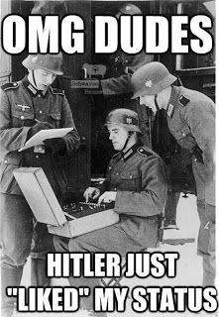
wEDNESDAY, February 24
Sporting News:
Playoff Bball –Boys Wednesday vs. Jtown 7:30 @ Mercy
Senior Announcements:
Malibu Jack’s – Tomorrow , February 25th @ 6:30 $16
Class Announcements:
US History Agreements due TODAY
WWII Comp Check & Packet due Friday
Agenda:
School Survey
WWII @ Home PPT & Cornell
Propaganda Creation

Slide 6
Wednesday, February 24
Learning Target:
I can explain why America enters WWII and what it meant for Americans at home.
Vocabulary:
Propaganda: information that is spread for the purpose of promoting some cause
Ration: a fixed portion that is allotted (especially in times of scarcity)

Slide 7
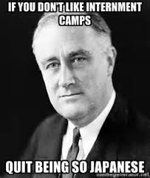
Thursday, February 25
Sporting News:
Playoff Bball –Boys FRIDAY vs Bullitt East 7:30 @ Mercy
Senior Announcements:
Malibu Jack’s – TONIGHT, February 25th @ 6:30 $16
Class Announcements:
WWII Comp Check & Packet due TOMORROW
Agenda:
Finish Propaganda Creation
Bad@$$ of the Week – Daniel Inouye
Japanese Internment Camps Reading & Quick Notes

Slide 8
Thursday, February 25
Learning Target:
I can explain how the war affected minorities and basic American freedoms
Vocabulary:
Executive Order 9066: authorized the removal of any or all people from military areas “as deemed necessary or desirable.” (Japanese)

Slide 9
Propaganda Posters – Remember…
Must be a creation of your own – nothing you’ve seen before
Make sure your message is one of the following:
Rationing
Buying War Bonds
Planting Victory Gardens
Women in the War
Military Recruitment
Leave very little white space on your poster
Im not judging your art, just your application of WWII propaganda

Slide 10
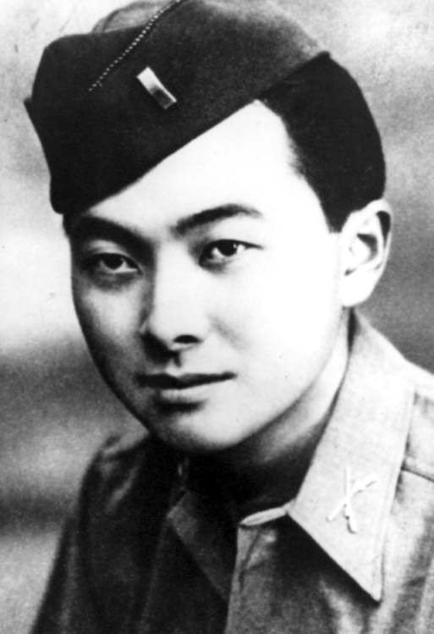
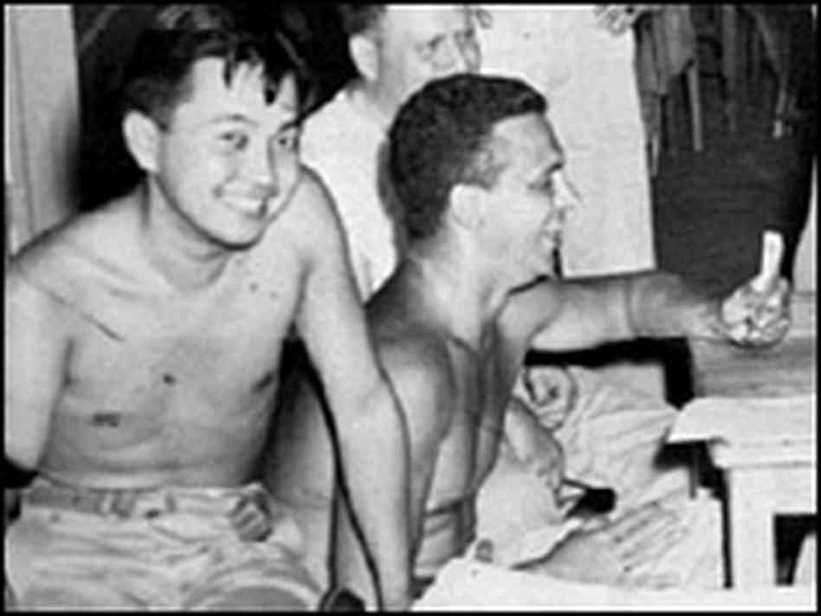
BADASS of the WEEK
Daniel
Inouye

Slide 11
Friday, February 26
Sporting News:
Playoff Bball –Boys TONIGHT vs Bullitt East 7:30 @ Mercy
Senior Announcements:
Class Announcements:
WWII Comp Check & Packet TODAY
Agenda:
Korematsu vs. United States
Finish Unit Exit Questions
Take Comp Check; score Unit Work Packet

Slide 12
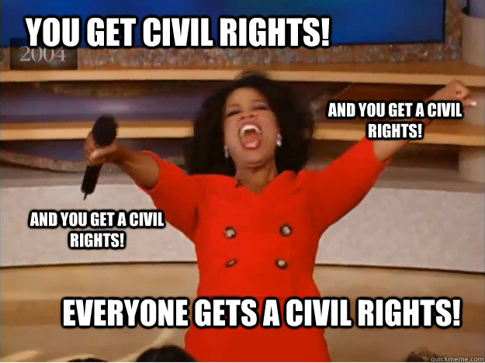
Monday, February 29
Sporting News:
Regional Bball vs Moore tomorrow @ 7:00 - $5 in café!!!
Senior Announcements:
Senior Trip Payments ASAP
Senior March Mania - TBA
Class Announcements:
Remediation after school; ESD
Agenda:
New Work Product for New Unit – Civil Rights History
Unit Vocab & Timeline
Begin Civil Rights PPT & Cornell

Slide 13
Monday, February 29
Learning Target:
I can explain the origins of Civil Rights struggles and define key terms that pertain to them
Vocabulary:
14th Amendment: defined national citizenship; states cannot restrict the basic rights of citizens or other persons; due process of the law

Slide 14
Monday, February 29
Exit Question(s):
1.) As review, how were the 13th-15th amendments ignored?
2.) What gave rise to Jim Crow laws?

Slide 15
Tuesday, March 1
Learning Target:
I can explain the origins of Civil Rights struggles and the different philosophies as to how to address them
Vocabulary:
W.E.B. du Bois: progressive activist who helped establish NAACP
disenfranchisement: denying or taking away the right to vote

Slide 16
Tuesday, March 1
Sporting News:
Regional Bball vs Moore tonight@ 7:00 - $5 in café!!!
Senior Announcements:
Senior Trip Payments ASAP
Senior March Mania - TBA
Class Announcements:
Remediation after school; ESD
Agenda:
Yesterday’s Exit Questions
Finish Unit Vocab & Timeline
Booker T Washington v DuBois Reading & Questions
Continue Civil Rights PPT & Cornell

Slide 17
Tuesday, March 1
Exit Question(s):
1.) How did DuBois & Washington ideas differ?
2.) Whose ideas did you find most impactful & why?

Slide 18
Wednesday, March 2
Learning Target:
I can explain how the Civil Rights movement reemerged in the 1950s and the events that led to change
Vocabulary:
SCLC: is an African-American civil rights organization led by Dr. Martin Luther King, Jr.; non-violence; had a large role in the American Civil Rights Movement

Slide 19
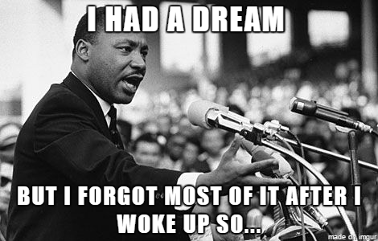
Wednesday, March 2
Sporting News:
Regional Bball vs Doss Thursday @ Valley $7.00
Senior Announcements:
Senior Trip Payments ASAP
Senior March Mania – March 24th
Class Announcements:
Remediation after school; ESD
Agenda:
Exit Question(s) from yesterday
Watch Eyes on the Prize Part 1 & Discuss
Secondary Source Reading on Emmett Till Case

Slide 20
Wednesday, March 2
Exit Question(s):
1.) What is the significance of Brown v. Board?
2.) What major issue is demonstrated by the Emmett Till Case?

Slide 21
Thursday, March 3
Learning Target:
I can explain the origins of Civil Rights struggles and the different philosophies as to how to address them
Vocabulary:
Little Rock 9: 9 African American students who enrolled in High School but were denied following desegregation.

Slide 22
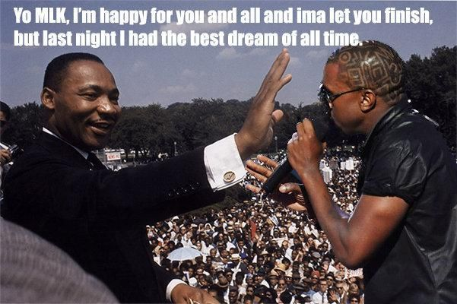
Thursday, March 3
Sporting News:
Regional Bball vs Doss @ Valley 7:30 $7.00; free bus
Senior Announcements:
Senior Trip Payments ASAP
Senior March Mania - TBA
Class Announcements:
Remediation after school; ESD; vocab quiz tomorrow
Agenda:
Finish Emmett Till Clip; complete reading
Yesterday’s Exit Questions
Begin Little Rock 9; complete reading

Slide 23
Thursday, March 3
Exit Question(s):
1.)Explain the bigger American issue (besides segregation and racism) at hand in the Little Rock 9 event?

Slide 24
Friday, March 4
Learning Target:
I can explain the origins of Civil Rights struggles and the events that led to change
Vocabulary:
De jure segregation: segregation that is imposed by law.
De facto segregation: segregation resulting from economic or social conditions or personal choice.

Slide 25
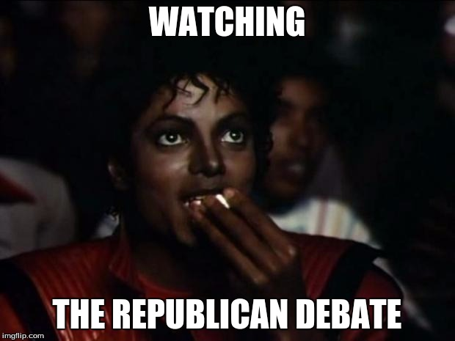
Friday, March 4
Sporting News:
Softball & Baseball begin this week!
Senior Announcements:
Senior Trip Payments ASAP
Senior March Mania – March 24th
Class Announcements:
Remediation after school; ESD; Civil Rights Comp Check next Friday
Agenda:
Discuss debate; vocab quiz
Finish Little Rock 9; complete reading
Yesterday’s Exit Questions
Begin Lunch Counter Sit-Ins & Birmingham

Slide 26
Friday, March 4
Exit Question(s):
1.)How effective were sit-ins?
2.) Why were they effective?

Slide 27
Monday, March 7
Learning Target:
I can explain the origins of Civil Rights struggles and the events that led to change
Vocabulary:
MLK: Civil rights leader who took a nonviolent approach to the change.

Slide 28
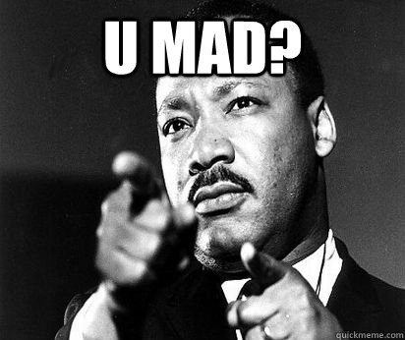
Monday, March 7
Sporting News:
Softball & Baseball begin this week!
Senior Announcements:
Senior Trip Papers ASAP
Senior March Mania – March 24th
Class Announcements:
Remediation after school; ESD; Civil Rights Comp Check Friday
Agenda:
Finish Friday’s Exit Questions
Begin Birmingham & Bus Boycott
Reading
Movie

Slide 29
Group Readings
Group 1 – Freedom Rides
Group 2 – Rosa Parks Remembers
Group 3 – A New Leader Emerges (Document 4, pg 47)
Group 4 – Letter from a Birmingham Jail
Answer the questions at the end of your section and discuss them with your peers. As your classmates are explaining, be sure to actively listening/learning.
Describe the impact your event had on the movement.

Slide 30
Monday, March 7
Exit Question(s):
1.) From what other famous advocate did MLK get the idea of non-violent protest?
2.) What did freedom rides, sit-ins and bus boycotts all have in common? (Think beyond non-violence)

Slide 31
Tuesday, March 8
Learning Target:
I can explain the origins of Civil Rights struggles and the events that led to change
Vocabulary:
Malcolm X: civil rights leader who encouraged violent responses to racial discrimination.

Slide 32
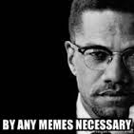
Tuesday, March 8
Sporting News:
Softball & Baseball begin this week!
Senior Announcements:
Senior Trip Papers ASAP
Senior March Mania – March 24th
Class Announcements:
Remediation after school; ESD; Civil Rights Comp Check Friday
Agenda:
Catch up Begin Malcolm X, Black Panthers & Black Muslims
Readings
Movie

Slide 33
Civil Rights / Voting Rights Act
Visit the class Weebly
Click on CIVIL RIGHTS MOVEMENT tab, under Units
Find the Provisions of the Civil Rights Act & the Provisions of the Voting Rights Act
Choose one provisions of each, and tweet about them (excitement or displeasure)
In your tweet, include a hashtag as well as @FCCoachAbell
If you don’t have a Twitter, write your tweets out on paper and staple to the back of your packet

Slide 34
Tuesday, March 8
Exit Question(s):
1.) Why did Malcolm X disagree with the idea on non- violence?
2.) Use a Venn diagram like this to compare the ideas on civil rights between Malcolm X, MLK Jr & NOI
MLK
MX
NOI

Slide 35
Wednesday, March 9
Learning Target:
I can explain the origins of Civil Rights struggles and the events that led to change
Vocabulary:
Black Panthers: a militant political organization set up in the US in 1966 to fight for black rights.

Slide 36
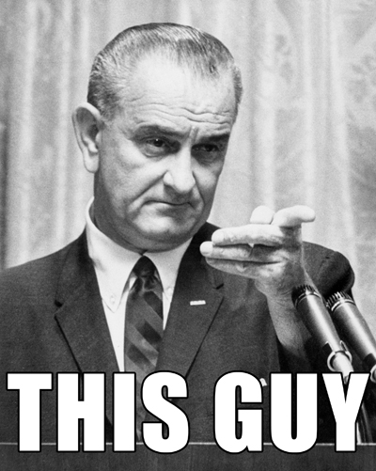
Wednesday, March 9
Sporting News:
Softball & Baseball begin this week!
Senior Announcements:
Senior Trip Papers ASAP
Senior March Mania – March 24th
Class Announcements:
Remediation after school; ESD; Civil Rights Comp Check Friday
Agenda:
Women’s League of Voters
Compare the Acts of the Civil Rights Movement
Civil Rights Act of 1964
Voting Rights Act of 1965

Slide 37
Wednesday, March 9
Exit Question(s):
1.) Describe the major impact the Civil Rights Act will have on American society.
2.) Do the same for the Voting Rights Act.

Slide 38
Thursday, March 10
Learning Target:
I can explain the origins of Civil Rights struggles and the events that led to reform
Vocabulary:
Voting Rights Act 1965: Eliminated literacy tests and other restrictions that had been used to restrict voting by black people.

Slide 39
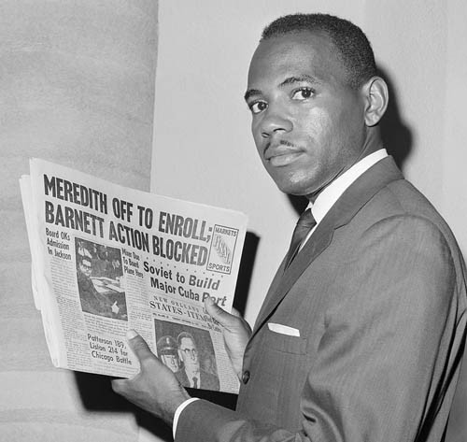
Thursday, March 10
Sporting News:
Softball & Baseball begin this week!
Senior Announcements:
Senior Trip Papers ASAP
Senior March Mania – March 24th
Class Announcements:
Remediation after school; ESD; Civil Rights Comp Check tomorrow
Agenda:
30 for 30 – James Meredith & Ole Miss

Slide 40
Thursday, March 10
Exit Question(s):
1.) Briefly provide your thoughts and reactions on the James Meredith case.

Slide 41
Friday, March 11
Learning Target:
I can explain the origins of Civil Rights struggles and the events that led to change

Slide 42
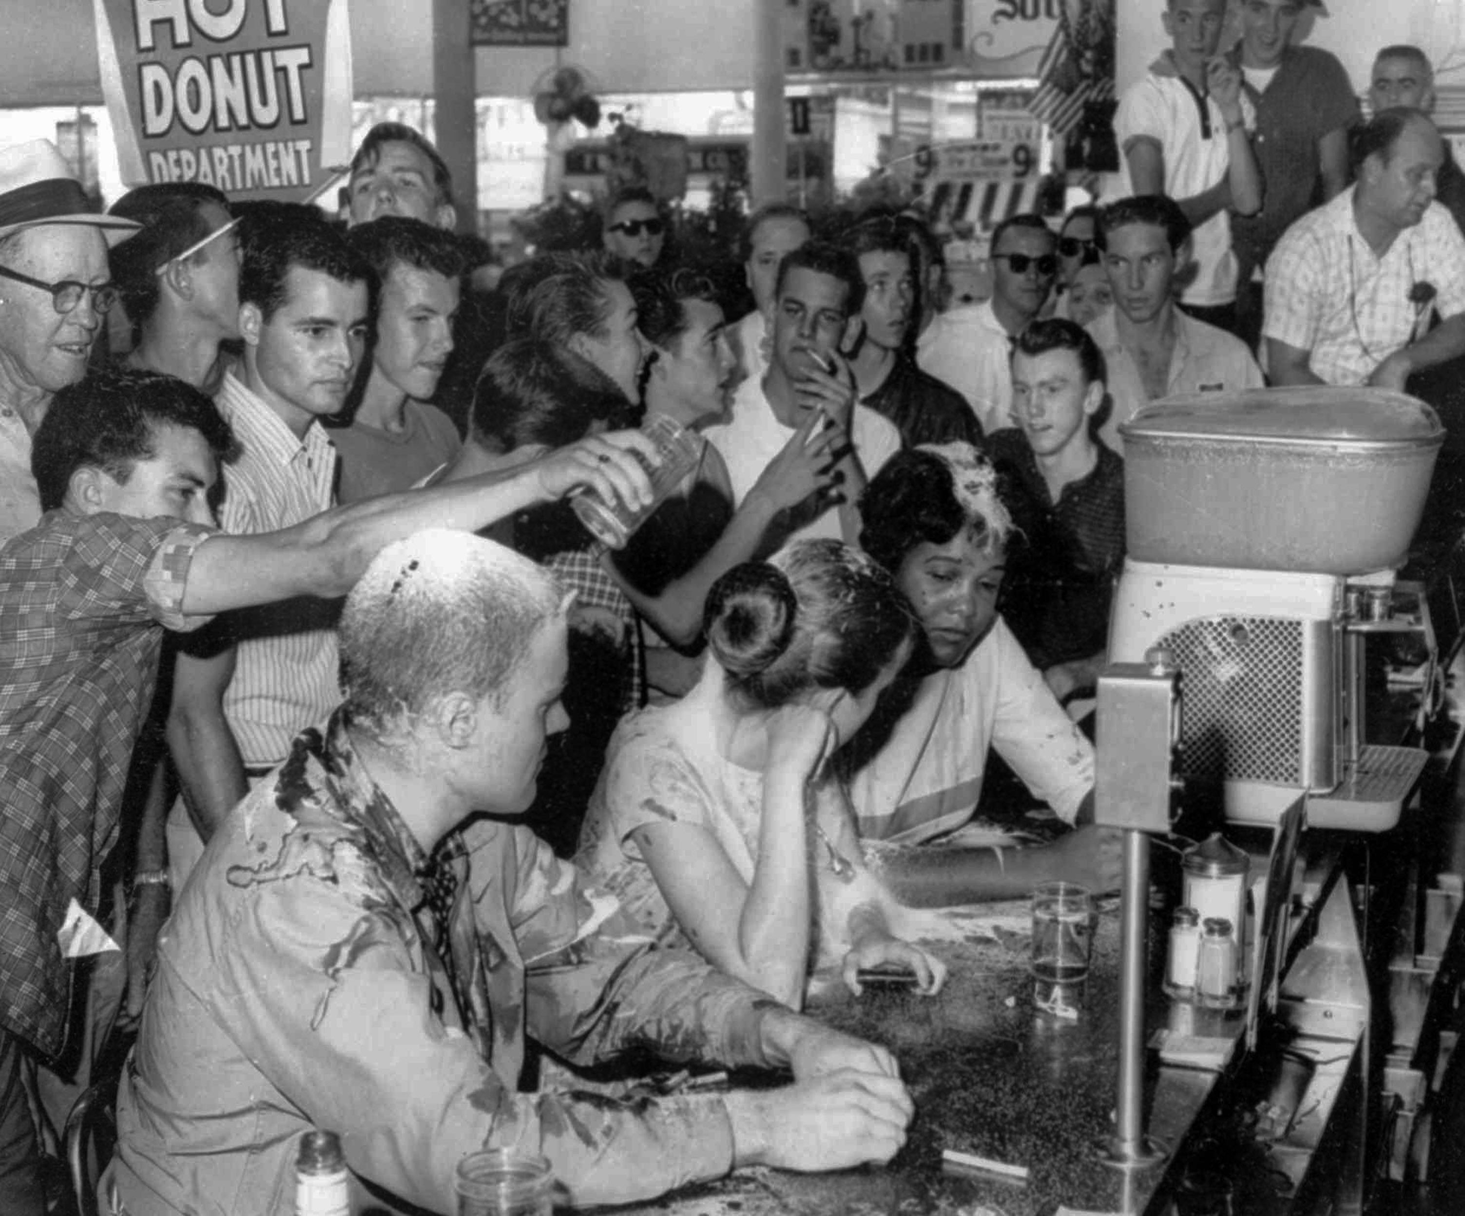
Friday, March 11
Sporting News:
Softball & Baseball begin this week!
Senior Announcements:
Senior March Mania – March 24th
Class Announcements:
Civil Rights Comp Check Today
Agenda:
Competency Check
Finish 30 for 30 Video

