Slide 1
Monday, March 14
Learning Target:
I can analyze why the US drops the atomic bombs
Vocabulary:
MAD: the policy that if either US or the USSR was hit with a nuclear weapons they would respond with the same

Slide 2
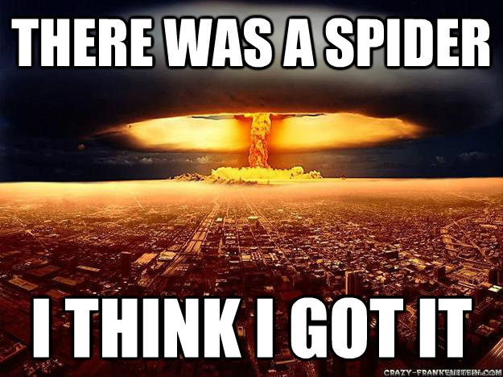
Monday, March 14
Sporting News:
Softball – Wed vs. Atherton 5:30; Fri vs. Ballard 5:30
Baseball – today vs. Whitfield 5:00
Senior Announcements:
Senior Papers ASAP
Senior March Mania – March 24th
Class Announcements:
Remediation after school; ESD;
Next Comp Check – Tuesday, March 22nd
First Proficiency – next Friday; STUDY!!!
Agenda:
Review Topic – early foreign policies
Timeline Topic – American wars
Discuss the Atomic Bomb; silent debate #1
Unit Timeline & Vocabulary

Slide 3
Monday, March 14
Exit Question(s):
1.) Do you agree with your role in the atomic bomb debate? Why or why not?

Slide 4
Tuesday, March 15
Learning Target:
I can explain the origins of the Cold War tension between USA and USSR
Vocabulary:
Communism: belief in collective ownership of all land and businesses. The state controls the economy
Capitalism: belief in private ownership of land and businesses. The people and supply and demand control the economy.

Slide 5
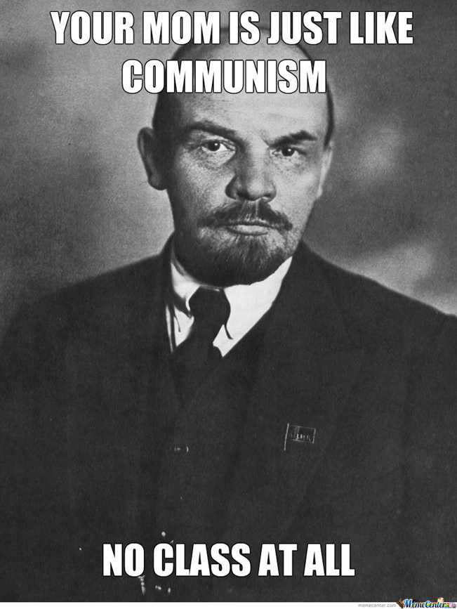
Tuesday, March 15
Sporting News:
Softball – Wed vs. Atherton 5:30; Fri vs. Ballard 5:30
Baseball - today vs. Whitfield 5:00
Senior Announcements:
Senior Papers ASAP
Senior March Mania – March 24th
Class Announcements:
Remediation after school; ESD;
Next Comp Check – Tuesday, March 22nd
First Proficiency – next Friday; STUDY!!!
Agenda:
Review Topic – early foreign policies
Timeline Topic – American wars
Begin PPT & Cornell Notes
Chp Reading
Cold War Map #1

Slide 6
Tuesday, March 15
Exit Question(s):
Explain why capitalism & communism can’t coexist.
How did Potsdam lead to the start of the Cold War?

Slide 7
Wednesday, March 16
Learning Target:
I can compare the Truman and Monroe doctrines
Vocabulary:
United Nations: meeting of all member nations to try and resolved conflicts around the world. Replaced the League of Nations.
Warsaw Pact: alliance of communist forces (USSR and it's allies) during the Cold War.

Slide 8
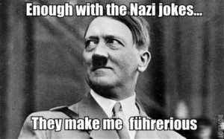
Wednesday, March 16
Sporting News:
Softball – today & Friday 5:30
Baseball -
Senior Announcements:
Senior Dues ASAP
Senior March Mania – March 24th
Class Announcements:
Remediation after school; ESD;
Next Comp Check – Tuesday, March 22nd
First Proficiency – next Friday; STUDY!!!
Agenda:
Review Topic – early foreign policies
Timeline Topic – American wars
Finish PPT & Cornell Notes
Chp Reading
Silent Debate #2

Slide 9
Wednesday, March 16
Exit Question(s):
Do you agree with your role in the Truman doctrine debate? Why or why not?

Slide 10
Thursday, March 17
Learning Target:
I can explain the significance and purpose of the Berlin Airlift.
Vocabulary:
Berlin Airlift: when the US shipped all goods into Berlin for several weeks after WWII to keep the city from being taken by communist forces.

Slide 11
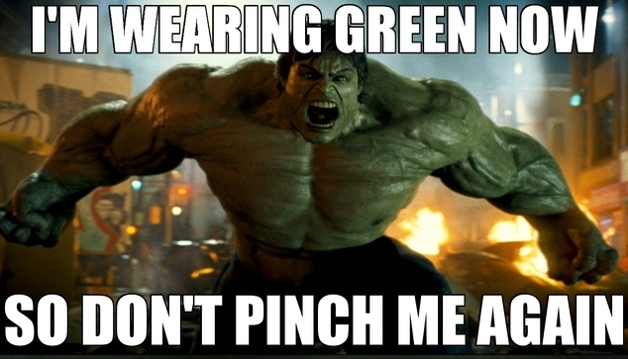
Thursday, March 17
Sporting News:
Softball – Friday 6:30
Baseball – Friday 6:30
Senior Announcements:
Senior dues ASAP
Senior March Mania – March 24th
Class Announcements:
Remediation after school; ESD;
Next Comp Check – Tuesday, March 22nd
First Proficiency – next Friday; STUDY!!!
Agenda:
Review Topic – early foreign policies
Timeline Topic – American wars
Clips on the Berlin Wall
Cold War Map #2

Slide 12
Thursday, March 17
Exit Question(s):
Explain the purpose of the Marshall Plan & Berlin Airlift.

Slide 13
Friday, March 18
Learning Target:
I can review the beginning of the Cold War by completing an assignment on the phone/iPad.
Vocabulary:
Truman Doctrine: Truman's pledge to defend democracy by fighting communism around the world.
Marshall Plan: American plan to help rebuild Europe following WWII by giving billions of dollars in aid.

Slide 14
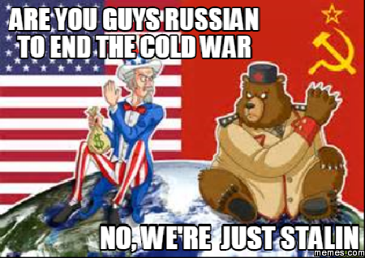
Friday, March 18
Sporting News:
Softball –
Baseball -
Senior Announcements:
Senior Papers ASAP
Senior March Mania – March 24th
Class Announcements:
Remediation after school; ESD;
Next Comp Check – Tuesday, March 22nd
First Proficiency – next Friday; STUDY!!!
Agenda:
Review Topic – early foreign policies
Timeline Topic – American wars
iPad Blendspace Activity

Slide 15
Friday, March 18
Exit Question(s):
What is the overall message of Dr. Seuss’s Butter Battle Book?

Slide 16
Monday, March 21st
Learning Target:
I can explain the significance and purpose of the Berlin Airlift.
Vocabulary:
U-2 Incident: 1960 incident in which the Soviet military used a guided missile to shoot down an American U-2 spy plane over Soviet territory
Sputnik: any of a series of Soviet earth-orbiting satellites

Slide 17
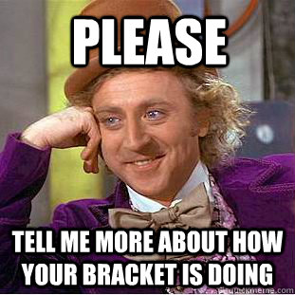
Monday, March 21st
Sporting News:
Softball –
Baseball -
Senior Announcements:
Senior Papers ASAP
Senior March Mania – THURSDAY
Class Announcements:
Remediation after school; ESD;
Next Comp Check – Tuesday
First Proficiency – Friday; STUDY!!!
Agenda:
Timeline Topic – early foreign policies
Clips on the U-2 Incident
Finish Blendspace OR
Chp Reading & Review

Slide 18
Monday, March 21st
Exit Question(s):
What would you do? Trade the spies or leave each of them in their enemy countries? Why?

Slide 19
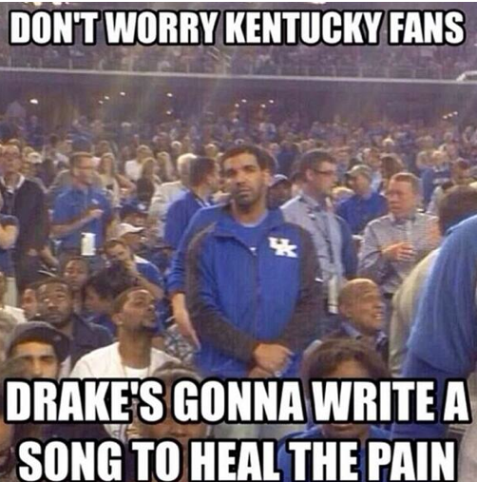
Tuesday, March 22nd
Sporting News:
Softball –
Baseball -
Senior Announcements:
Senior Papers ASAP
Senior March Mania – THURSDAY
Class Announcements:
Remediation after school; ESD;
Next Comp Check – TODAY
First Proficiency – Friday; STUDY!!!
Agenda:
Review with the Presidential Timeline
Take Vocab, Check it
Take Comp Check
Turn in Unit Product

Slide 20
Wednesday, March 23rd
Learning Target:
I can define key terms of Cold War conflicts and place events chronologically on a timeline
Vocabulary:
Truman Doctrine: U.S. policy of fighting the spread of communism throughout the world
Brinkmanship: policy of threatening to go to war in response to any enemy aggression

Slide 21
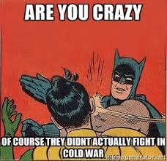
Wednesday, March 23rd
Sporting News:
Softball & Baseball
Senior Announcements:
Senior Papers ASAP
Senior March Mania – tomorrow!!!
Class Announcements:
Remediation after school; ESD;
First Proficiency – Friday; STUDY!!!
Agenda:
Review Game
Quizlet vocabulary
Mapping Activity
Timeline

Slide 23
Wednesday, March 23rd
Exit Question(s):
Briefly describe the characteristic that the three countries on your map have in common.

Slide 24
Thursday, March 24th
Learning Target:
I can explain how and why a country for Israel was established after WWII
Vocabulary:
Israel: a nation state created in the Middle East for Jews displaced by the holocaust
Palestine: region in southwestern Asia that became the ancient home Jews and Muslims

Slide 25
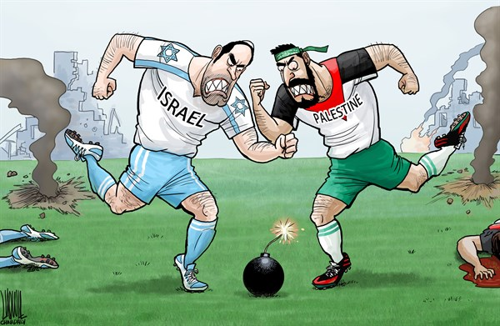
Thursday, March 24th
Sporting News:
Softball & Baseball
Senior Announcements:
Senior Papers ASAP
Senior March Mania – today after school
Class Announcements:
Remediation after school; ESD;
First Proficiency – TOMORROW; STUDY!!!
Agenda:
Student Voice Survey
Review Game
Reading on Israel in packets
PPT & Cornell Notes (with videos)
Exit Questions

Slide 26
Thursday, March 24th
Exit Question(s):
Why was a separate Israel created?
Why is this area still one of conflict today?

Slide 27
Friday, March 25th
Learning Target:
I can analyze why we fight the Korean War and the impact of its outcome
Vocabulary:
U.N.: international organization formed after WWII to promote international peace, security, and cooperation.
38th Parallel: the line of the globe that is the official separation of North and South Korea

Slide 28
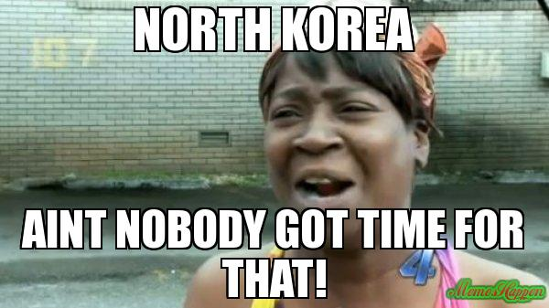
Friday, March 25th
Sporting News:
Softball & Baseball
Senior Announcements:
New Dates & Announcements:
Class Announcements:
Remediation after school; ESD;
First Proficiency – TODAY!
Agenda:
Review Game
Proficiency Exam, grade & review
Reading on Korea
PPT on Korea
Exit question

Slide 29
Friday, March 25th
Exit Question(s):
Why do some historians argue that the Korean War was an American victory? What do you think?

Slide 30
Monday, March 28th
Learning Target:
I can explain the history of the Suez Canal and how it ties into the Cold War.
Vocabulary:
Suez Canal: A canal in northeastern Egypt linking the Red Sea with the Mediterranean Sea

Slide 31
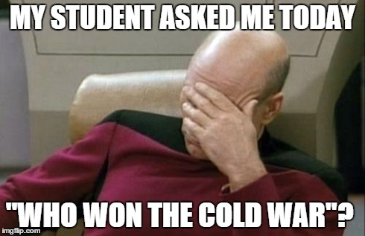
Monday, March 28th
Sporting News:
Softball & Baseball
Senior Announcements:
New Dates & Announcements:
Class Announcements:
Remediation after school; ESD;
First Proficiency – TODAY!
Agenda:
Review Game

Slide 32
Monday, March 28th
Exit Question(s):
How does the Suez Canal symbolize the Cold War?

Slide 33
Tuesday, March 29th
Learning Target:
I can analyze how the situation in Cuba almost leads to an official war with the Soviets.
Vocabulary:
Fidel Castro: Cuban leader who overthrew a dictator in 1959 and established a communist state in Cuba
Bay of Pigs: a failed attempted to overthrown the Castro regime using Cuban exiles as soldiers

Slide 34
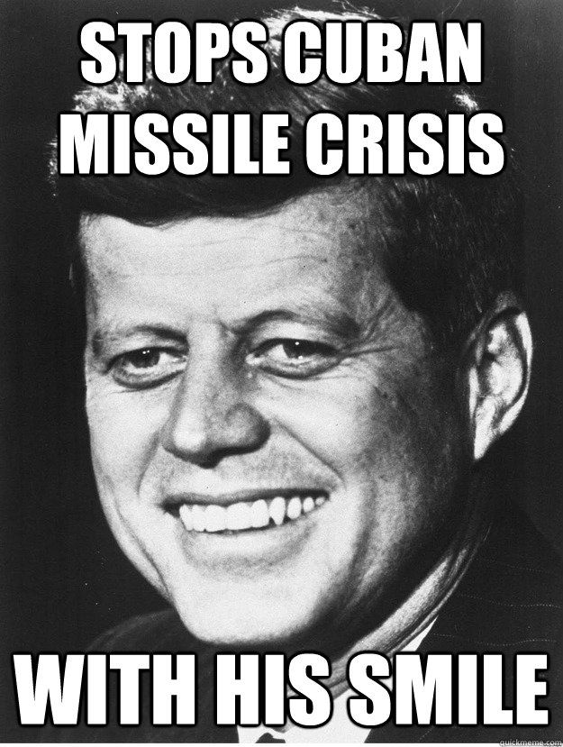
Tuesday, March 29th
Sporting News:
Softball & Baseball
Senior Announcements:
New Dates & Announcements:
Class Announcements:
Remediation after school; ESD;
First Proficiency – TODAY!
Agenda:
Review Game

Slide 35
Tuesday, March 29th
Exit Question(s):
Do you agree with your stance on the issue of the Cuban Missile Crisis? Why or why not?

Slide 36
Wednesday, March 30th
Learning Target:
I can describe the Vietnam War and discuss its significance in warfare and the Cold War.
Vocabulary:
Ho Chi Minh: Communist leader of North Vietnam
Vietnamization: the process of making South Vietnam assume more of the war effort by slowly withdrawing American troops from Vietnam

Slide 37
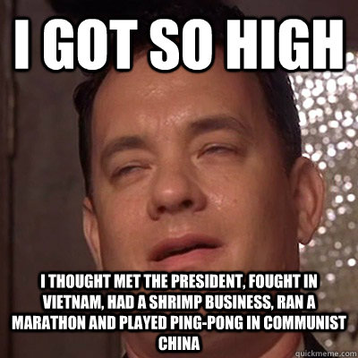
Wednesday, March 30th
Sporting News:
Softball & Baseball
Senior Announcements:
New Dates & Announcements:
Class Announcements:
Remediation after school; ESD;
First Proficiency – TODAY!
Agenda:
Review Game

Slide 38
Wednesday, March 30th
Exit Question(s):
List three reasons why the Vietnam War is so significant to studying the Cold War. (What was so unique about it?)

Slide 39
Thursday, March 31st
Learning Target:
I can evaluate the outcomes and hypothesize the effects of the Cold War conflicts
Vocabulary:
Capitalism: an economic system based on private ownership businesses
Communism: an economic system in which the government owns all property and makes all decisions.

Slide 40
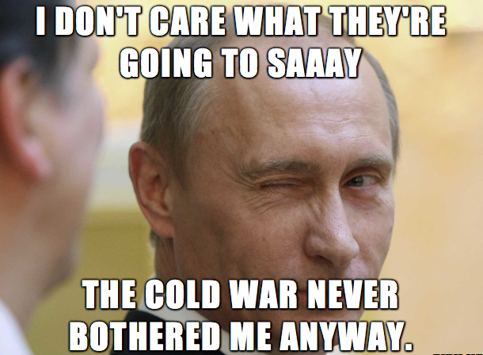
Thursday, March 31st
Sporting News:
Softball & Baseball
Senior Announcements:
New Dates & Announcements:
Class Announcements:
Remediation after school; ESD;
First Proficiency – TODAY!
Agenda:
Review Game

Slide 41
Thursday, March 31st
Exit Question(s):
Under each president, list the “foreign policies” or “Cold War” events that occurred during their term
JFK LBJ Nixon

Slide 42
Friday, April 1st
Sporting News:
Softball & Baseball
Senior Announcements:
New Dates & Announcements:
Class Announcements:
Remediation after school; ESD;
First Proficiency – TODAY!
Agenda:
Review Game

