Slide 1
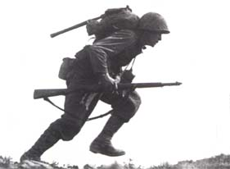
THE UNITED STATES IN WORLD WAR II
AMERICA TURNS THE TIDE
http://www.history.com/topics/world-war-ii/videos#attack-pearl-harbor

Slide 2
ONSET OF THE WAR
How/Why it ALLLLL Began

Slide 3
Causes of WWII
The Great Depression
Treaty of Versailles
Totalitarianism

Slide 4
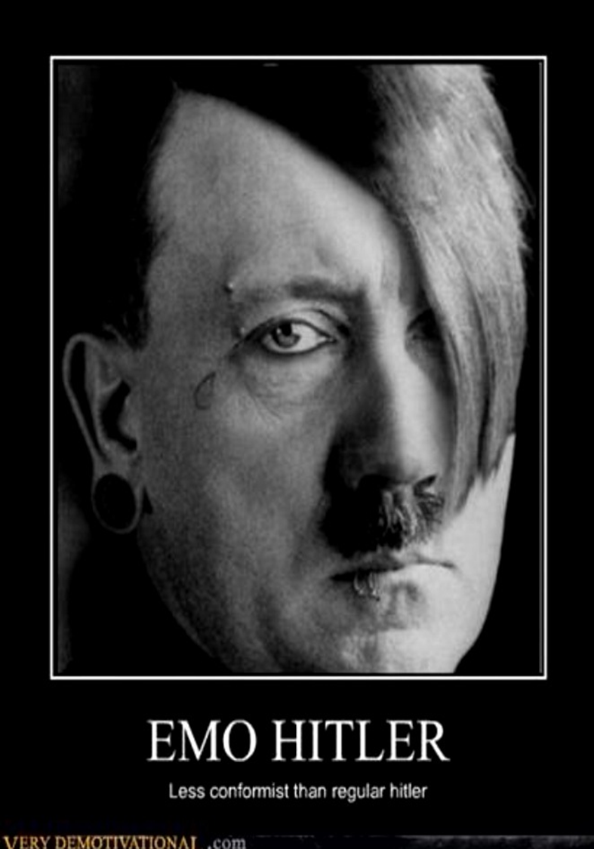
Paths to War
After Hitler comes to power he starts on his plans:
Rearmament
Taking back the land that was lost (lebensraum)
Domination of the Aryan race

Slide 5
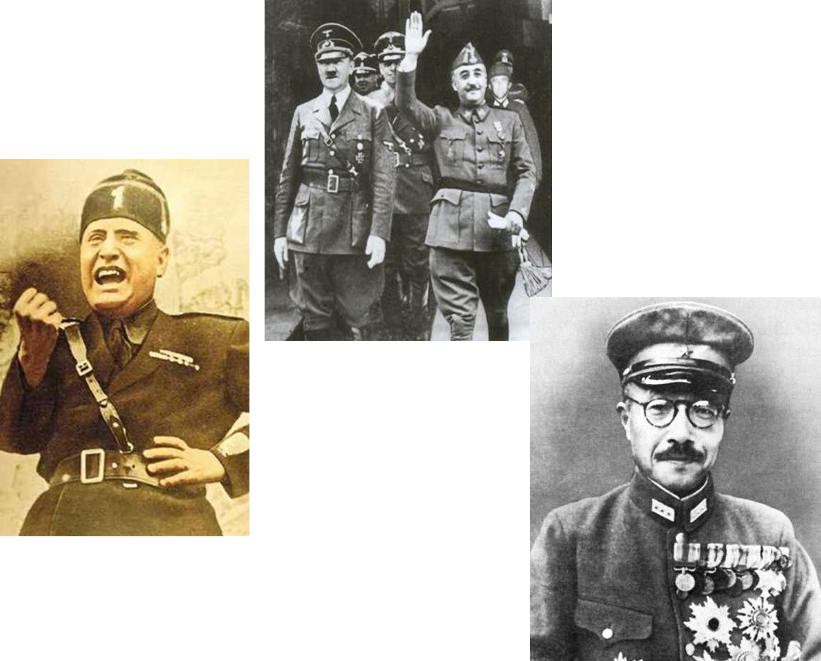
Hitler’s BFFs
Notes:
Mussolini- shared view with Hitler, welcomes his support
Together they sent troops to Spain to help Franco
Franco- Fascist leader trying to get rid of the communist government of Spain. Remember fascist hate communists!!!!
Tojo- Leader of Japan’s army and Prime Minister. He realizes he will need Hitler to beat the power in the Pacific, the US

Slide 6
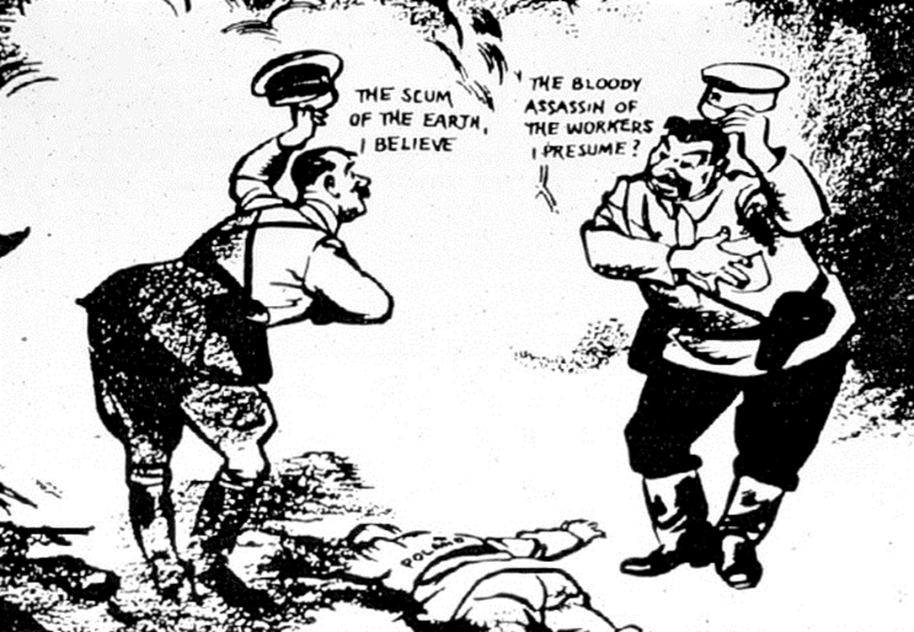
Appeasement
Notes:
Define appeasement
Nonaggression pact

Slide 7
PRODUCTION
We made a lot of stuff

Slide 8
A PRODUCTION MIRACLE
What was done by industry to prepare for the war?
Notes:
Americans converted their auto industry into a war industry
The nation’s automobile plants began to produce tanks, planes, boats, and command cars
Many other industries also converted to war-related supplies

Slide 9
WAR PRODUCTION BOARD
Explain the actions taken by the Office of Price Administration & War Production Board during the war
Notes:
To ensure the troops had ample resources, FDR created the WPB
The WPB decided which companies would convert to wartime production and how to best allocate raw materials to those industries

Slide 10
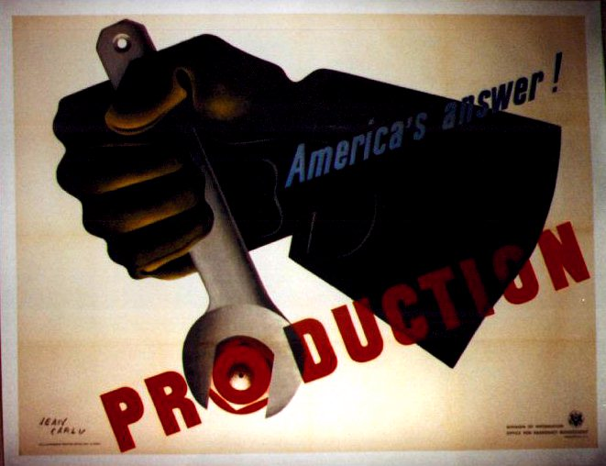
Production

Slide 11
RATIONING
The ratio of stuff per person

Slide 12
FEDERAL GOVERNMENT TAKES CONTROL OF INFLATION
Office of Price Administration (OPA)
Notes:
With prices of goods threatening to rise out of control, FDR responded by creating the Office of Price Administration (OPA)
The OPA froze prices on most goods and encouraged the purchase of war bonds to fight inflation

Slide 13
COLLECTION DRIVES
Define rationing and explain how it was used during the war.
Notes:
The WPB also organized nationwide drives to collect scrap iron, tin cans, paper, rags and cooking fat for recycling
Additionally, the OPA set up a system of rationing
Households had set allocations of scarce goods – gas, meat, shoes, sugar, coffee

Slide 14
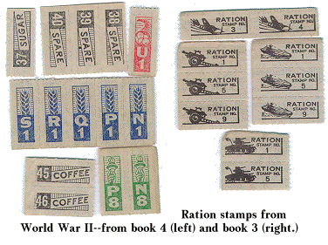

Slide 15
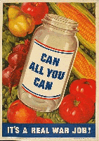
Conserve Food

Slide 16
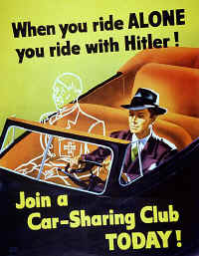
Ration

Slide 17
MINORITIES
African Americans and Mexican Americans

Slide 18
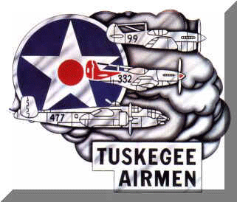
TUSKEGEE AIRMEN
Among the brave men who fought in Italy were pilots of the all-black 99th squadron – the Tuskegee Airmen
Notes:
The pilots made numerous effective strikes against Germany and won two distinguished Unit Citations

Slide 19
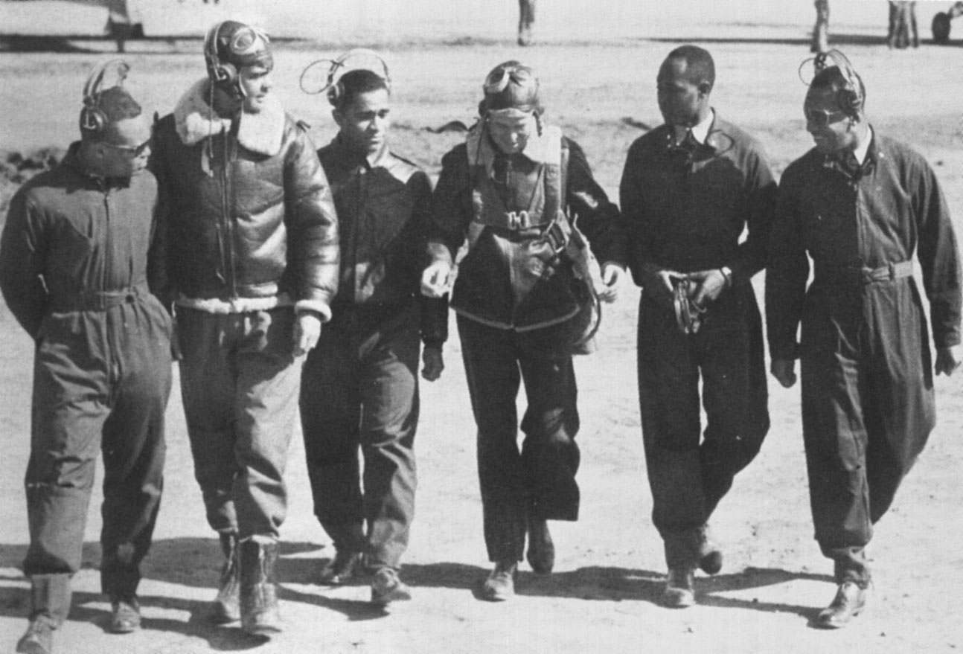
On May 31, 1943, the 99th Squadron, the first group of African-American pilots trained at the Tuskegee Institute, arrived in North Africa

Slide 20
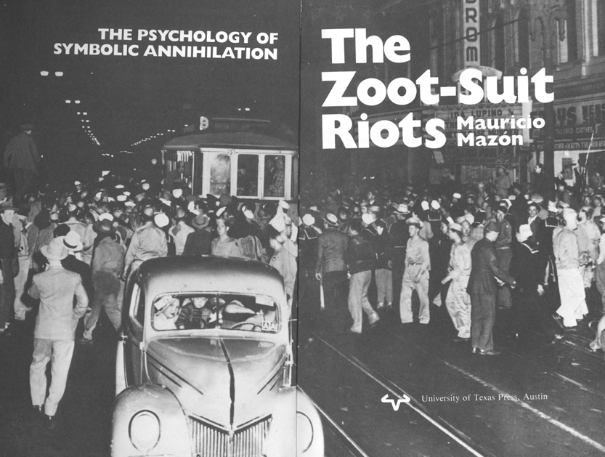

Slide 21
WOMEN
Hell hath no fury…

Slide 22
WOMEN JOIN THE FIGHT
Describe the importance of women in war production and their treatment by industry
Notes:
Army Chief of Staff General George Marshall pushed for the formation of the Women’s Auxiliary Army Corps (WAAC)
Under this program women worked in non-combat roles such as nurses, ambulance drivers, radio operators, and pilots

Slide 23
WOMEN MAKE GAINS
Describe the new role of women in the workforce.
Notes:
Women enjoyed economic gains during the war, although many lost their jobs after the war
Over 6 million women entered the work force for the first time
Over 1/3 were in the defense industry

Slide 24
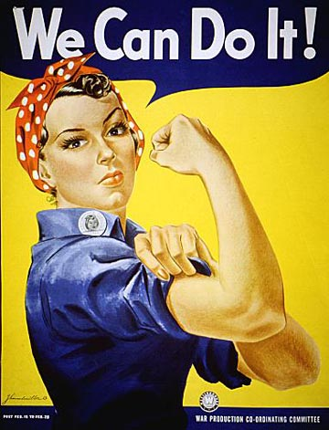
Rosie the Riveter
What does this mean to you? What’s the message?

Slide 25
JAPANESE INTERNMENT
Protection…and rascism
http://www.history.com/shows/wwii-in-hd/videos/japanese-internment-in-america#japanese-internment-in-america

Slide 26
INTERNMENT OF JAPANESE AMERICANS
Why segregate the Japanese?
Similarities to other themes of history?
Japanese Americans felt the sting of discrimination during WWII
Notes:
When the war began, 120,000 Japanese Americans lived in the U.S. – mostly on the West Coast
After Pearl Harbor, many people were suspicious of possible spy activity by Japanese Americans
In 1942, FDR ordered Japanese Americans into 10 relocation centers

Slide 27
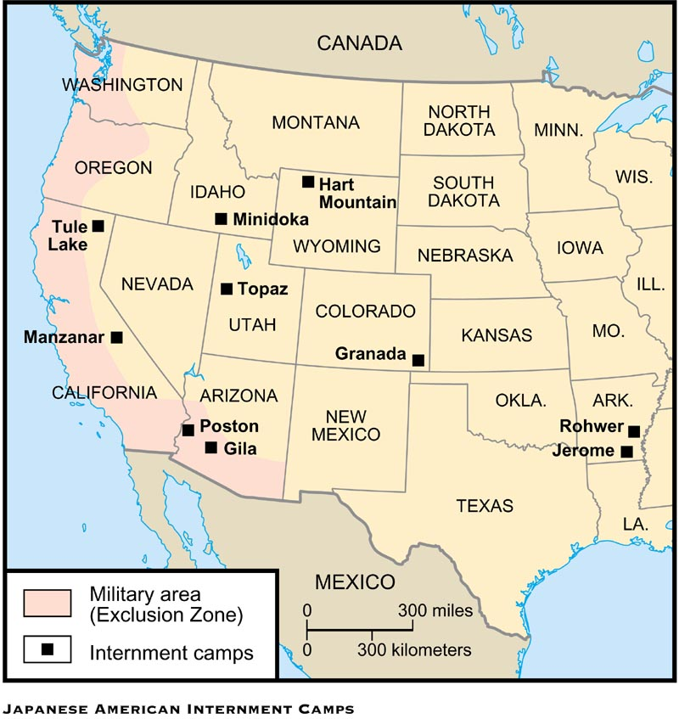
Location of the 10 Internment camps

Slide 28
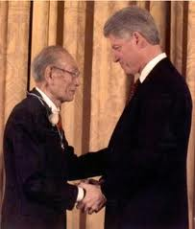

Slide 29
ENDING THE WAR
The Battles and The BOMB

Slide 30
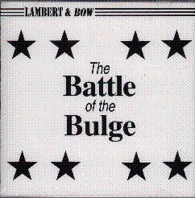
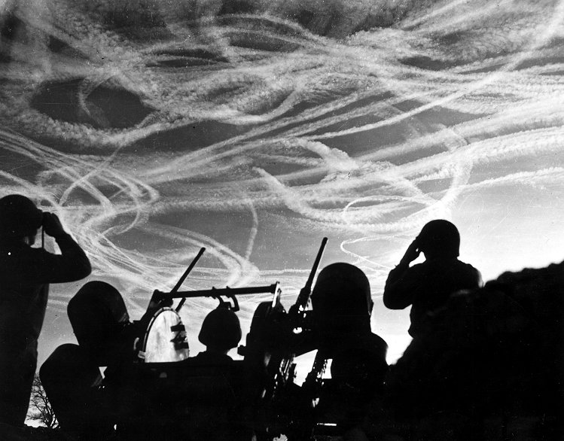
BATTLE OF THE BULGE
The Battle of the Bulge was Germany’s last gasp
Notes:
In October 1944, Americans captured their first German town (Aachen)– the Allies were closing in
Hitler responded with one last ditch massive offensive
Hitler hoped breaking through the Allied line would break up Allied supply lines
The battle raged for a month – the Germans had been pushed back
Little seemed to have changed, but in fact the Germans had sustained heavy losses
Germany lost 120,000 troops, 600 tanks and 1,600 planes
From that point on the Nazis could do little but retreat

Slide 31
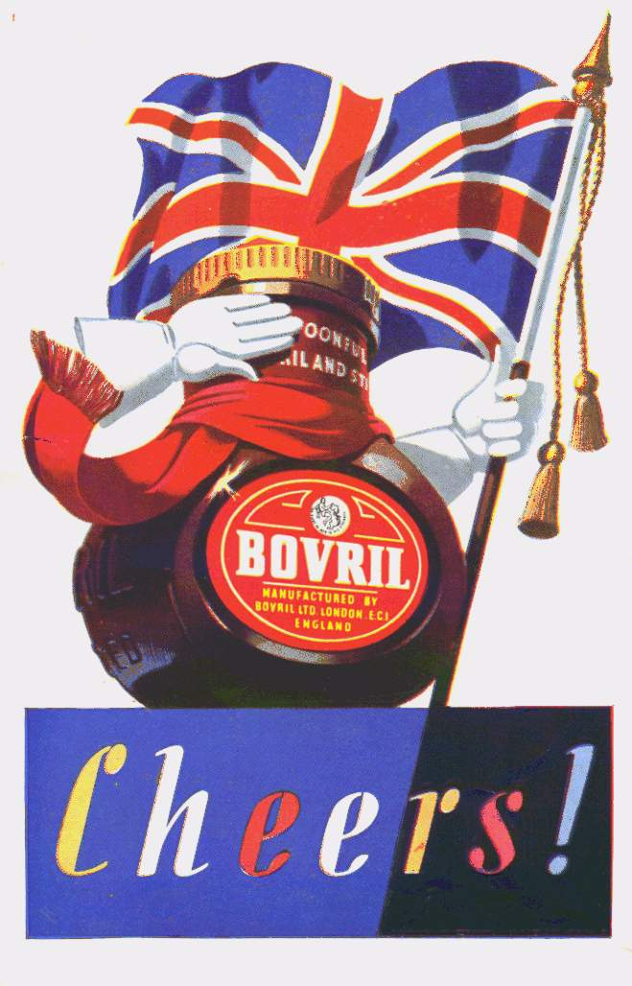
V-E DAY
On May 8, 1945, the Allies celebrated V-E Day – victory in Europe Day
Notes:
General Eisenhower accepted the unconditional surrender of the Third Reich
On May 8, 1945, the Allies celebrated V-E Day – victory in Europe Day
The war in Europe was finally over

Slide 32
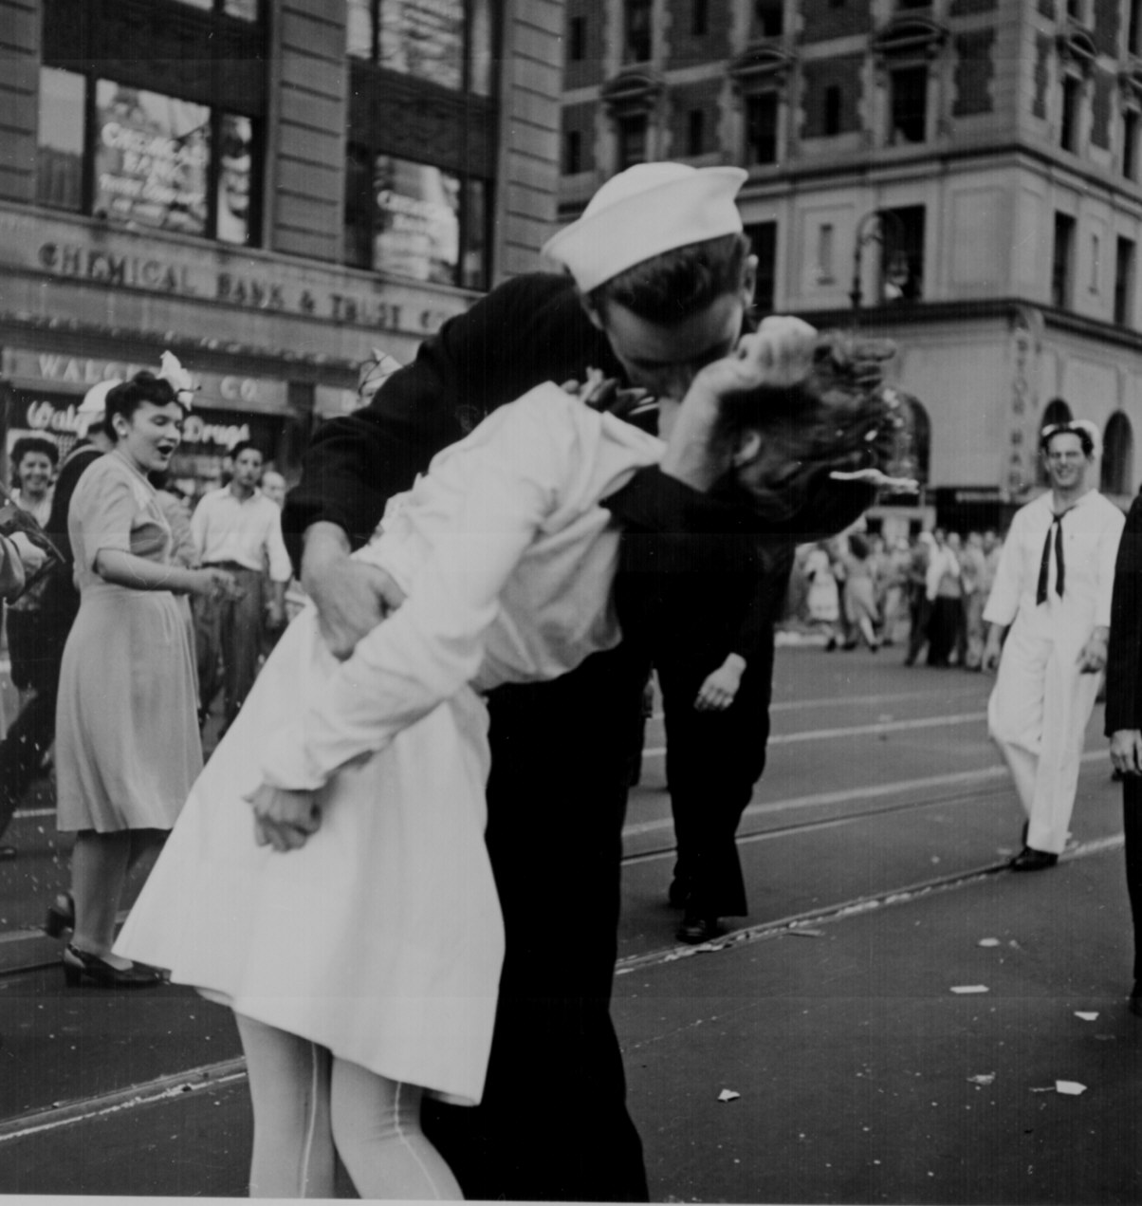
Famous picture of an American soldier celebrating the end of the war

Slide 33
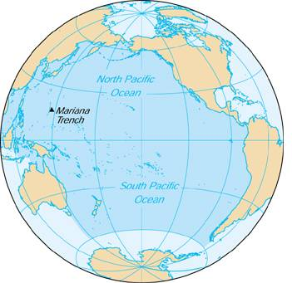
THE WAR IN THE PACIFIC
The Americans did not celebrate long, as Japan was busy conquering an empire that dwarfed Hitler’s Third Reich
Japan had conquered much of southeast Asia including the Dutch East Indies, Guam, and most of China

Slide 34
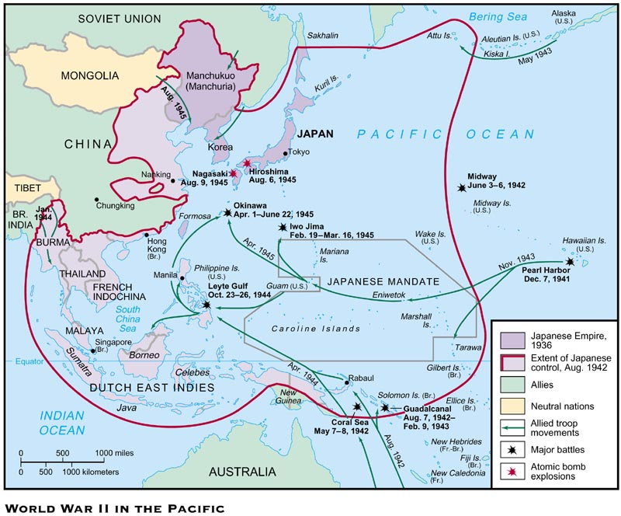

Slide 35
THE BATTLE OF MIDWAY
Notes:
Japan’s next thrust was toward Midway Island – a strategic Island northwest of Hawaii
Admiral Chester Nimitz, the Commander of American Naval forces in the Pacific, moved to defend the Island
The Americans won a decisive victory as their planes destroyed 4 Japanese aircraft carriers and 250 planes

Slide 36
MOBILIZATION OF SCIENTISTS
OSRD
Office of Scientific Research and Development
Notes:
In 1941, FDR created the Office of Scientific Research and Development (OSRD) to bring scientists into the war effort
Focus was on radar and sonar to locate submarines
Also the scientists worked on penicillin and pesticides like DDT

Slide 37
MANHATTAN PROJECT
Notes:
The most important achievement of the OSRD was the secret development of the atomic bomb
Einstein wrote to FDR warning him that the Germans were attempting to develop such a weapon
The code used to describe American efforts to build the bomb was the “Manhattan Project”

Slide 38
THE YALTA CONFERENCE
In February 1945, as the Allies pushed toward victory in Europe, an ailing FDR met with Churchill and Stalin at the Black Sea resort of Yalta in the USSR
A series of compromises were worked out concerning postwar Europe
(L to R) Churchill, FDR and Stalin at Yalta

Slide 39
YALTA AGREEMENTS
1) They agreed to divide Germany into 4 occupied zones after the war
2) Stalin agreed to free elections in Eastern Europe
3) Stalin agreed to help the U.S. in the war against Japan and to join the United Nations

Slide 40
NUREMBERG WAR TRIALS
Herman Goering, Hitler's right-hand man and chief architect of the German war effort, testifies at his trial. He was found guilty of war crimes but avoided execution by swallowing potassium cyanide.
The discovery of Hitler’s death camps led the Allies to put 24 surviving Nazi leaders on trial for crimes against humanity, crimes against the peace, and war crimes
The trials were held in Nuremberg, Germany
“I was only following orders” was not an acceptable defense as 12 of the 24 were sentenced to death and the others to life in prison

Slide 41
GI BILL HELPS RETURNING VETS
What kind of impact will this bill have on American society?
Notes:
To help returning servicemen ease back into civilian life, Congress passed the Servicemen’s Readjustment Act (GI Bill of Rights)
The act provided education for 7.8 million vets

